Slide 1
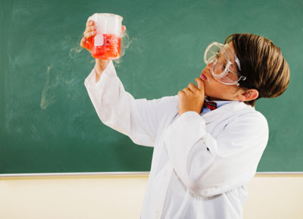
HYPOTHESIS TESTING SCIENTIFIC METHOD
LEARNING OUTCOME 1
GRADE 11
14 OCTOBER 2012

Slide 2
HOW DOES SCIENCE WORK?
SCIENCE IS BASED ON:
Fundamental knowledge built on scientific evidence and verified findings;
Observing;
Investigating;
Making measurements (understand scaling);
Collecting and presenting data;
Identifying patterns and relationships in data;
Communicating findings

Slide 3
WHY THE SCIENTIFIC METHOD?
From the beginning of our existence, humans have been curious as to why and how things happen in the world around us. The scientific method provides us a structured scientific platform to help us find the answers… With the scientific method, the sky is the limit!

Slide 4
Plan and execute an investigation by using the Scientific Method
Formulate a QUESTION for the investigation
Formulate a HYPOTHESIS.
Design an EXPERIMENT
AIM
APPARATUS
DETERMINE THE VARIABLES
METHOD

Slide 5
Plan and execute an investigation by using the Scientific Method…Continued
Do the INVESTIGATION
ANALYSE and PROCESS the results
Make CONCLUSIONS
TEST HYPOTHESIS
ACCEPT
REJECT

Slide 6
Do Research to support your investigation
Become informed on the topic of your research.
Question: If the level of water/moisture increases, will the amount of germinating seeds also increase?
Now you can do research on the effect of water on germinating seeds!
Background research also helps narrow broad questions into focus/research questions.
Wetenskaptydskrifte en joernale is ‘n goeie beginpunt om agtergeondkennis op te doen.
Scientific journals are a good place to start doing background research.
Try making the two questions to the left more focused and specific…

Slide 7
ANY INVESTIGATION STARTS WITH…
An observation, then….
A FOCUS QUESTION: This is a question that regulates/drives the investigation

Slide 8
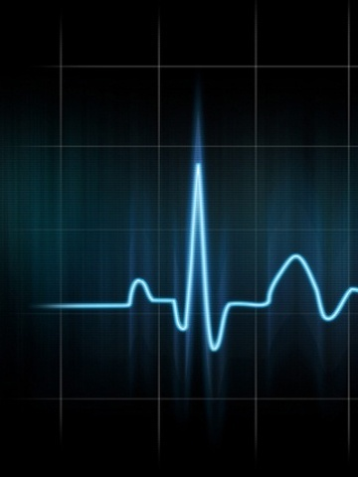
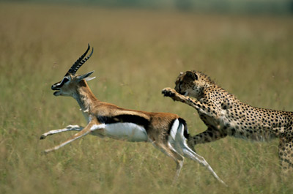
Observing Phenomena
We are observing various biological systems, relationships and phenomena happening around us all the time.
The observations one can make are endless and range anything from:
Physiological observations - noticing your heart rate increase when you are nervous to…
Ecological observations - the relationship between predator and prey in a particular habitat.
Observations naturally lead onto questions about the phenomena being observed.
‘n Elektrokardiogram (EKG) meet die hart se elektriese aktiwiteit.
An electrocardiogram (ECG) measures the heart’s electrical activity.
It is important to keep an eye on populations of species within a community.

Slide 9
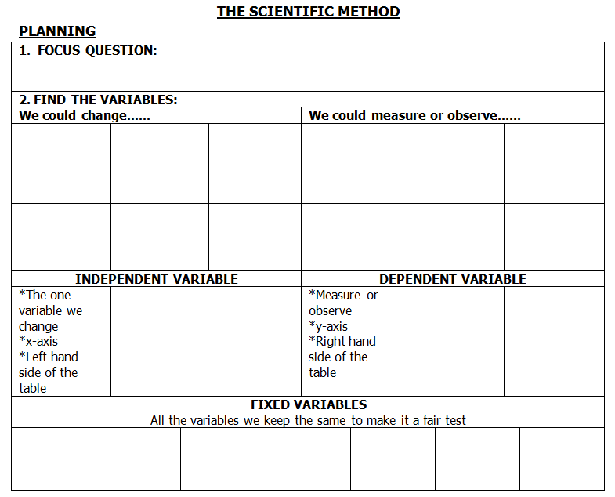

Slide 10
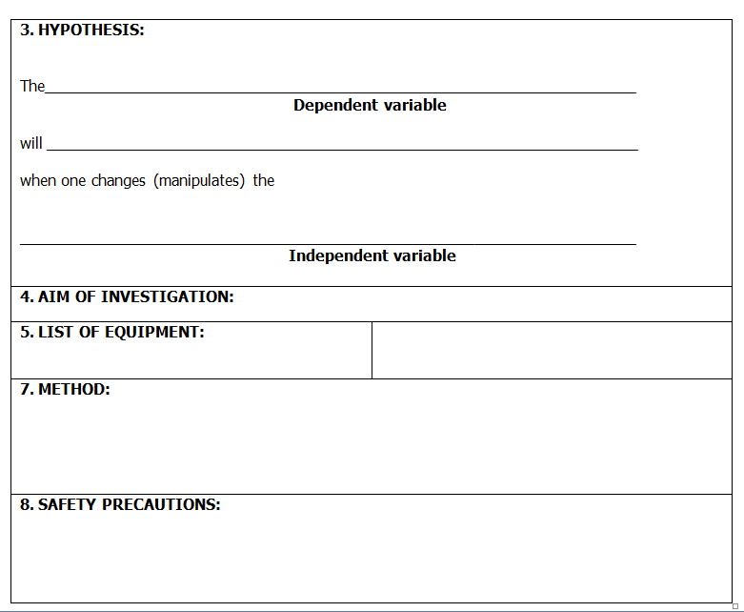

Slide 11
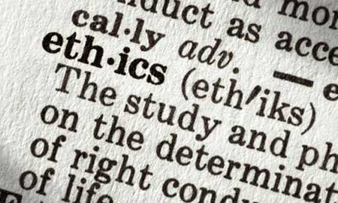
WHAT TO CONSIDER WHEN YOU PLAN YOUR INVESTIGATION!
If necessary, scientist has to consider other factors for the investigation such as:
A literature review on all the background research.
A research proposal.
Funding of the investigation/research.
Moral and ethical considerations.
Conducting a pilot study.

Slide 12
AIM OF THE INVESTIGATION
Aims can vary and don’t necessarily have to relate to the hypothesis
Always begin with:
TO ........
E.g. TO determine how the amount of moisture would affect the number of germinating seeds

Slide 13
Writing an Aim
Some ways of wording an aim are:
To determine...
To show that...
To investigate...
To find out...
To observe...
To measure...
Do not write ‘To prove...’ because not only will your investigation more than likely not get to this stage, but also because many scientists believe that nothing is proven absolute.

Slide 14
Forming a Hypothesis
A HYPOTHESIS is a possible explanation to an observation that can be supported through experimentation.
Educated statement as to your prediction of the outcome of the investigation.
All good hypotheses SHOULD…
be written as a statement and not a question.
be testable through experimentation.
be falsifiable.
be based on observations and prior knowledge (educated).
give an explanation to an observation.
state the independent and dependent variables.
refer to only one independent variable per hypothesis.
lead to further predictions about the system being investigated.
Think of a good hypothesis for our focus question.
Q: How does the amount of water affect the number of germinating seeds?

Slide 15
May be formulated as follows:
How does the independent variable affect the dependent variable?
Example:
How does the amount of water/moisture affect the amount of germinating seeds?
How does temperature affect the rate of transpiration?

Slide 16
A HYPOTHESIS….
: is a Statement that serves as a possible answer to a Focus Question.
The statement should be testable and must be informed by background knowledge.

Slide 17
STATE A HYPOTHESIS
Must include the two variables – INDEPENDENT and DEPENDENT.
Must show the relationship between the variables.
Must be testable.
Must be a statement!

Slide 18
A HYPOTHESIS: A Statement that is the answer to the focus question. It must be testable and informed by background knowledge.
May be written as follows for continuous data:
If the independent variable changes, then the dependent variable changes
Example:
If the level of moisture increases then the number of seeds that will germinate will also increase

Slide 19
THE VARIABLES
Variables are factors that are subject to CHANGE/ MANIPULATION

Slide 20
THE VARIABLES- remember this…
INDEPENDENT VARIABLE :( cause) is the factor that CHANGES (being manipulated) by the investigator
DEPENDENT VARIABLE: (effect) is the factor that the investigator MEASURES
FIXED/(CONSTANT) VARIABLES: factors that are being kept CONSTANT throughout the investigation

Slide 21
DIFFERENCE BETWEEN AN AIM AND A HYPOTHESIS
The AIM is usually what you intend to investigate.
HYPOTHESIS is a prediction of the outcome of the investigation.

Slide 22
SO WHAT IS THE CONTROL?
The scientific ‘control’ of an investigation is an experiment that is done in addition to the test experiment but where the independent variable, the variable that the investigator changes, is removed.
This reinforces that the cause of the change in the dependent variable is due to the independent variable only.

Slide 23
Identify the variables!
Identify the independent & dependent variables in the hypotheses below.
Remember to always write out the variables fully and not just give words.
Increased light intensity will increase the growth of Pelargoniums .
Higher salaries are earned by studying more years at an educational institution.
Populations living at higher altitudes, can hold their breath for longer under water.

Slide 24
VARIABLES AND DATA
Data are the values that are collected from observed or measured variables.
There are various types of data that effect the way we collect and report our investigation.

Slide 25
TYPES OF DATA
QUALITATIVE DATA = descriptive data, non-numerical
E.g. colour, names, sex, absence or presence).
QUANTITATIVE DATA = numerical data, measurements or counts can be made (e.g. height (1.5m – 2.2m), mass, length, number)

Slide 26
TYPES OF DATA
CONTINUOUS DATA = data that has joined values or in between values (e.g. height: 1.5m – 2.2m).
DISCONTINUOUS DATA = values that are discrete from one another, no in between values (e.g. number of children in a class: 23, 24, 25)

Slide 27
PLAN THE INVESTIGATION
Steps to consider when planning an investigation:
The focus question, then plan the investigation:

Slide 28
Test the Hypothesis
Once variables have been identified, you need to decide how these variables will be set and measured.
You need to be clear on the type and quantity of data that you collect.
Written stages of an investigation:
Planning the investigation.
Reporting the investigation.
Practical stages of an investigation:
Laboratory work.
Field work (natural system).

Slide 29
Testing Hypotheses
Now think of ways of setting and measuring these variables (see the example).
IV = independent variable
DV = dependent variable
Setting up IV:
Change light intensity = different quantities of shade cloth,
placing pelargonium’s in
different parts of a
greenhouse….
Increased light intensity will increase the growth rate of pelargonium's.
Important!
‘Rate’ means that time must be involved. How can you ensure that you measure a growth rate?
Measuring DV:
Height/Time = use a measuring tape, use a ruler or placing a wooden rod next to plant
and marking height at set
time intervals.

Slide 30
Testing Hypotheses
Now think of ways of setting and measuring these variables (see the first 3 examples).
IV = independent variable
DV = dependent variable
Measuring DV:
Amount of money = Survey question asking to tick the appropriate income bracket.
Higher salaries are earned after more years spent studying in educational institutions.
Setting up IV:
Years spent studying = Survey seems to be the easiest way to get this
type of data – “How many years did
you spend studying in
educational institutions?”

Slide 31
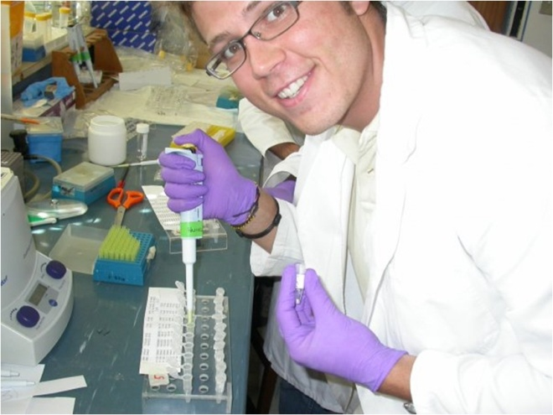
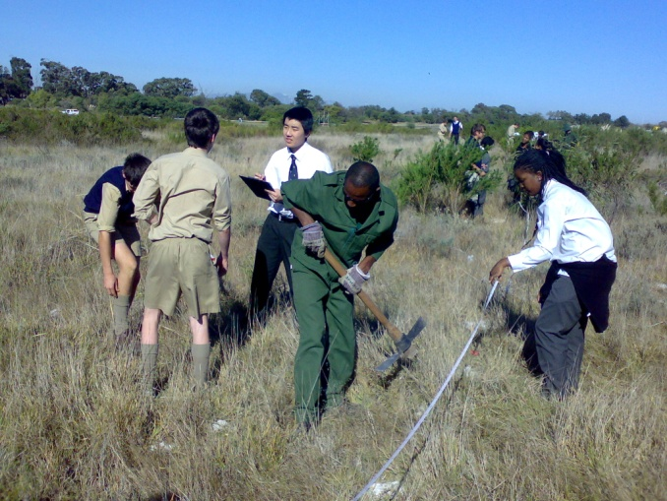
Doing an Experiment
You’ve decided on how you want to test your hypothesis including how you are going to collect your data.
Two things to consider before doing an experiment are:
Sample Size
Particularly important when doing field work.
Replication
Setting up a Polymerase Chain Reaction (PCR) in a biomedical laboratory.
Laying out transects to investigate ant populations.

Slide 32
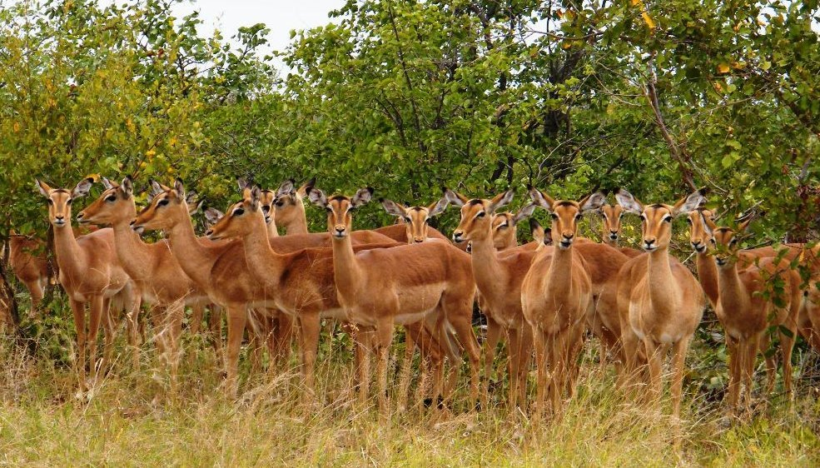
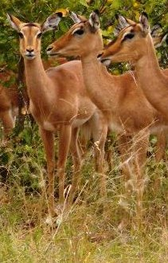
Sample Size
Sample size (n) is the number of sampling units being investigated within any given population.
Sampling units for example could be the number of individual organisms, transects or quadrants.
Always best to try and take as many samples as possible.
This way you have a better representation of the population.
It accounts for any natural variability that may be present in your sample groups.
You can have greater confidence in your data.
An investigation may be on a population of impala (above) so a sample group (right) n= 3 was selected to be studied as a representation of the impala population.

Slide 33
Replication refers to the number of times you REPEAT your entire experimental design (including controls).
This improves the reliability of your results.
Increasing your sample size doesn’t necessarily mean you’ve replicated the experiment more times.
The experiment to the left has been repeated only twice.
The sample size (n) = 3
Water Regime: 0ml water/day @ 15°C, pH 7 (control)
Water Regime: 500ml water/day @ 15°C, pH 7
Water Regime: 1000ml water/day @ 15°C, pH 7
Water Regime: 0ml water/day @ 15°C, pH 7 (control)
Water Regime: 500ml water/day @ 15°C, pH 7
Water Regime: 1000ml water/day @ 15°C, pH 7

Slide 34
VALIDITY vs RELIABILITY
Validity: refers to experimental procedure:
Were all the fixed variables being kept constant?
Does the investigation only test one variable at a time?
Reliability: refers to the results
If the investigation should be repeated , would the results be the same?
If the sample size would be increased, would the results remain the same?

Slide 35
ACTIVITY 8 (PAGE 5 IN NOTES)
The apparatus consisted of four flattened, inter-connecting covered dishes.
Two of these dishes were placed in dark and two in light conditions.
Moist paper was placed in one of the two dishes in the dark and one of the two dishes in the light.
Ten woodlice were placed in each of the four dishes and allowed to move freely between the dishes.
The number of woodlice present in each dish after 15 minutes is shown in the diagram.

Slide 36
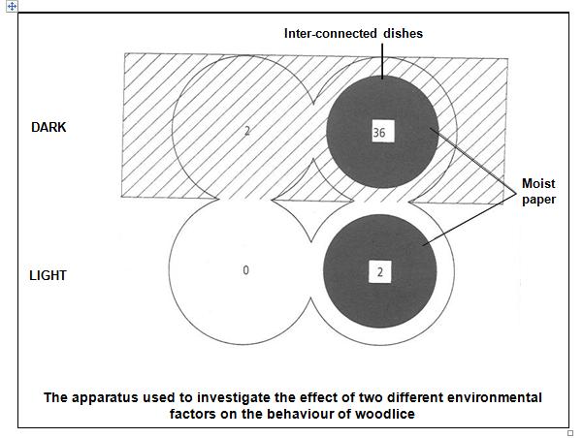

Slide 37
HOW DO YOU EVALUATE YOUR RESULTS?
OBSERVE/NOTE
SET UP TABLES
SET UP GRAPHS
ANALYSE RESULTS
MAKE DEDUCTIONS
EVALUATE RESULTS
Writing a discussion is one of the most important sections of the scientific report as it is where the worth of your investigation can be made clear.

Slide 38
PROCEDURE vs INVESTIGATION
A Scientific procedure is where the variables are all FIXED VARIABLES (i.e. no variables are being manipulated)
A Scientific investigation is where the INDEPENDENT VARIABLE (at least ONE variable) is being manipulated / changed to turn it into an investigation

