Slide 1
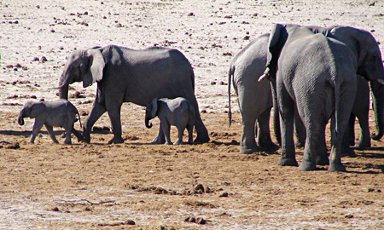
SOCIAL ORGANISATION
Social organisation enhance survival of species

Slide 2
Benefits of living in groups

Slide 3
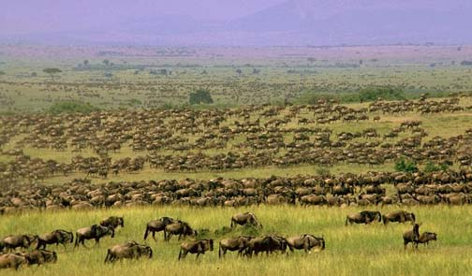
Animals that live in herds, schools, swarms, and flocks typically give up on their individual defences because they pursue another survival strategy.
If you are a member of a herd, you do not need to run faster than your predator; you only need to run faster than the slowest member of your herd.

Slide 4
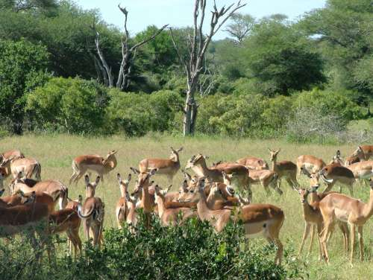
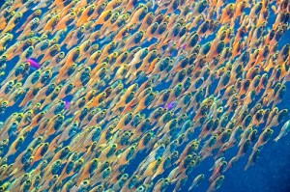
1. Groups as a predator avoidance strategy
With many eyes and ears, the group as a whole is more watchful

Slide 5
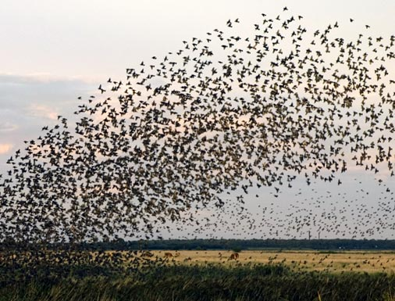
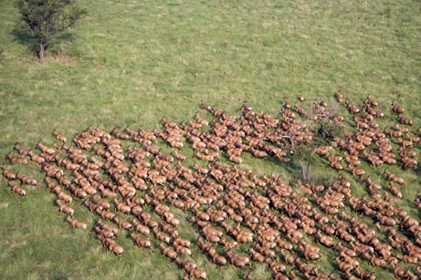
The greater the number of individuals in group, the greater the survival chances of the individual (dilution effect)
As a predator tries to single out its prey, the herd scatters in all directions, confusing the predator (confusing and distraction effect)

Slide 6
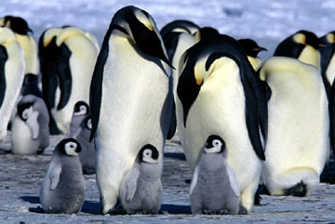
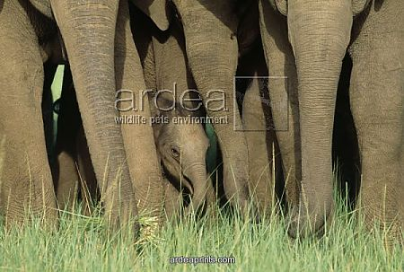
The members of a flock protect those who are vulnerable against predators, eg penguins
During migration, the inexperienced are given guidance and protection by the herd or flock

Slide 7
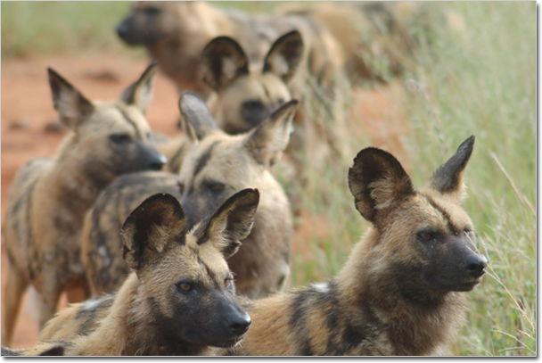
2. Hunting as a pack (a successful hunting strategy) e.g. African wild dogs

Slide 8
They chase until their prey tires, reaching speeds up to 55 kmph, and sometimes disembowelling prey while it is still running

Slide 9
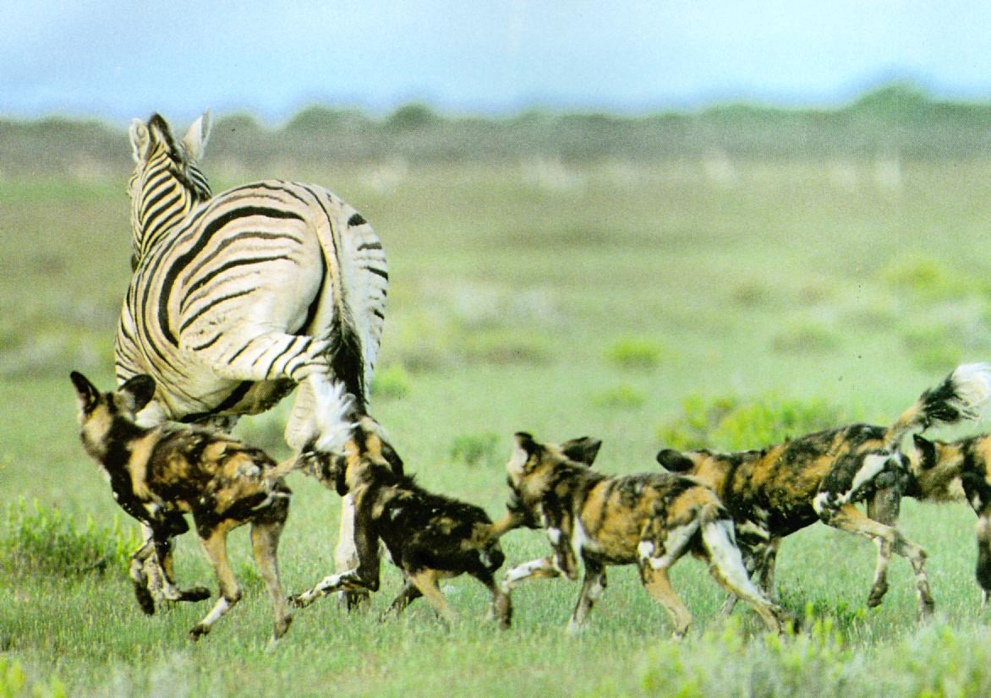
Very high success rate for any predator species
After detecting the prey by sight or sound, they chase it at about 45 km/h.
They are tireless runners who can chase their prey for a hour or more
When the prey tires, one grab the tail and another its upper lip to immobilize it. The rest of the pack then kills it

Slide 10
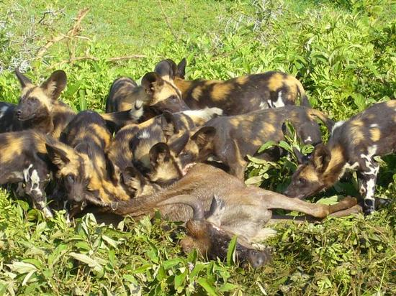
The whole pack shares in the kill with the young feeding first
Wild dogs left behind in the den – the dominant female and the pups, the sick, injured and very old, are fed on regurgitated meat
In this most efficient system of hunting and feeding, the needs of the whole pack are satisfied

Slide 11
Sharks also hunt in groups

Slide 12
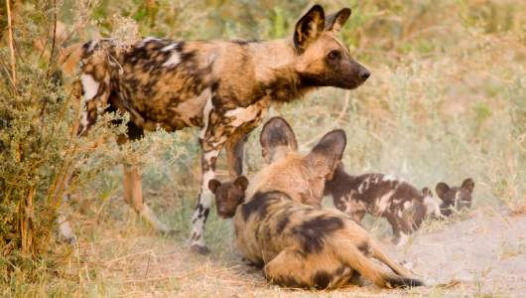
Animals with dominant breeding pairs
Strongest individuals are the only ones allowed to reproduce
Like other dogs, African wild dogs are highly social. They usually live in packs of six to twenty individuals with a dominant breeding pair. The dominant breeding pair carries over the strongest genes to the offspring –making their chance of survival better

Slide 13
Animals with dominant breeding pairs- the giant otter
Giant otters live in groups with one breeding pair. There is one dominant female in the group She has many offspring and is also the top fish catcher and the leader of the hunt.

Slide 14
The Southern ground hornbill
The Southern ground-hornbill occurs from Kenya to southern Africa, living in a wide range of grassland, savannah woodland habitats. eeder, with a group consisting of a dominant breeding pair and 0-9 helpers, who are usually either adult males, or juveniles from previous breeding seasons. It lays 1-2 eggs, which hatch in the sequence laid, meaning that the one chick is 3-14 days older than the other chick

Slide 15
Animals with dominant breeding pairs – Lions
The advantages of dominant breeding pairs are:
- offspring are cared for by many members of the group
- dominant males and females are usually the strongest and most efficient members of the group, their genetic material will be carried to the next generation

Slide 16
Dominant breeding pairs - meerkat
Meerkats are facultative monogamous, which means that they breed with only one other member of the opposite sex. The female does not depend on the male for help raising the pups. She depends instead on kin and non-kin helpers. Cooperation in meerkat breeding is obligate because the breeding female cannot reproduce and raise offspring without help. Subordinate meerkats occasionally breed, but the dominant pair is always responsible for the majority of reproduction.

Slide 17
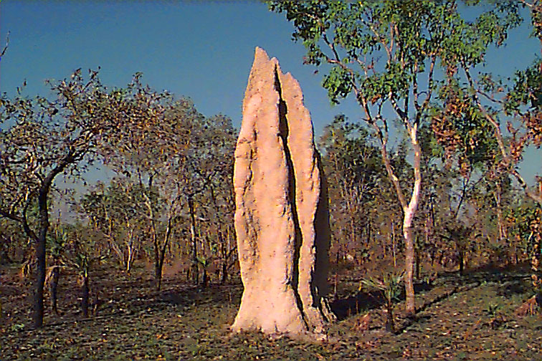
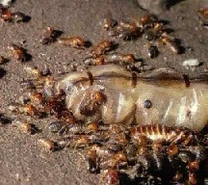
Division of labour amongst members of a colony
Caste system
Tasks include collecting food, caring for the young and building, maintaining and protecting the nest
Queen, the dominant female
Produces up to four litters (about 12 pups) a year
During gestation and lactation she uses up a lot of energy and depends on the sterile females for food and protection
She produces urine that contains pheromones to suppress the breeding of all the other females in the colony
These females can regain their fertility if the queen dies

Slide 18
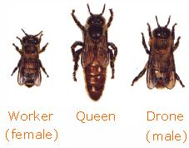
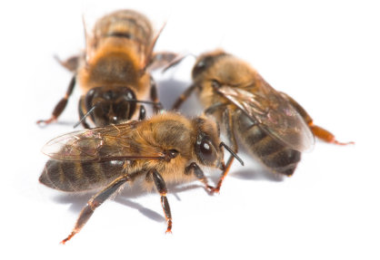
Division of labour amongst members of a colony
The honeybee community consists of three structurally different forms-the queen (reproductive female), the drone (male), and the worker (nonreproductive female). These castes are associated with different functions in the colony; each caste possesses its own special instincts geared to the needs of the colony.

Slide 19
The workers (females) collect pollen and nectar every day

Slide 20
Workers have a special wagging dance with which they communicate with other workers on the distance and direction of food sources

Slide 21
Honey is stored to feed the developing embryos

Slide 22
Division of labour among members of a colony, e.g. an ant colony
Sociality is more advanced in bees, ants, and termites. As a rule, only one female (a queen) lays eggs in a colony, and numerous workers are sterile. Workers are involved in other functions like construction, defence and taking care of juveniles. They often have a division of labour and corresponding morphological differences.

Slide 23
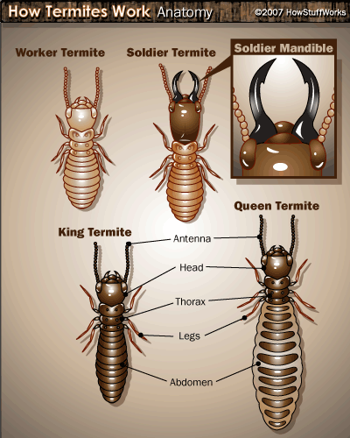
The fertile males, one to three, fertilises the queen
The influence the sex ration in the colony by producing more sperm of one sex
More female offspring useful, they are the workers
However, when colony needs more males the sperm make-up changes, so more males are produced
Sterile males are defenders, they protect colony against intruders
Sterile females are workers
They dig tunnels, collect food (tubers and roots)Care for both the young and the queen

Slide 24
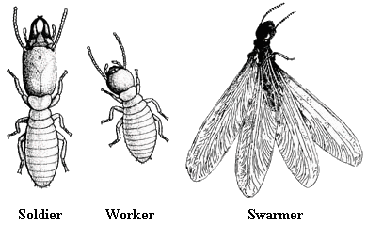
This picture shows some forms (casts) of termites. Social insects have
very complicated behaviour. Their success largely depends oncoordinated actions of many individuals. For example, leaf-cutting ants have underground fungus gardens. Ants bring foliage to this garden and collect fungus for food. This is insect agriculture!

Slide 25
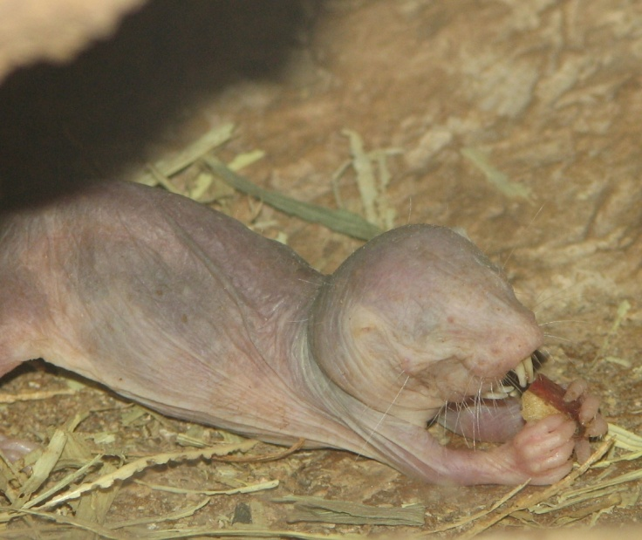
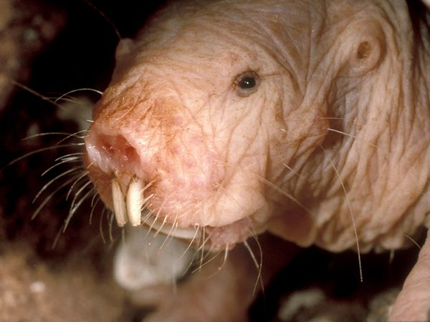
Naked mole-rat
The naked mole rat (Heterocephalus glaber), also known as the sand puppy or desert mole rat, is a burrowing rodent native to parts of East Africa and the only species currently classified in the genus Heterocephalus. It is one of only two known eusocial mammals (the other being the Damaraland mole rat) and has a highly unusual set of physical traits that enables it to thrive in an otherwise harsh, underground environment, including a lack of pain sensation in its skin and a very low metabolism.

Slide 26
Naked mole rats
Roles
There is dimorphism between the queen, her breeding
males, and two kinds of workers. They have a complex
social structure in which only one female (the queen) and one to three males reproduce, while the rest of the members of the colony function as workers.
Queen
The relationships between the queen and the breeding males may last for many years; other females are temporally sterile. Queens live from 13 to 18 years, and are extremely hostile to other females behaving like queens
When the queen dies, another female takes her place. Once established, the new queen stretches the space between the vertebrae in her backbone to become longer and ready to bear pups.[
A litter typically ranges from three to twelve pups, but may be as large as 28. T
Workers
Smaller workers focus on acquiring food and maintaining tunnels, while the larger workers are more reactive in case of attacks.
Colonies
Colonies range in size from 20 to 300 individuals, averaging 75 individuals.[

