Slide 1
Reproduction in plants

Slide 2
What is reproduction?
Reproduction is the process by which
organisms produce more of their own kind.

Slide 3
Reproduction:
The Continuity of Life
Reproduction
Sexual
Reproduction
Asexual
Reproduction

Slide 4
What is Sexual Reproduction?
Two parents involved (sperm/pollen and egg as gametes)
Process of mitosis and meiosis occurs.

Slide 5
Sexual Reproduction
ADVANTAGES
Offspring are genetically different and have a better chance of surviving if conditions change.
Zygote can be protected by a thick coat.
DISADVANTAGE
Need to find a mate to reproduce.
Is a longer process

Slide 6
What is Asexual Reproduction?
Only one parent is involved.
Offspring are genetically identical to their parent (they are all clones-made by mitosis only).

Slide 7
Asexual reproduction
ADVANTAGE
It is a quicker process.
Offspring are identical and have adaptations of the parents.
No need to find a mate
DISADVANTAGE
Offspring are identical, if conditions change, all might not be suited.

Slide 8
Act 1.2.8 pg 69.

Slide 9
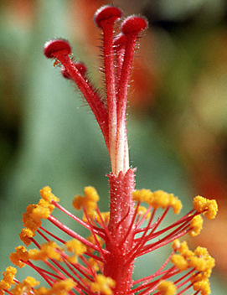
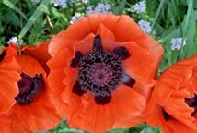
FLOWERS AS REPRODUCTIVE STRUCTURES

Slide 10
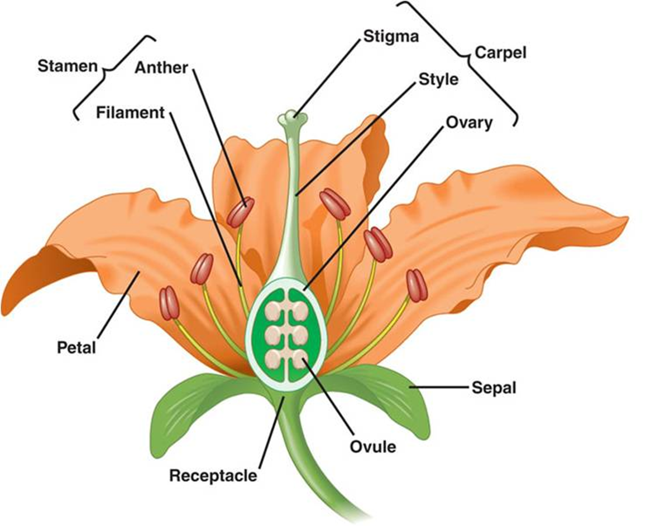
REFER TO PG 70

Slide 11
Terms
Whorl- circular pattern
Regular- parts of each whorl are identical.

Slide 12
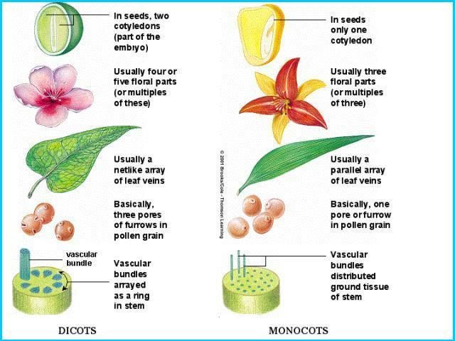

Slide 13
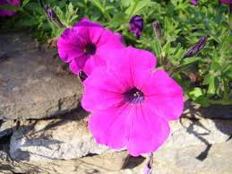
Dicotyledonous flower
Contains 4 whorls androecium, gynaecium, calyx and corolla (calyx + corolla = perianth)
Complete flower- has 4 whorls.
Parts of each whorl in 2’s or 5’s

Slide 14
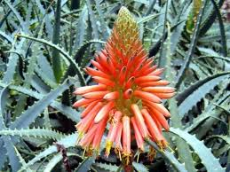
Monocotyledonous flower
Contains 3 whorls androecium, gynaecium and perianth (Perianth NOT differentiated into corolla and calyx)
Parts of each whorl in 3’s

Slide 15
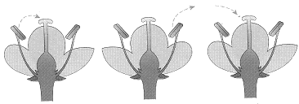
Pollination
The transfer of pollen from the anther to the ripe stigma.
Pollen
Pollen
Self-pollination
Cross-pollination

Slide 16
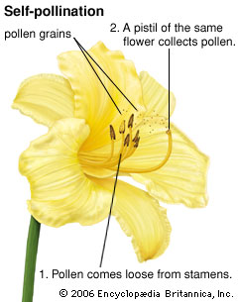
Pollination
Self-pollination
Pollen from the anther is transferred to the stigma of the same flower/plant

Slide 17
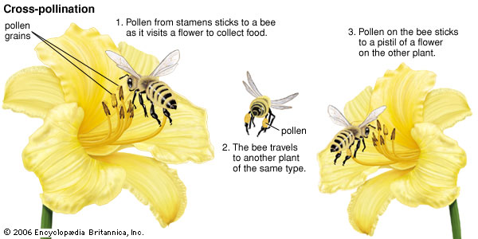
Cross Pollination
Pollen from the anther of one plant is transferred to the stigma of a different plant

Slide 18
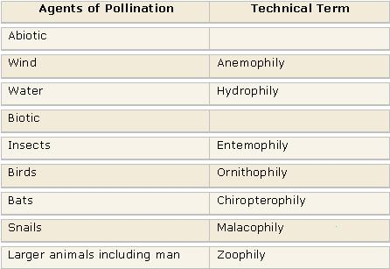

Slide 19
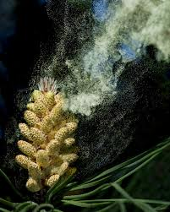
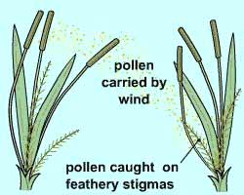
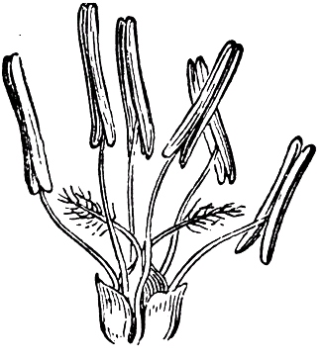
Wind pollinated flowers
Large anthers
No petal
Large feathery stigma

Slide 20
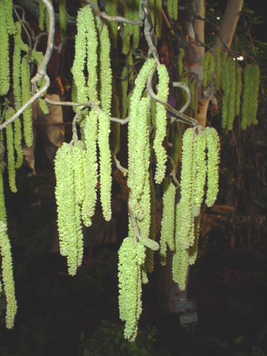
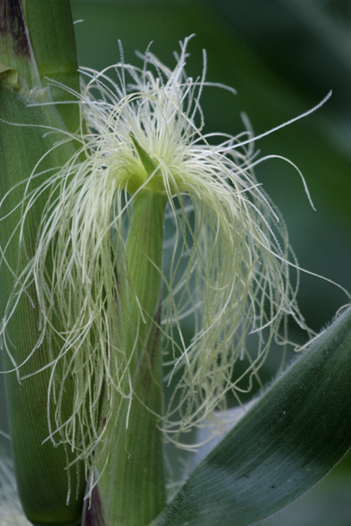
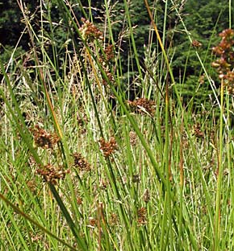

Slide 21
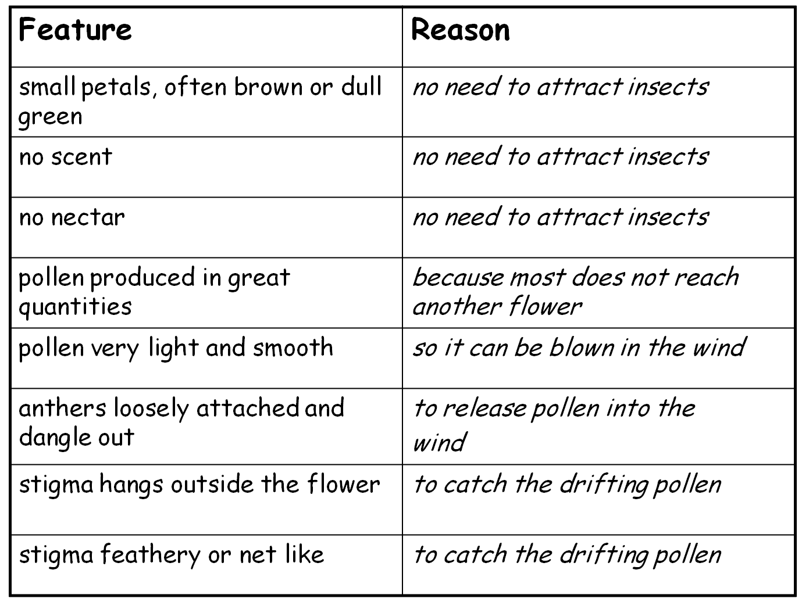
Wind Pollinated Flowers

Slide 22
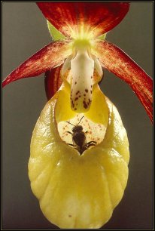
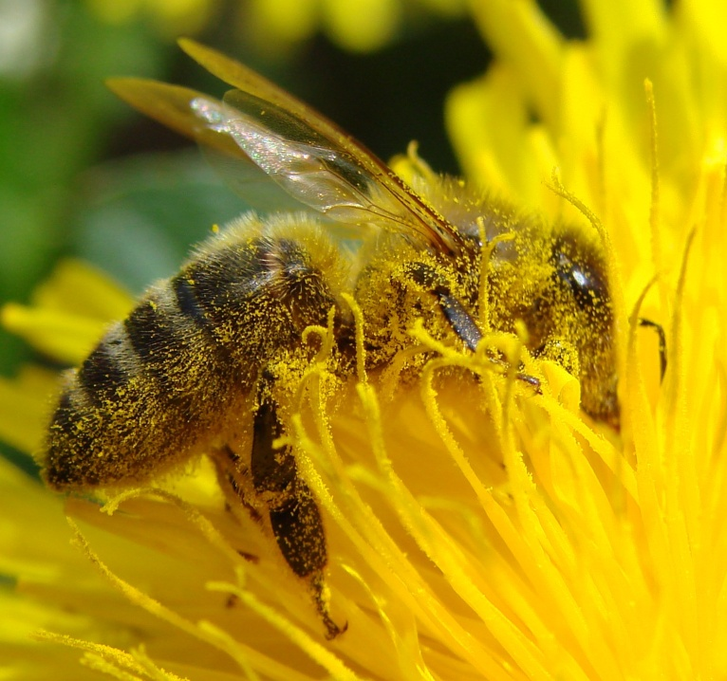
Insect pollinated flowers
Small anthers
Big colourfull petals
Small inside stigma
Nectar as attraction

Slide 23
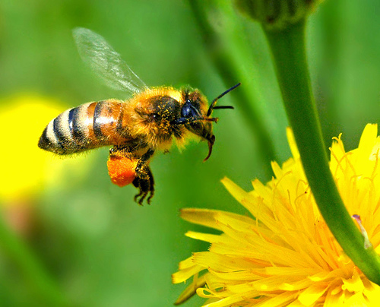

Slide 24
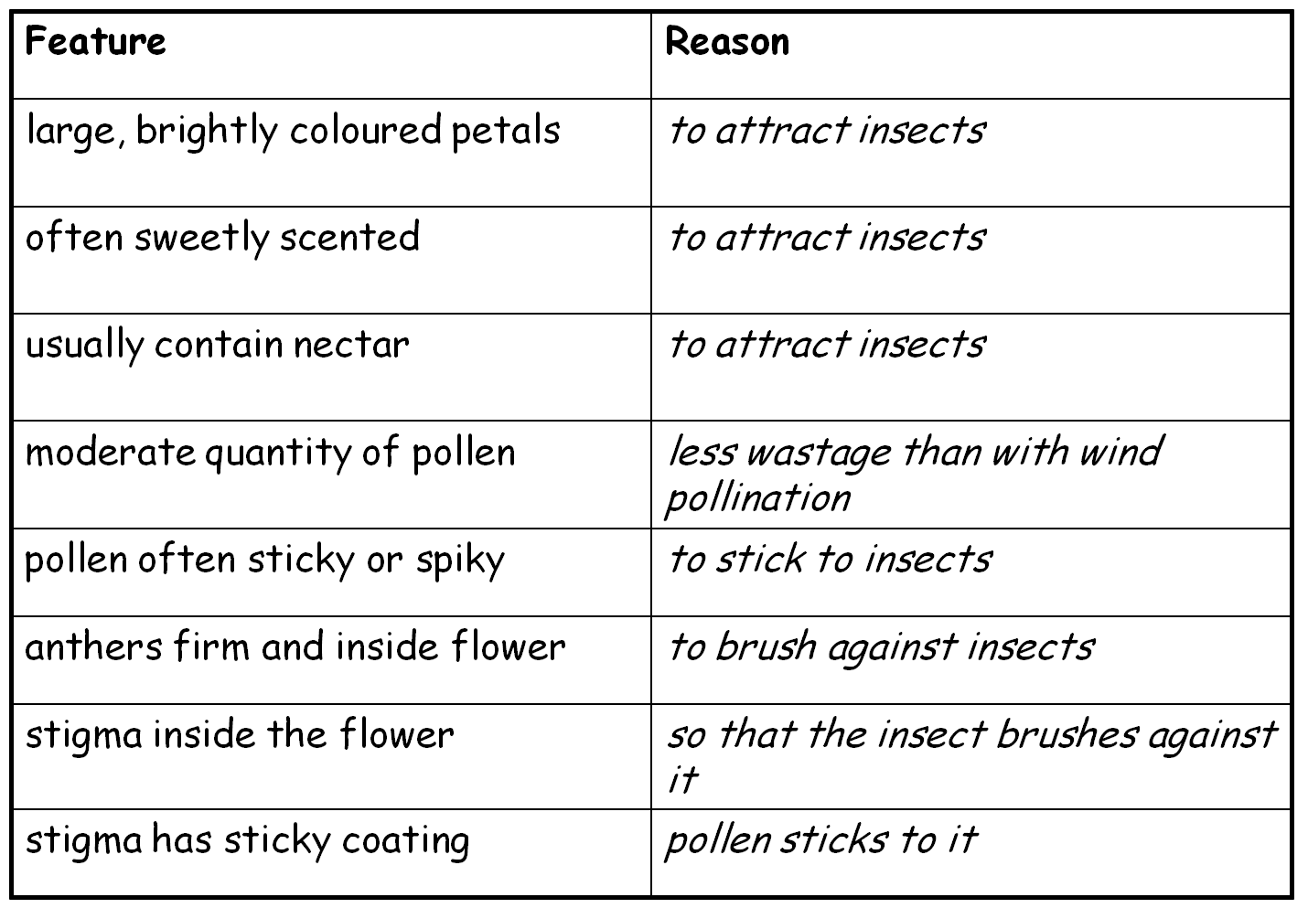
Insect Pollinated Flowers

Slide 25
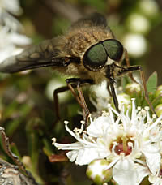
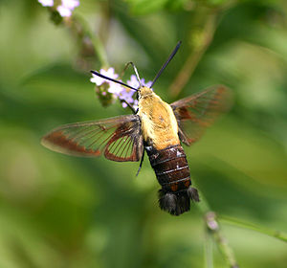
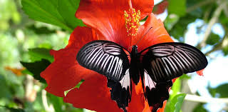

Slide 26
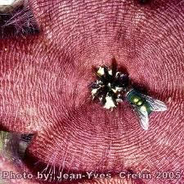
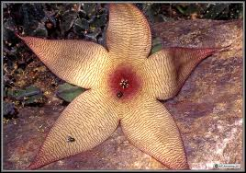

Slide 27
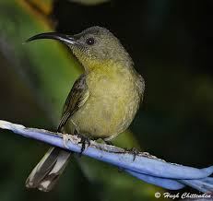
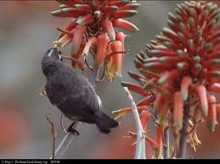
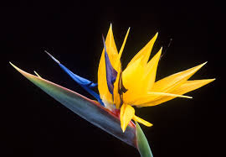
Bird Pollinated Flowers
Long tube-shaped flowers
Bright red and yellow flowers
No odour.

Slide 28
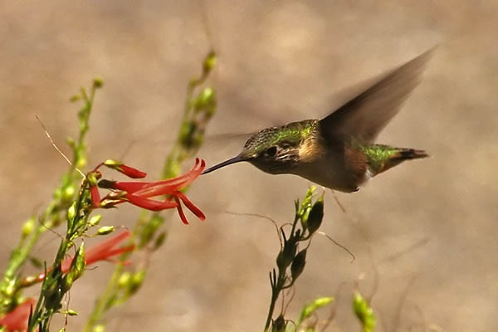

Slide 29
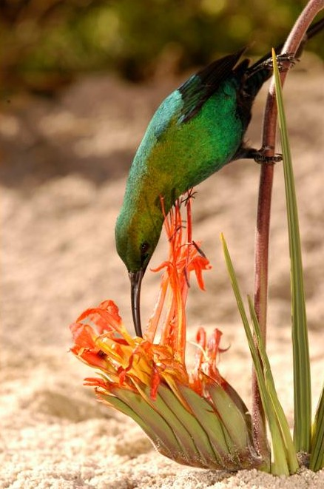
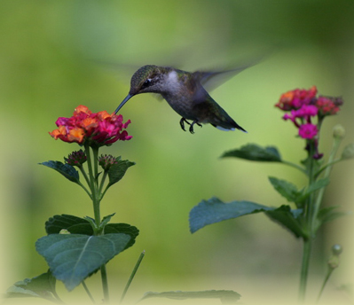

Slide 30
Fertilisation: The nucleus of the pollen joins with the nucleus of the egg to form a zygote

Slide 31
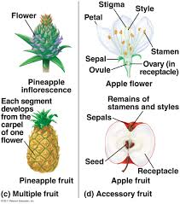
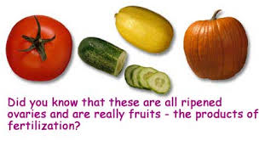
After fertilization …
The seed develops from the ovule and fruit from the ovary.
.

Slide 32
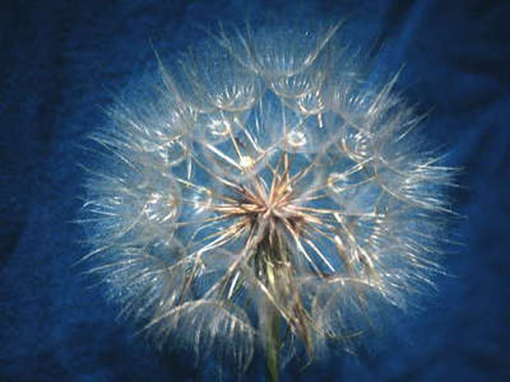
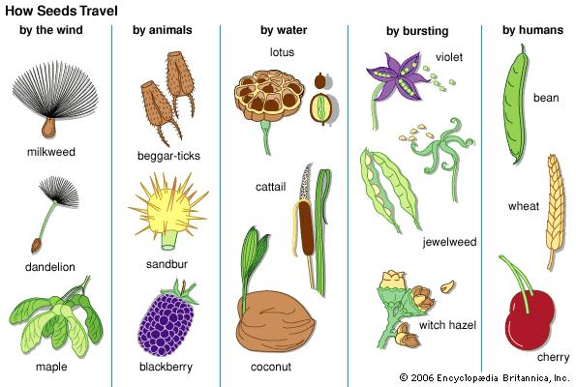
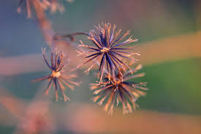
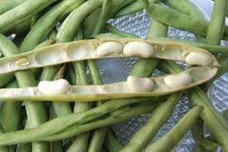
Seeds are dispersed and will germinate.

Slide 33
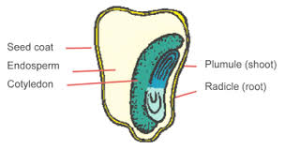
Significance of seeds
Reduce competition when dispersed.
Survive harsh environmental conditions while dormant.
Store food.
Ensure protection of the embryo.
Provide seedling with food until it can photosynthesise.

Slide 34
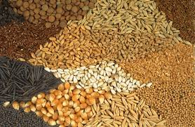
Seeds as sources of food:
Form the staple diet of most people.
Can be used to make beverages.
Fruits are a source of vitamins and minerals.
Used to make spices.
Other parts of plants also provide food
Seeds are used as feed for animals.

Slide 35
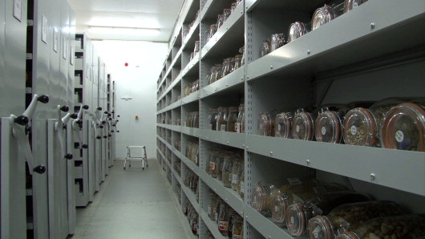
PRESERVING ENDEMIC SPECIES IN SEED BANKS

Slide 36
South Africa has high endemism.
Seed banks can preserve endangered, endemic species and those with medicinal value.
The Millenium Seed Bank Project was started in 2001 and they partnered with SANBI.
Seeds of the scarce, endangered and plants that have medicinal value are collected and kept in the seeds banks.
A DNA bank has been established in Kirstenbosch (W.C.). DNA extracts are stored at -80̊ C

