Slide 1

Plant response to
the environment

Slide 2
Responses are controlled by plant growth substances (hormones)
Auxins
Gibberrellins
Abscisic acid

Slide 3
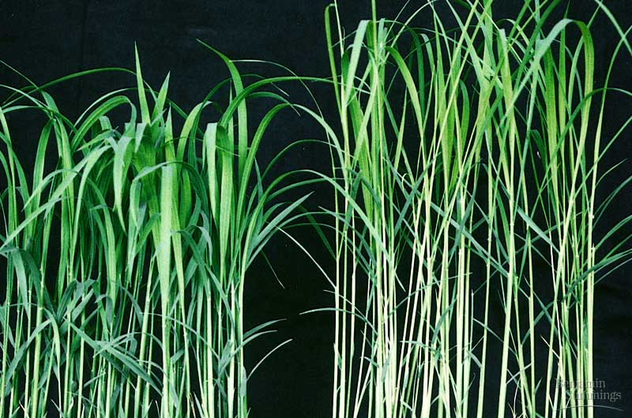
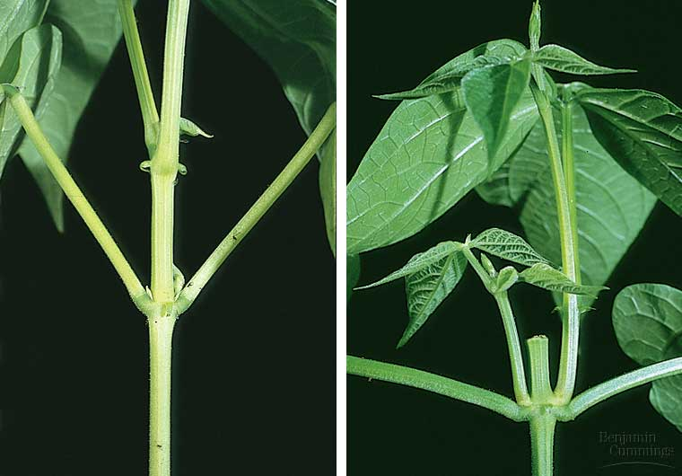
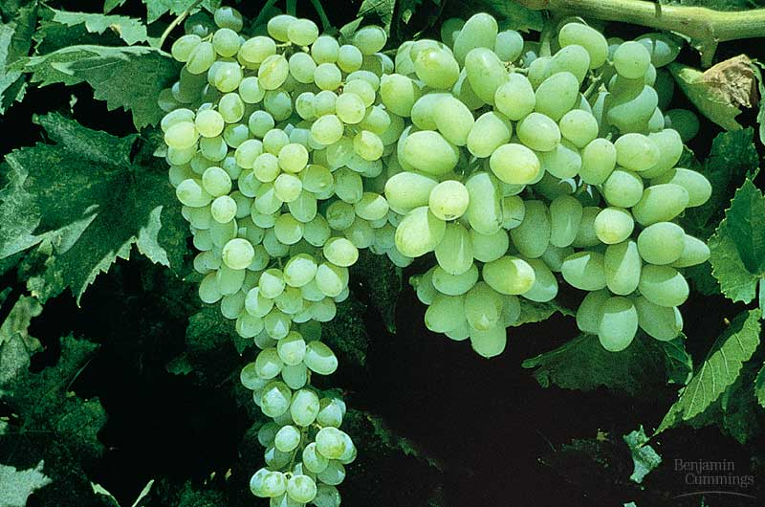
Responses are controlled by plant growth substances (hormones)
auxin
gibberellins
abscisic acid

Slide 4
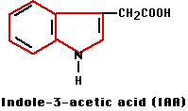
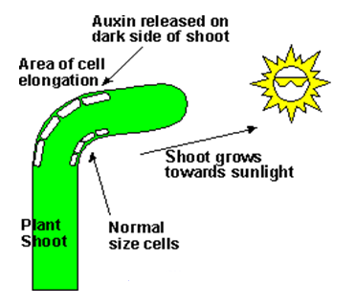
Auxin
Functions:
Cell division
Cell elongation (growth in stem length)
Tropic movement in stem and roots
apical dominance (it suppresses the growth of the lateral buds.)
Prevents the abscission of leaves and fruit
Root initiation.
The development of fruit and flowers
The development of adventitious root in stem cuttings

Slide 5
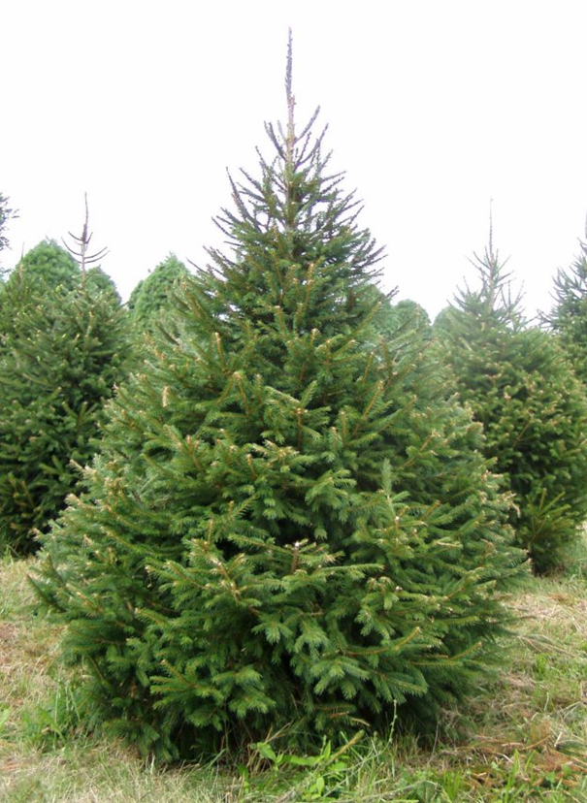
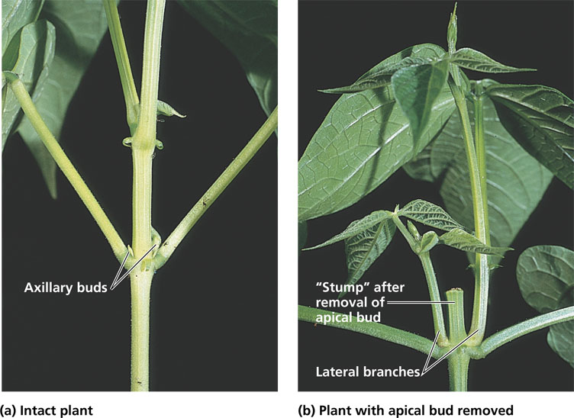
Apical dominance
The apical (top) shoot grows inhibiting the growth of lateral (side) shoots.
By cutting off the apical buds (auxin removed) the growth of lateral branches is stimulated.

Slide 6
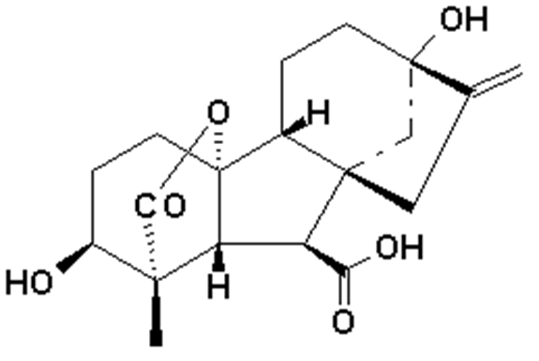
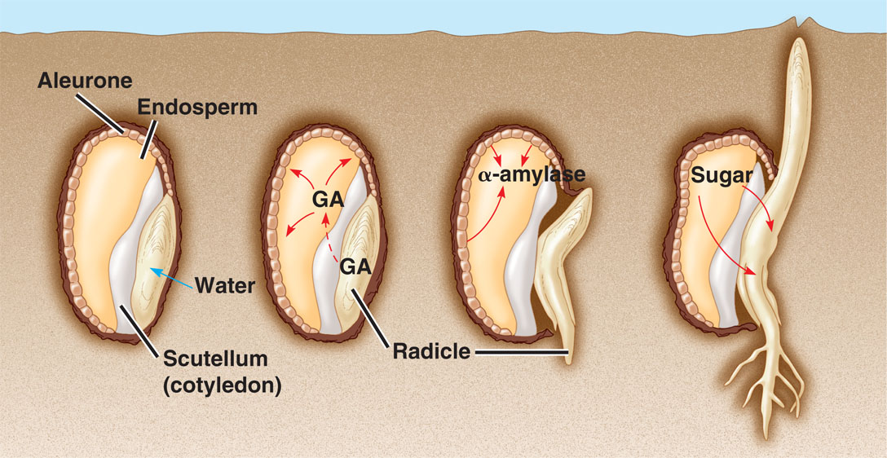
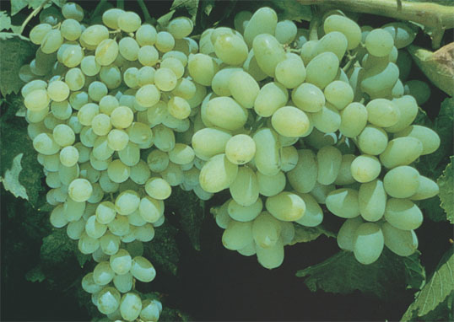
Gibberellins
Stimulate:
Stem elongation
The germination of seeds
Root growth
Promotes flowering and fruit development
plump grapes in grocery stores have been treated with gibberellin hormones while on the vine

Slide 7
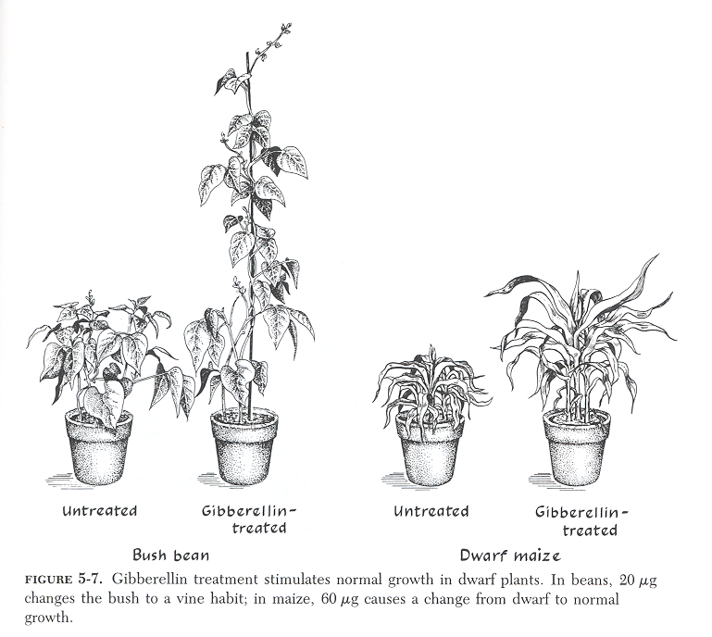

Slide 8
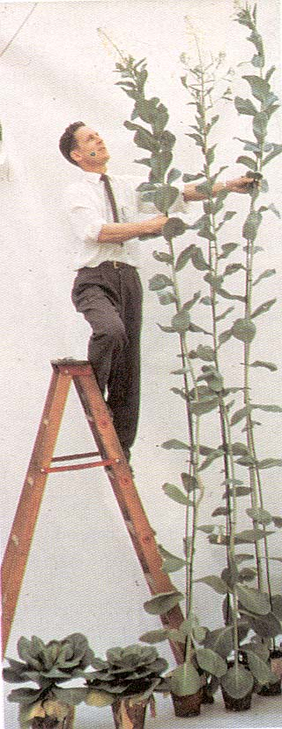
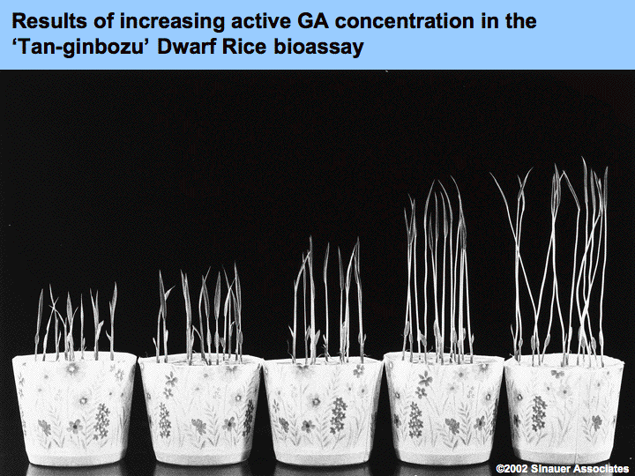
Application of Gibberellins cause cell elongation

Slide 9
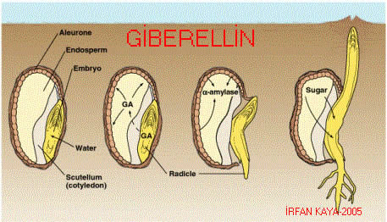
Use of gibberellins to stimulate seed germination
In this experiment carried out on germinating barley seeds, the results showed that the release of gibberellin from the embryo, triggers the germination

Slide 10
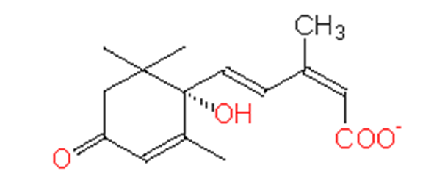
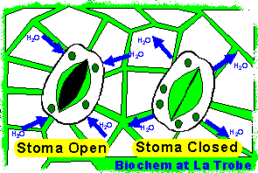
Abscisic acid (ABA)
Accelerate abscission in leaves and fruit. ABA is produced in ripe fruit and induced fruit fall.
ABA stimulates the closing of stomata in most plant species. (stimulated by water stress)
Causes dormancy of buds in winter.
Controls seed dormancy (inhibits germination)

Slide 11
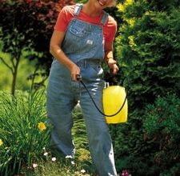
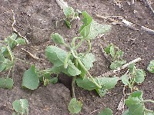
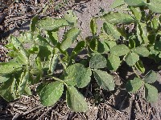
Auxins as herbicides
Auxins accelerate the metabolism of broad-leaved dicotyledonous weed and therefore stimulate growth These weeds grow so fast that their water absorption and food production are insufficient. The plants weaken and die. See pg 275

Slide 12
TROPISM
Response of a plant to stimuli.
Positive tropism is movement/growth towards the stimulus.
Negative tropism is movement/growth away from the stimulus.

Slide 13
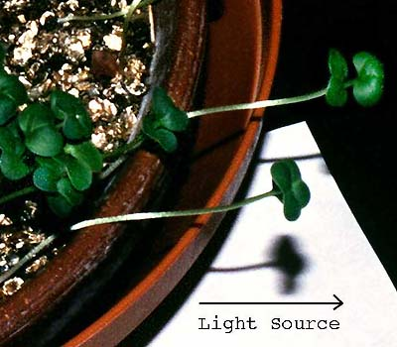
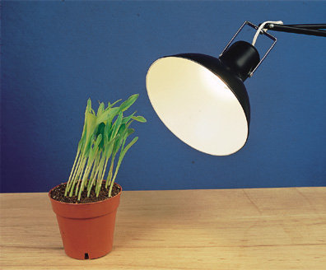
Phototropism
Movement of plant toward a light stimulus

Slide 14
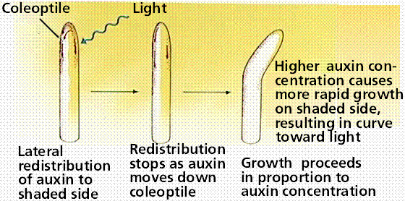
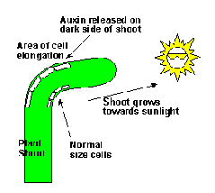
Phototropism
Movement of plant toward a light stimulus

Slide 15
PHOTOTROPISM
When plants are exposed to light from one side/unilateral light
The auxins move to the other side (shaded side)
Auxins cause cell division and elongation here.
The stem grows towards the light source.
This is called positive phototropism.

Slide 16
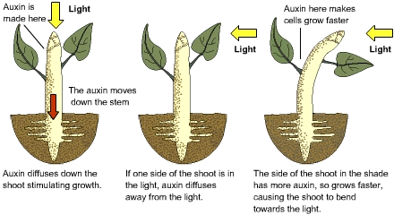

Slide 17
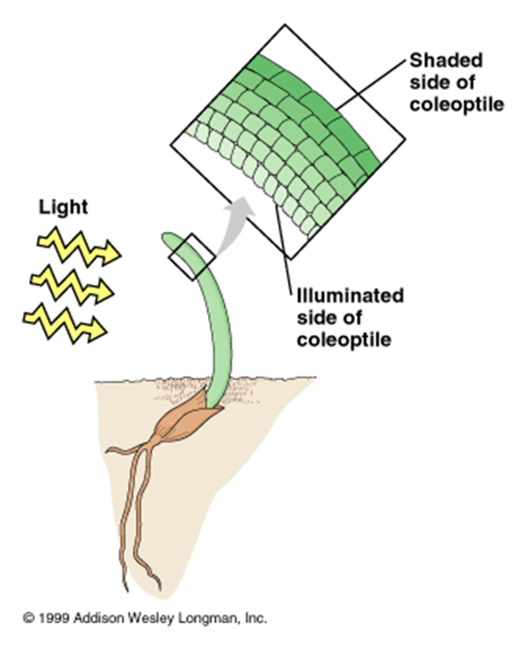

Slide 18
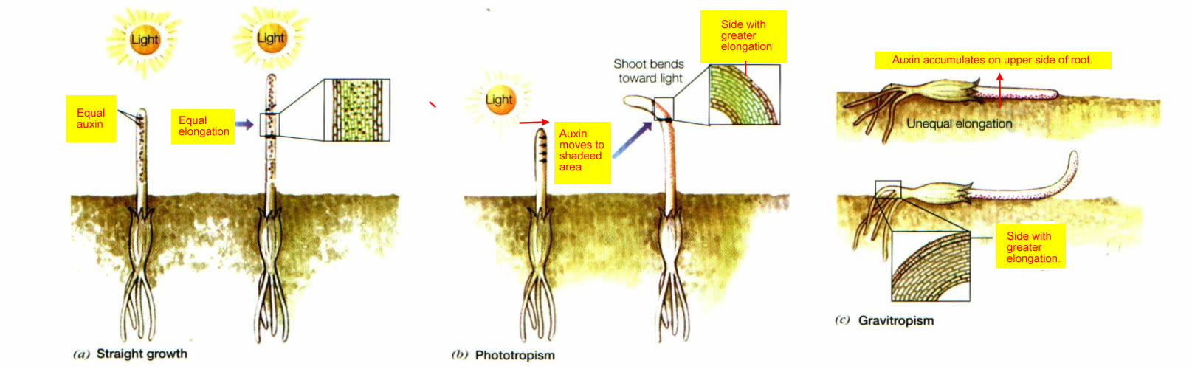

Slide 19
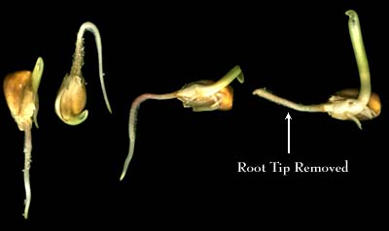
Geotropism
Growth in response to gravity.

Slide 20
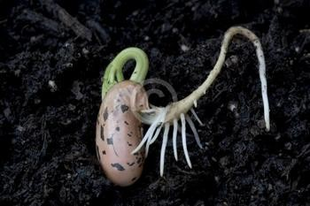
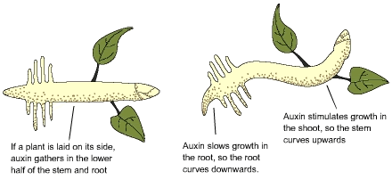
GEOTROPISM

Slide 21
GEOTROPISM
When plants are laid on their side
The auxins move to the bottom (gravity)
Auxins inhibit cell division and elongation here.
Root cells above still grow
The root grows towards the gravity (downwards)
This is called positive geotropism.

Slide 22
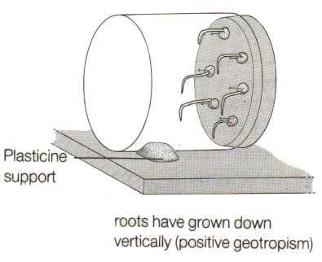
Experiment to illustrate geotropism
Roots growth downwards

Slide 23
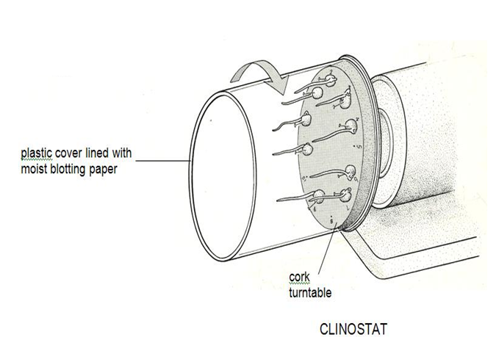
Clinostat turned –roots growth straight

Slide 24
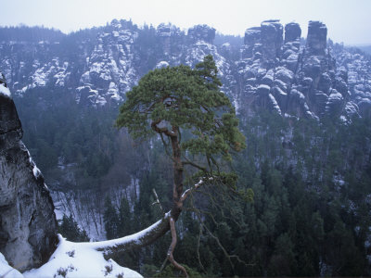
Tropism in nature

Slide 25
Unit questions pg 279

Slide 26
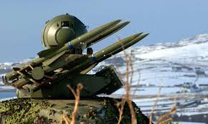

PLANT DEFENCE MECHANISMS

Slide 27
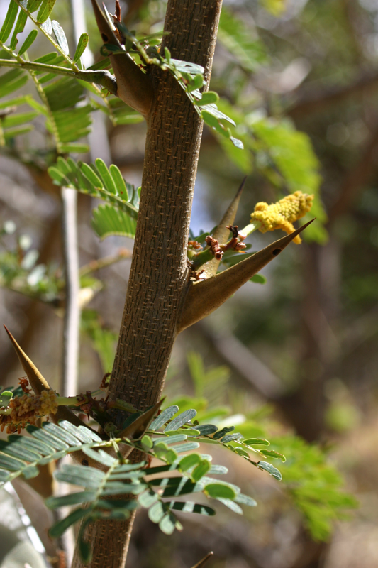
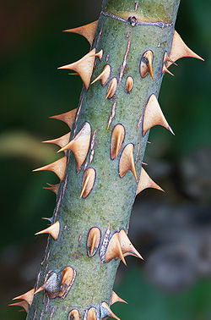
THORNS (mechanical defences)

Slide 28
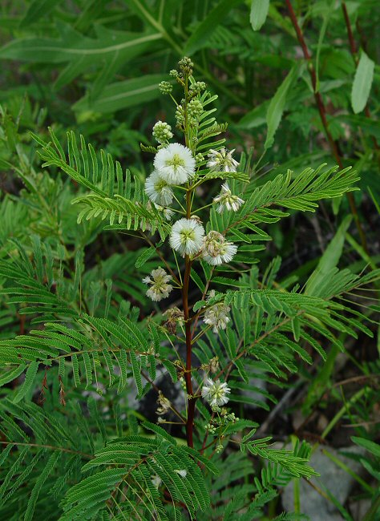
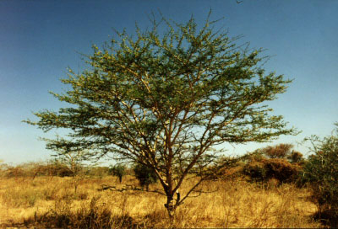
Acacia species have thorns to prevent excessive feeding by giraffes, kudu, impala etc

Slide 29
CHEMICAL DEFENCE
Many plants produce chemicals known as secondary metabolites that help protect them from herbivores. These chemicals acts as poisons, repellent, or affect the herbivores digestion. These include:

Slide 30
Alkaloids – group of nitrogen containing compounds found in plants which act as poison.
Tannin (phenol) – brownish substance found in plants with antiseptic properties that disrupt endocrine activities
Terpenoids – these chemicals destroy the herbivores red blood cells
See pg 276

