Slide 1
PLANT AND ANIMAL TISSUE
Grade 10

Slide 2
Plant tissue
Key concepts:
Levels of organisations
Definition of tissues
Types of plant tissue
Plant organs i.e. leaves, stems, ect.

Slide 3
Cells → Tissue → Organs → System → Organisms
Tissue is a group of similar cells adapted to a particular function.

Slide 4
PLANT TISSSUE
Meristematic Tissues
Permanent Tissues
epical meristem (Primary)
lateral meristem (Secondary)
Simple permanent tissues
Complex permanent tissues
Epidermis
Parenchyma
Chlorenchyma
Collenchymad
Sclerenchyma
Phloem (vascular tissues)
Xylem (vascular tissues)

Slide 5
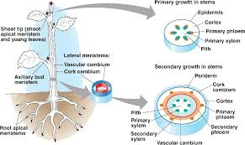
PLANT TISSUES | LOCATION | FUNCTION
MERISTEMATIC TISSUES (undifferentiated / unspecialised)
APICAL MERISTEM | Tips of roots and stems | Produce new cells for growth, repair and replacement of worn out / damaged tissues
LATERAL MERISTEM | Found between Xylem and phloem | Produce new cells for growth, repair and replacement of worn out / damaged tissues

Slide 6
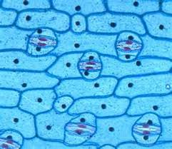
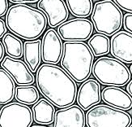
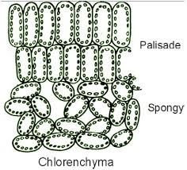
PERMANENT TISSUES
EPIDERMIS | Lines the surface of roots, stems and leaves | Protect plant organs, they form guard cells, or root hair cells which absorb water and minerals
COLLENCHYMA | Found in stem and leaves | Provides strength and support to the aerial parts of plants
PARENCHYMA | Fills up large spaces between other tissues in roots and stems | Packaging tissues, stores food as starch, allows movement of water and gases & gaseous exchange.
CHLORENCHYMA | Found in leaves | Contains chlorophyll for the manufacture of organic compounds such as glucose by photosynthesis

Slide 7
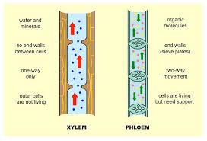
SCLERENCHYMA | Found in leaves, stems, roots and fruit of plants | Provides mechanical support to the plant
XYLEM | Found in roots, stems and leaves | Transports H₂O and mineral through the plant, provides support and strength to the plant
PHLOEM (NON-LIVING) | Found in roots, stems and leaves | Transports manufactured food from leaves to all other parts of the plant.

Slide 8
Activity 1.4.4 Pg 110 Homework

Slide 9
Animal tissue

Slide 10
ANIMAL TISSUES:
Epithelial tissues
Nerve tissues
Connective tissues
Muscle tissues

Slide 11
EPITHELIAL TISSUES:
Tightly, - joint closely – tightly packed cells
General function
Covers the outside of the body and lines the internal organs and cavities.
Protects against mechanical injury and Invasive micro-organisms

Slide 12
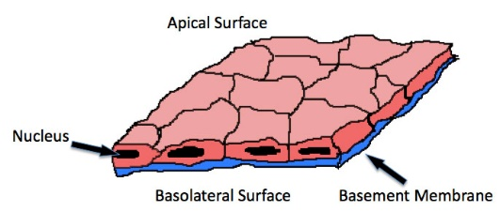
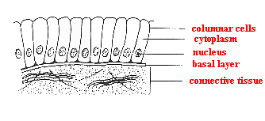
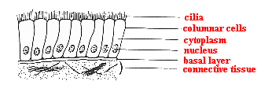
Squamous | Lines the lungs and mouth | Protects underlying tissues – allows certain c=substances to pass through, e.g. Gases and solutions
Columnar | Lines the inside of the small intestines | Provides support to other cell types, absorbs food, H₂O and minerals, contains’ goblet cells to secrete mucus.
Ciliated | Lines the breathing passages | Mucus from goblet cell traps dust, the beating cilia drives out the mucus with the dust.

Slide 13
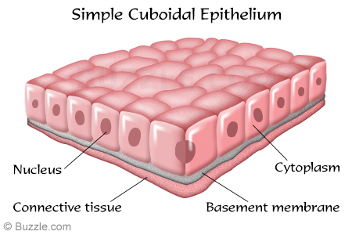
Cuboidal | Lines the gland | Produces a variety of secretions e.g. sweat, milk and sebum (oil)

Slide 14
Muscle Tissue
 | Location | Function
Striated | Found in voluntary muscles | Responsible for voluntary actions such as walking and running
Unstriated / smooth | Lines blood vessels, as well as the stomach and intestine walls. | Responsible for involuntary actions such as dilation and constrictions of blood vessels.
Cardiac | Found in walls of heart only | Responsible for involuntary contraction and relaxation of the heart.

Slide 15
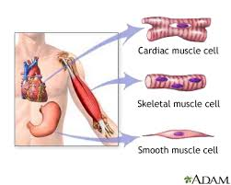
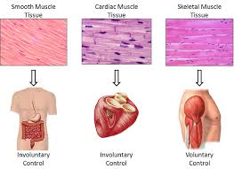

Slide 16
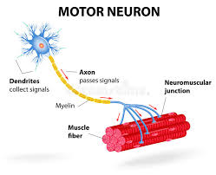
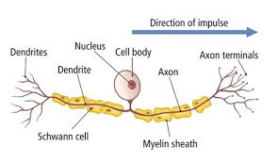
NERVE TISSUES
Nerve tissue | Location | Function
Motor | Found between central nervous system and nervous gland. | Carries impulses from the central nervous system to the effectors (muscle and glands)
Sensory | Found between the sense organs and central nervous system | Carries impulses from the sense organs (receptions) to the central nervous system

Slide 17
Connective tissue
Areolar | Found under the skin | Insulates the body – protects organs by serving as a packaging tissue
Yellow elastic | Forms ligaments | Makes up ligaments which connect bone to bone
White fibrous | Forms tendon | Makes up tendons which connect muscles to bones
White fibrocartilage | Found between the vertebrae | Acts as a shock absorber
Yellow elastic cartilage | Ear lobe and epiglottis | Epiglottis opens and closes the opening to the trachea

Slide 18
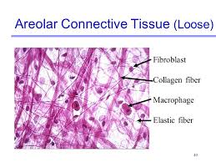
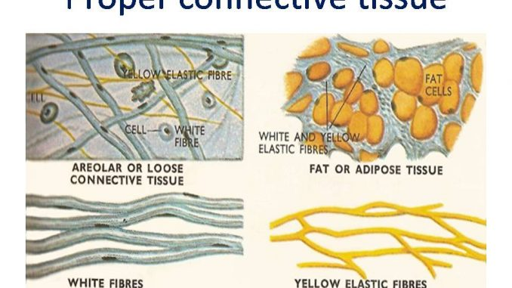
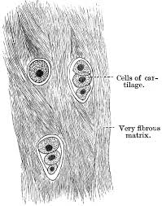
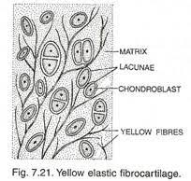

Slide 19
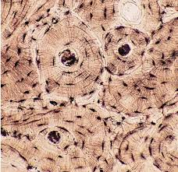
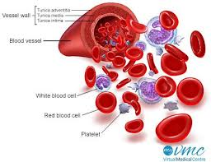
Hyaline cartilage | Found between the bone, in the ribs, ear, as rings in air passages | Reduces friction between bones and joints
Bone | Found in bone | Forms bones making up the endoskeleton of mammals, giving shape and support to the body, Endoskeleton also protects internal organs and serves for the attachment of muscles
Blood | Found in arteries, capillaries and veins | Transports digested food, hormones and enzymes, respiratory gases and excretory waste

Slide 20
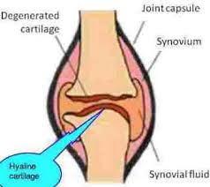
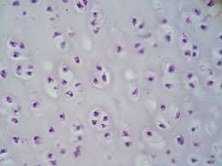

Slide 21
HOMEWORK
Activity 1.4.1 Plant and animal tissue.
Page 108

Slide 22
HOMEWORK
Activity 1.4.3 Plant and animal tissue.
Page 109

Slide 23
BIOTECHNOLOGY
Use of technology to obtain products from living organisms.
Examples
Medical – vaccines, antibiotics, blood transfusion
Cloning
Natural immunity
Acquired immunity

Slide 24
TRADITION TECHNOLOGY
Traditional technology is the use of traditional technology to obtain products form living organisms – traditional healers
E.g. African potato, pepper bark, ginger, honey, Devils claw, Sutherlinia
Read pgs 114-1115

Slide 25
Immunity
The human body has various lines of defence to protect itself from microbes entering the body:
Mucus in nose and throat
Cillia lining nasal passages and trachea
Tears and conjunctiva
Unbroken skin
HCL in stomach

Slide 26
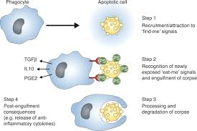
Immunity
Due to injury, thousands of microbes can enter the body in a very short space of time
Or, microbes can succeed in getting past these defences and enter the body
White blood corpuscles gather at the site of infection and attempt to destroy the microbe/s:
Engulfment
Detoxification
Antibodies

Slide 27
Immunity
Antibodies – produced by white blood corpuscles to fight off microbes
Each antibody is specific to a particular microbe or disease
Sometimes they can fight of closely related microbes/diseases

Slide 28
Immunity
Immunity refers to the body’s ability to produce antibodies to fight off diseases
Two types of immunity:
Natural immunity – innate
Acquired -
Active – through natural infection (Points pg 112)OR by artificial means
Passive – antibodies received from another organism
Figure 1.4.3
Antibiotics

Slide 29
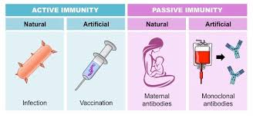

Slide 30
Homework ☺
Activity 1.4.5
Page 113

Slide 31
BLOOD TRANSFUSION
DONOR – Someone who donates the blood
RECIPIENT – A person who receives the blood

Slide 32
Blood tranfusions
Recipients blood | Safe donors
A | A, O
B | B, O
AB | A, B, AB, O
O | O
AB – universal acceptor
O – universal donor

Slide 33
Stem cell research
Undifferentiated cells which have potential to differentiate into any tissue or organ.
Can be used to cure diseased or damaged cells:
Pancreatic cells – diabetes
Brain cells – Alzheimers
Bone marrow – leukaemia

Slide 34
Stem cell research
Harvested from fertilized embryos during IVF
In-vitro fertilisation
One cell is harvested and used for differentiation. The other cells die due to this harvesting
For those that do not want to undergo IVF, there exists cord blood stem cells
Placenta
Cord blood bank – CT

Slide 35
ETHICAL FACTORS
Playing “God”
Fraudulent and criminal activity

Slide 36
Arguments for:
Medical research
To manage disease
Organ replacement
Better crops

Slide 37
Arguments against:
Killing embryos

Slide 38
Stem cell research
Should this research be continued?
Conducted all over the world in the hope that it will cure many incurable diseases and disorders
Some countries limit the harvesting:
Embryonic stage harvesting is illegal
Embryos fertilised just for harvesting is banned
Cord blood is allowed
Not everyone agrees with stem cell research
Type of abortion
Page 118 - 119

Slide 39
Stem cell cultivation

Slide 40
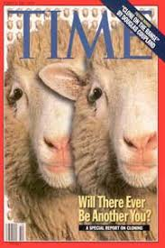

Slide 41
CLONING
Cloning/clone refers to genetically identical cells originating from one cell.
There is a difference between therapeutic and reproductive cloning
Therapeutic – replacement of organs, tissues, etc.
Reproductive – cloning an entire organ

Slide 42
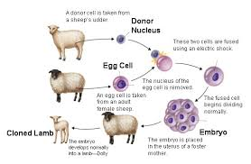

Slide 43
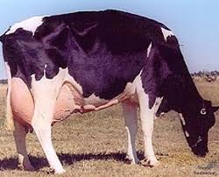
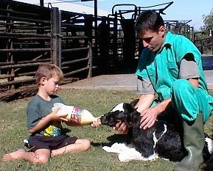
FUTHI Africa’s 1st clone

