Slide 1
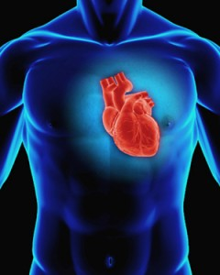
The heart

Slide 2
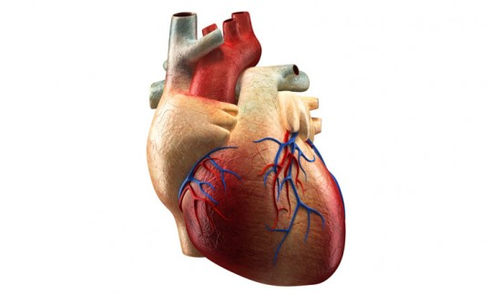
To circulate or not to circulate?
Some animals don’t have a transport system
Simple body structures that don’t require elaborate systems.
Can get all their needs and get rid of wastes through simple diffusion.
Slightly more complex organisms have gut pouches which provide nutrients to some cells which in-turn, provide other cells with nutrition.
Some animals require a transport system.
Most cells are too far away for diffusion to work effectively.
Require an elaborate transport system to deliver nutrients and essentials and carry away wastes

Slide 3
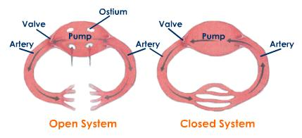
Open and close blood systems
But why do we need such an elaborate system?

Slide 4
OUR HEART

Slide 5
Structure of the heart
Made up of a special type of muscle.
Location: middle of the chest, apex slightly towards the left.
Protected by the ribs and the lungs.
The heart is covered with thin, strong, double-walled sac. The PERICARDIUM
Blood vessels of the heart. Coronary arteries and veins.
Various arteries and veins – oxygenated and de-oxygentated.

Slide 6
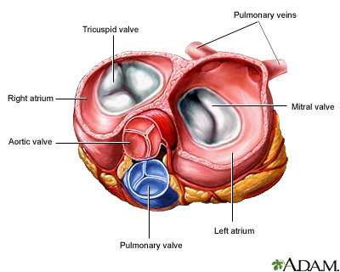
Valves!!!
What is a valve?
Tricuspid
Bicuspid
Semi-lunar

Slide 7
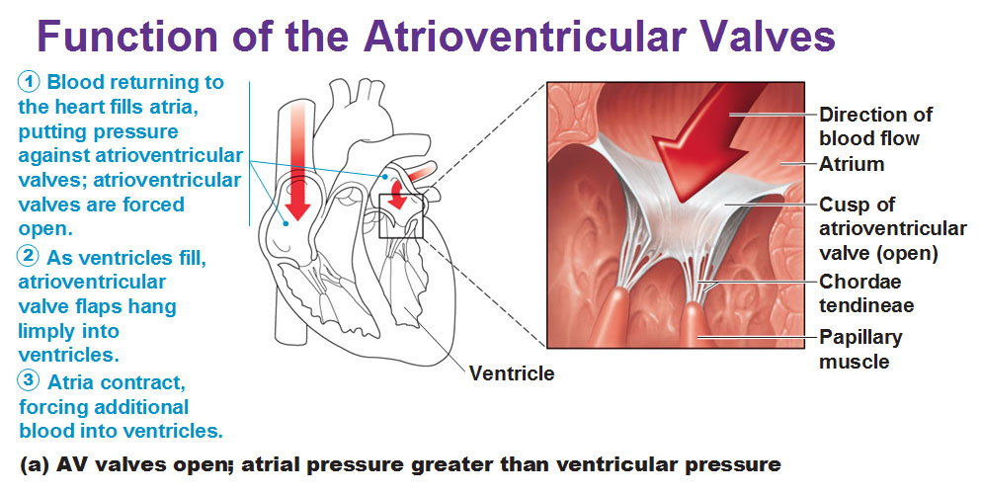
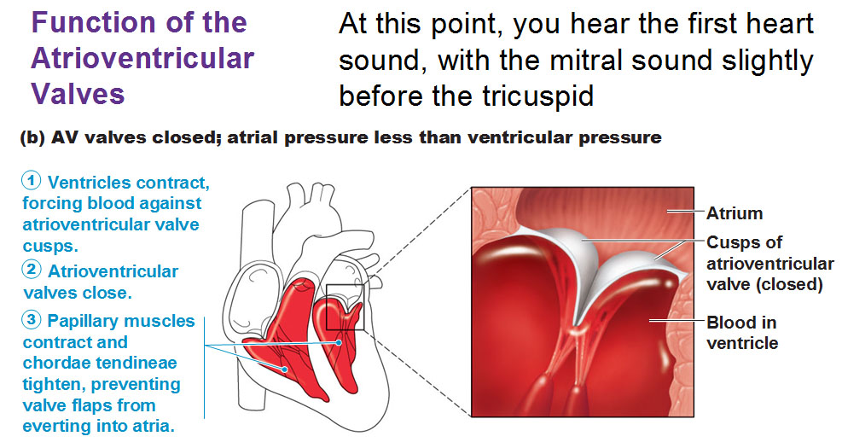

Slide 8
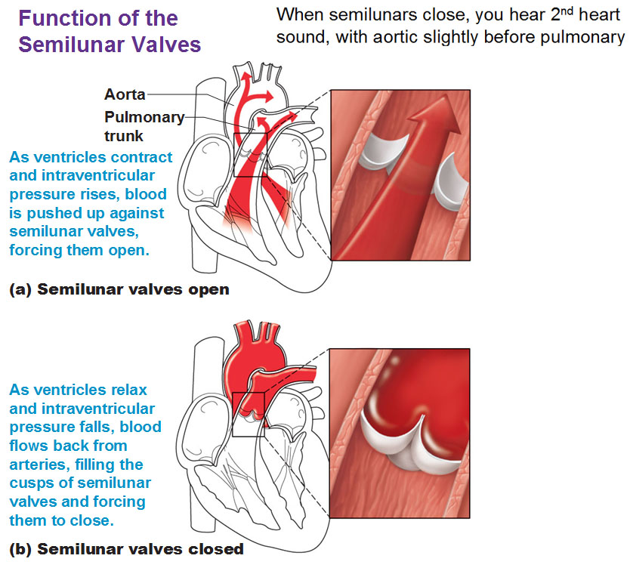

Slide 9
Homework ☺
Activity 2.3.2
Page 199 – 200

Slide 11
Functioning of the heart
The heart is a pump.
Blood is forced by contractions of the heart into the next chamber.
While the atria are contracting, the ventricles are relaxing and vice versa.
Contraction is known as SYSTOLE.
Relaxation is known as DIASTOLE.

Slide 12
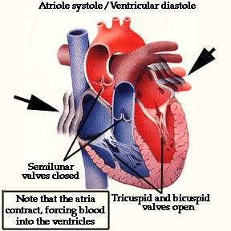
Phases of the cycle
In one cycle, three phases occur:
Atrial systole
Ventricular systole
General diastole
Atrial systole (0.1 seconds)
SA Node found in the right atrium
Atria contact together
Tricuspid and bicuspid valves open
Blood flows into ventricles

Slide 13
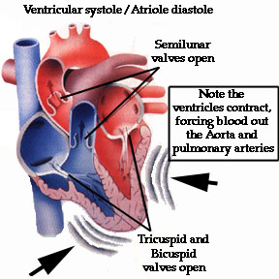
Ventricular systole (0.3 seconds)
Both ventricles contract together.
Tricuspid and bicuspid valves close.
Blood is forced into the Pulmonary Artery and Aorta

Slide 14
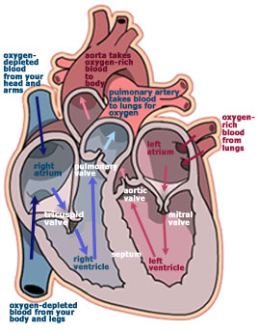
General diastole (0.4 seconds)
Both atria and ventricles relax.
Both semi-lunar valves close.
Blood enters the atria through Vena Cava and Pulmonary Vein.

Slide 15
In the Atrial Systolic phase, the Ventricles are in diastole.
In the Ventricular Systolic phase, the Atria are in diastole.
All valves close when blood pushes back on them.
All three phases take 0.8 seconds
0.1 – AS
0.3 – VS
0.4 – GD
Mechanism for controlling the cardiac cycle:
The SA node
Various levels of needs depending of level of activity
Receptor cells in the carotid arteries detect CO2 changes
Message sent to medulla oblongata
When CO2 level is high – sympathetic nerves from the medulla oblongata stimulate SA node to fire faster.
When CO2 level is low – parasympathetic nerves from medulla oblongata stimulate SA node to fire slower.

Slide 16
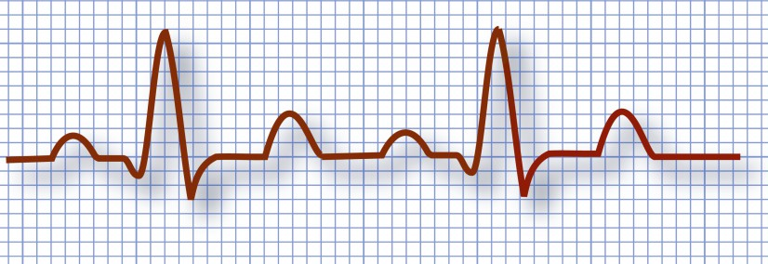
ECG – Electrocardiograph
The pattern that is produced on paper to represent a heart beat.
Used by doctors to determine whether a heart is functioning adequately or not.
Even though your heart may be functioning adequately, it will not produce the same ECG as another person.
Fig 2.3.10
a

Slide 17
Homework ☺
Activity 2.3.3
Page 203

Slide 18
Blood Vessels!!!
We have approx. 5 litres of blood in our entire body.
Each heartbeat pumps about 150ml out of the heart with enough pressure to pass through the entire body.
This blood is carried back and forth by our blood vessels.
Three types of vessels occur:
Arteries
Veins
capillaries

Slide 19
Blood vessel: Arteries, veins and capillaries.
Arteries carry blood away from the heart to the
organs and limbs of the body.
They have thick elastic walls because arteries
must be able to stretch when blood is pumped
into them by the heart.
The blood surges with each heartbeat.
This pulse can be felt where an artery runs near
the surface of the skin or over a bone.
Arteries divide into thinner vessels, arterioles,
These arterioles branch to form a dense network
of capillaries in the body organs.

Slide 20
Veins
Veins have thinner less elastic walls than arteries.
They provide a wider passage for blood flow.
As the blood pressure is very low in veins blood
could flow backwards.
To prevent the blood from flowing backward
veins have a system of one way valves that prevent
the backflow of blood.
When the blood flows backwards the valves close
to prevent this.

Slide 21
Capillaries.
Capillaries are thinner than a human hair.
Their walls are only one cell thick, with spaces between the cells so
that plasma and white blood cells can pass through.
Plasma carries dissolved food and oxygen directly to the tissue cells,
and carbon-dioxide and other waste products are carried away.
Blood flow slows down in the capillaries so that this exchange has
more time to take place between tissue fluid and the capillary.
Red blood cells do not leave the capillaries.
Capillaries join to form wider vessels called venules which then
become veins.

Slide 22
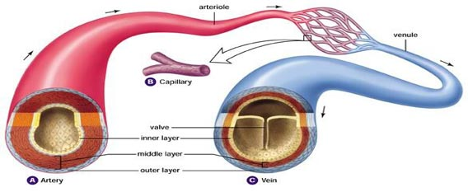

Slide 23
Why is the middle muscle layer of the veins thinner than those found in the arteries?
Blood in the veins has lost its pressure due to the distance it has been transported, and due to being squeezed through the capillaries.
Blood in the veins has TWO problems.
Not enough pressure to travel back to the heart.
Blood may flow backwards due to gravity.
Muscular movements such as running/walking assist is creating a squeezing force.
Semi-lunar valves are found at intervals in the veins.

Slide 25
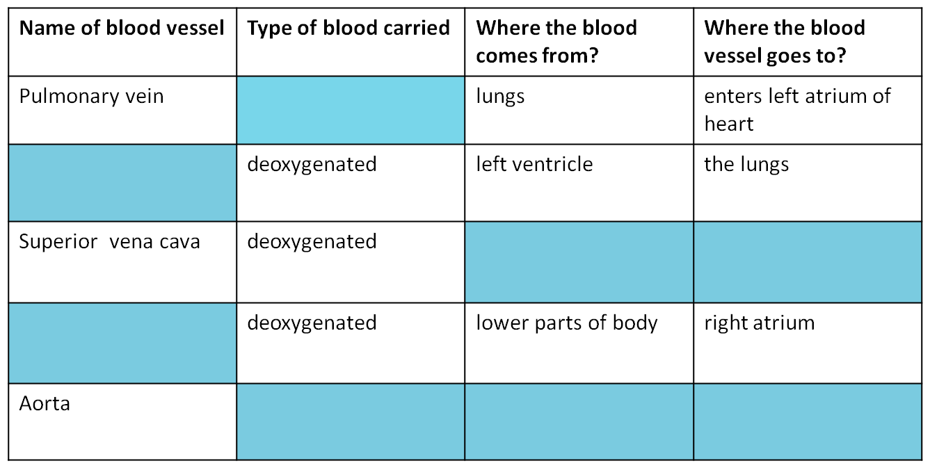
Copy this table showing the different blood vessels found in the heart and complete it.

Slide 26
Solution
Table showing the different blood vessels found in the heart.
Name of blood vessel | Type of blood carried | Where does the blood come from? | Where does the blood go to?
Pulmonary vein | oxygenated | lungs | The left atrium of the heart
Pulmonary artery | deoxygenated | Right ventricle | The lungs
Superior vena cava | deoxygenated | The upper parts of the body | The right atrium of the heart
Inferior vena cava | deoxygenated | The lower parts of the body | The right atrium of the heart
Aorta | oxygenated | Left ventricle of the heart | All parts of the body

Slide 27
Double Circulation
Humans have two circuits of blood flow. This is called double circulation. This means that blood flows in two different directions at the same time.
These two circuits of blood flow are :
The pulmonary circuit.
The systemic circuit.
In the pulmonary circuit blood flows from the heart to the lungs and back to the heart.
In the systemic circuit blood flows from the heart to all parts of the body and back to the heart.

Slide 28
Double Circulation

Slide 29
Pulmonary circulation
Right ventricle contracts
Deoxygenated blood pumped into the pulmonary artery.
Pulmonary artery splits into two branches leading to the two lungs.
Artery branches off to form capillaries which infuse into the lungs to oxygenate blood.
Carbon dioxide and other waste products diffuse out of the blood and are exhaled.
Oxygen is inhaled which diffuses into the blood.
Capillaries rejoin to form the pulmonary vein.
Pulmonary vein opens into left atrium.

Slide 31
Systemic circulation
The left ventricle contracts.
Oxygenated blood is forced – under high pressure - into the aorta.
Aorta branches out to form capillaries.
Capillaries infuse each and every organ and cell in the body.
Oxygen diffuses into cells and organs.
Waste products and carbon dioxide diffuses into blood vessels.
The blood is now deoxygenated.
Blood vessels exit organs and cells as capillaries which later join to form veins.
Veins join to form the superior and inferior vena cava which opens into the right atrium.

Slide 32
Systemic Circulation

Slide 33
Special circulations
In the systemic circulation:
Coronary circulation
Portal circulation
Coronary circulation:
Two branches arise from the aorta known as the coronary arteries.
They immediately divide to form capillaries which infuse into the cardiac muscle.
They provide the muscle with rich oxygen, glucose and carry away the carbon dioxide and waste products produced by the tissue.
They rejoin to form the coronary vein which opens into the right atrium.

Slide 35
Portal circulation
Branches off from the aorta.
The portal circulation carries oxygenated blood to the alimentary canal (stomach, intestines, etc.).
The artery branches off to form capillaries which absorb digested nutrients from the contents of the intestine.
The capillaries rejoin to form a vein known as the hepatic portal vein which carries the blood to the liver.
Once past the liver, the veins rejoin and join the inferior vena cava which leads back to the right atrium.

Slide 37
Activity 2.3.7 Page 213

Slide 38
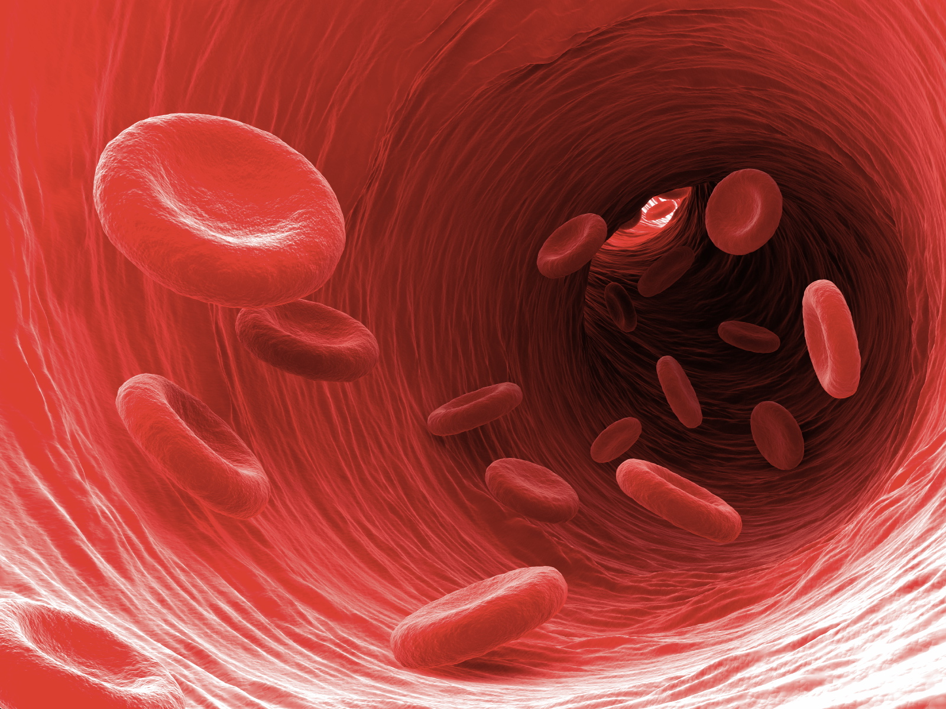
Blood!!!

Slide 39
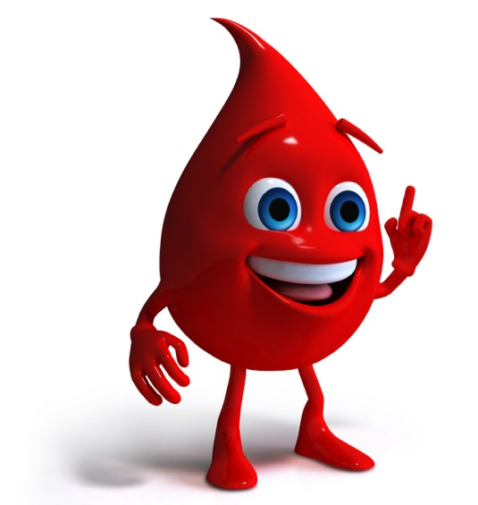
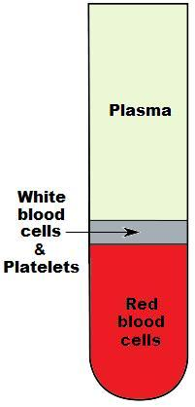
Slightly salty, sticky, dark red fluid.
pH = >7 (slightly alkaline)
The human body has abut 5 – 6 litres of blood.
55% of blood is plasma
45% is corpuscles
The liquid plasma is 90% water and 10%
Dissolved substances (digested food, salts,
Gasses, excretory wastes, etc).

Slide 40
Three types of corpuscles:
RBC’s – Erythrocytes
WBS’s – Leucocytes
Blood Platelets
Erythrocytes are disk shaped, have no nuclei and contain a pigment haemoglobin.
Leucocytes are irregular shaped and have nuclei.
Platelets are fragments of cells with no nuclei.

Slide 41
Functions of blood tissue
Each blood tissue has its own unique functions.
Blood Plasma:
Acts as the transport system of digested food substances.
Plasma proteins assist with clotting. (fibrinogen)
Transports salts and gasses.
Transports hormones and enzymes.

Slide 42
The main function of erythrocytes is
To transport oxygen.
The oxygen dissolves in the haemoglobin
to form oxyhaemoglobin.
The leucocytes:
Protect the body and make up the immune system.
Engulf microbes
Form a barrier against microbes.
Produce antibodies which destroy microbes.
Blood platelets play an important role in the clotting of blood.

Slide 43
Functions of the blood system
Overall, the blood system has three main functions:
Absorb and transport digested food.
Absorb and transport oxygen.
Transports excretory waste to relevant organs.

Slide 44
The lymphatic system
Blood in the capillaries are under a great deal of pressure.
The pressure forces some of the blood
plasma out of the capillaries.
The blood plasma surrounds the cells
and is now called tissue fluid.
Some of this tissue fluid would enter the lymph vessels and is now called lymph.
Some tissue fluid re enters the blood
capillaries and is more blood plasma.

Slide 45
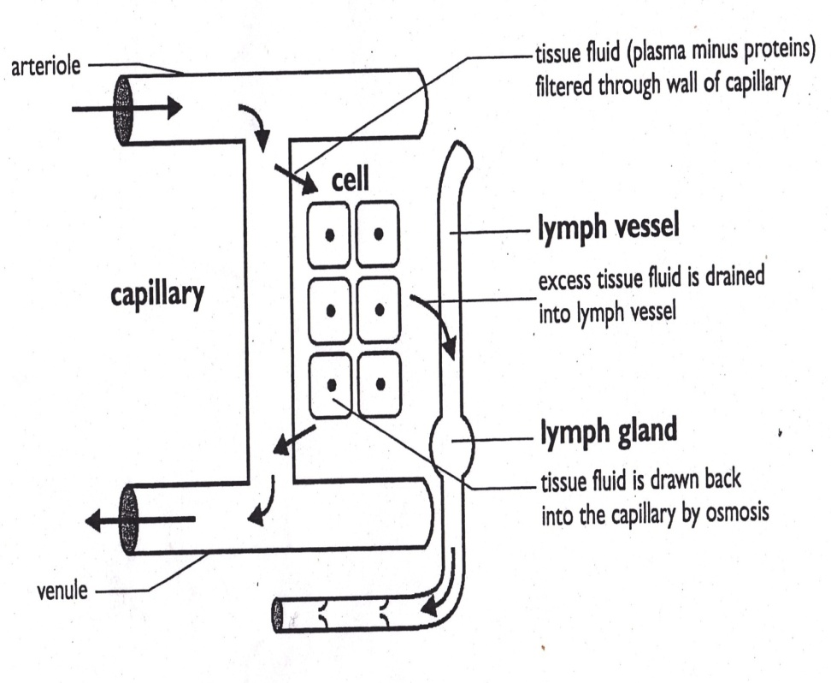
The Lymphatic System

Slide 46
Lymph capillaries are blind-ended thin walled vessels.
These lymph capillaries are found in all tissues except the brain and spinal cord.
The lymph capillaries rejoin to form lymph venules.
These lymph venules join to form lymph ducts .
The largest of these lymph ducts are the left thoracic duct and the right lymphatic duct.
The left thoracic duct drains lymph from the intestines, legs and left side of the body and returns it to the left subclavian vein.
The right lymphatic duct drains lymph from the upper and right portion of the body and pours this lymph into the right subclavian vein.
The subclavian returns the lymph to the right atrium of the heart
The lymphatic system helps to return fluid to the heart.

Slide 47
Functions of the lymphatic system
Helps return fluid to the heart.
The lacteal, which is the lymph vessel inside the villi or the intestines, helps in the absorption and transport of fat around the body
Lymph glands or lymph nodes play a vital role in destroying diseases. If you have a sore throat, the glands in your neck swell to indicate infection.

Slide 48
Homework ☺
Activity 2.3.8
Page 215

Slide 49
Terminology test
8. The vein that carries deoxygenated blood from the upper parts of the body to the right atrium of the heart.
9. Vein that carries deoxygenated blood from the lower parts of the body to the right atrium of the heart.
10. Tissue that separates the heart into right and left halves.
11. Valves found at the entrance of blood vessels to prevent the backflow of blood.
12. Tissue fluid that enters the lymph vessels
13. Circuit of blood that flows from the heart to the lungs and back to the heart
14. Circuit of blood from the heart to all parts of the body and back to the heart.
Blood which has more carbon dioxide than oxygen.
Blood that has more oxygen than carbon dioxide.
Valve that is found between left atrium and ventricle
Valve that is found between right ventricle and atrium.
Large artery that carries oxygen blood out of the heart to all parts of the body.
Artery that carries deoxygenated blood from heart to the lungs
Vein that carries oxygenated blood from the lungs to the heart

Slide 50
Solution
Deoxygenated
Oxygenated
Bicuspid valve
Tricuspid valve
Aorta
Pulmonary vein
Pulmonary artery
Superior vena cava
Inferior vena cava
10. Vertical septum
11. Semi lunar valves
12. Lymph
13. Pulmonary circuit
14. Systemic circuit
Notes:
Note to the teacher:
This list can be used as a pre learning tool, were you can ask learners to copy them down and find their meanings before you begin the module.
It is also can be used as homework at the end of every sub section. Learners can be asked to define a few of these terms at the end of every sub section. The definitions appear on the last slide.

Slide 51
Diseases and disorders of the circulatory system

Slide 52
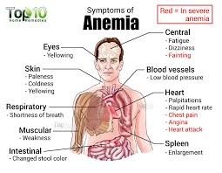
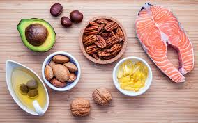
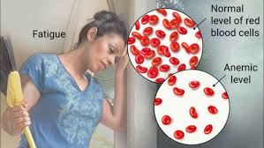
Anaemia - When a person has too few red blood cells due to a lack of iron. The person appears pale with no energy.

Slide 53
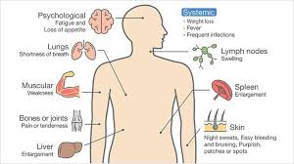
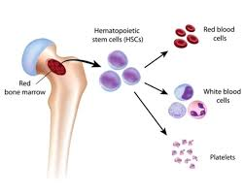
Leukaemia - A type of blood cancer that causes uncontrolled division of the leucocytes (white blood cells).

Slide 54
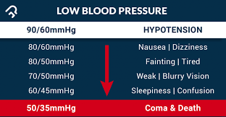
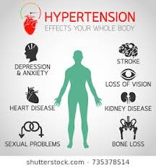
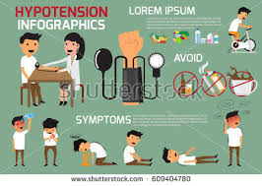
Blood pressure - Hypertension is high blood pressure and hypotension is low blood pressure. In high blood pressure, the heart has to work harder, which can lead to stroke, heart attack or kidney disease. In low blood pressure, a person feels dizzy and has fainting spells.

Slide 55
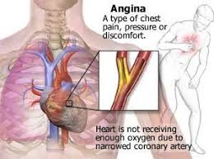
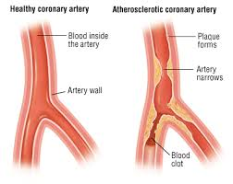
Angina, arteriosclerosis - Angina is chest pain associated with too little oxygen being delivered to the heart muscles. This can be associated with arteriosclerosis which is a narrowing of the arteries due to arteriosclerotic plaque.

Slide 56
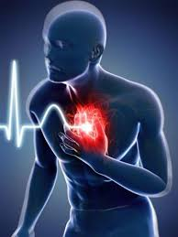
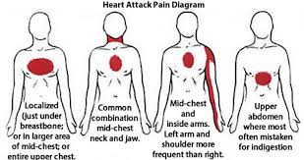
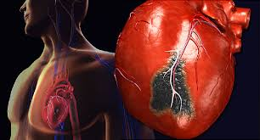
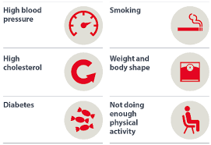
Heart attack In a heart attack, the coronary arteries, supplying oxygen to the heart, become blocked or they spasm. The heart no longer has enough oxygen to work and stops pumping.

Slide 57
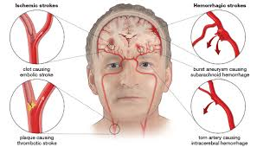
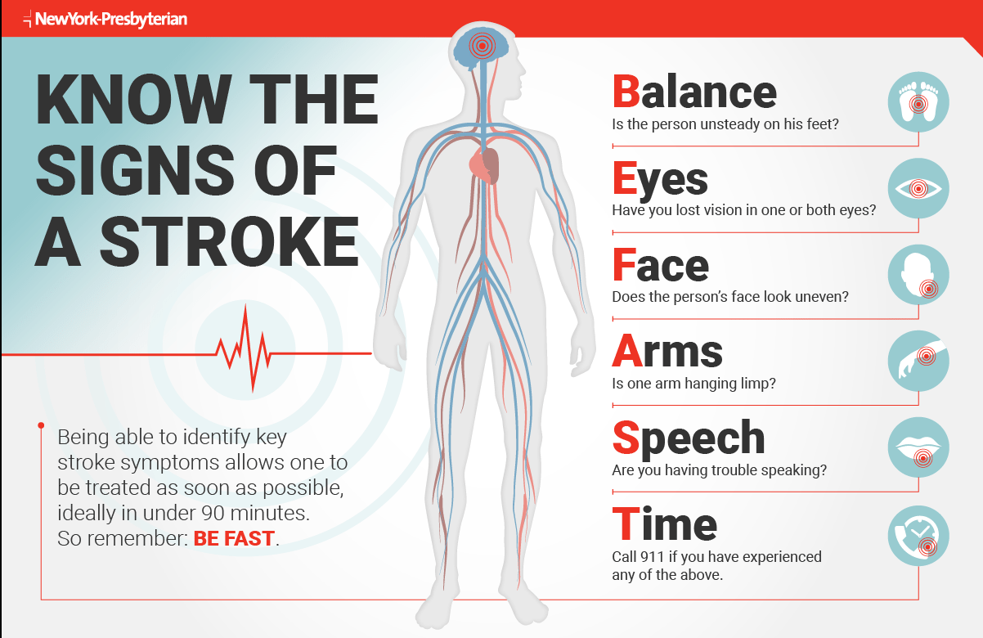
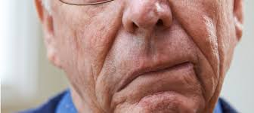
Strokes - In a stroke, a clot may form and block one of the arteries to the brain, starving it of oxygen, or a blood vessel may burst as a result of a blockage or hypertension and weakening of the artery walls.

Slide 58
2.3.9 pg 218

Slide 59
We are done with the Transport System in Mammals!!!

