Slide 1
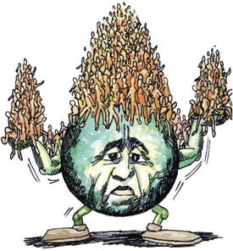
Human Population

Slide 2
It is evident from the graph that :- 1. the human population is increasing rapidly and shows a geometric (J-shaped) growth form 2. the population is doubling in shorter periods 3. the next doubling period (8 000 million) has been calculated to be in the year 2010 – a doubling period of 35 years 4. this increase in population CANNOT go on indefinitely – as environmental resistance (shortage of food, O₂ and living space) increases – something has to give – unless we are able to stabilise the population at the carrying capacity of the world
See pg 309-310
The time for doubling of the human population is_______
Trend in the human population growth from 1650 to the present moment

Slide 3
Worldwide human population growth from 1750 to 2000

Slide 4
Human population growth according to History

Slide 5
Trends in human population before 1650 were based on estimates.
Estimates of the human population up to 1650 when the first censuses were taken, were based on radiocarbon dating procedures
They determined the date of fossils and weapons
The number of weapons were used to estimate population size
The geographical distribution of the archaeological sites which contained the weapons and tools indicated the distribution of the population
According to this estimate the human population rose from 5 million ten thousand years ago (8000 BCE) to between 200 and 300 million at the beginning of the current era (0 CE)

Slide 6
Trends in human population from 1650 up to the Present Time based on census data
Determination of the human population size from 1650 to the present time was by means of censuses.
By 1650 the population was about 500 million
1850 (200 years later) the population doubled to 1000 million
1930 (80 years later) the population doubled to 2000 million
1975 (45 years later) the population doubled to 4000 million
1999 (24 years later) the population was 6000 million
© Lizette Neethling
0828246343

Slide 7
What are the reasons for human population growth continuing exponentially?

Slide 8
Originally the population was very slow, because
people died from starvation and disease
Infant mortality rates were very high
In the last 1000 years the population growth has increased exponentially
Reasons:
Humans have reduced environmental resistance
1. They have increased the carrying capacity of the world’s
food- producing regions
How?
Food production has increased due to:
- More land being cultivated
- Improved methods of food production and using artificial fertilizers to increase the yield of the monoculture crops
2. Methods of treating diseases have improved greatly
- This has allowed people to stay alive to reproduce

Slide 9
How do population pyramids help us learn about population?

Slide 10
Differences between developed and developing countries. See table on page 312

Slide 11
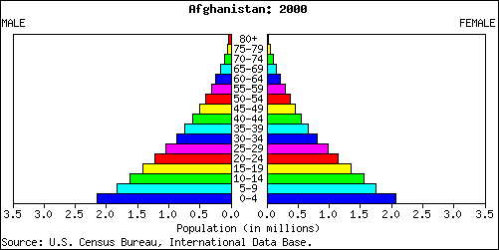
Population pyramids are used to show information about the age and gender of people in a specific country.
Male
Female
There is also a high Death Rate.
In this country there is a high Birth Rate
Population in millions
This population pyramid is typical of countries in poorer parts of the world

Slide 12
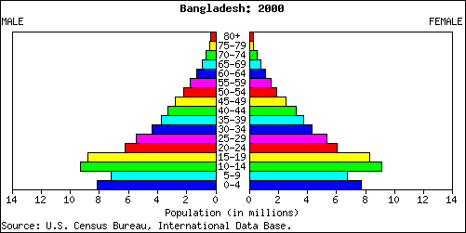
In some countries the government is encouraging couples to have smaller families. This means the birth rate has fallen.

Slide 13
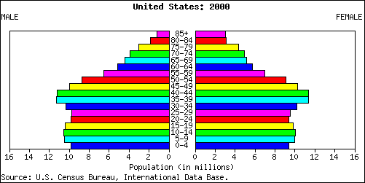
Male
Female
The largest category of people were born about 40 years ago.
In this country the number of people in each age group is about the same.
Population in millions
In this country there is a low Birth Rate and a low Death Rate.
This population pyramid is typical of countries in the richer parts of the world
Developed countries

Slide 14
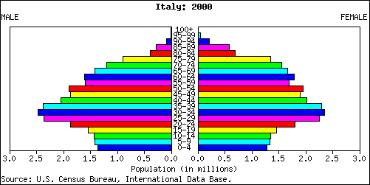
Male
Female
Population in millions
In this country the birth rate is decreasing.
In the future the elderly people will make up the largest section of the population in this country.
This is happening more and more in many of the world’s richer countries.

Slide 15
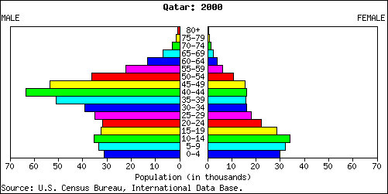
Male
Female
Population in thousands
This country has a large number of temporary workers. These are people who migrate here especially to find a job.

Slide 16
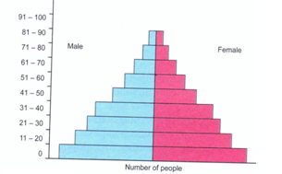
Graph of a developing country
This pattern is typical of less economically developed countries (LDC) like South Africa, South America and Asia (excluding Japan)
Age (years)
Male (%)
Female (%)
High birth rate
Rapid fall in each upward age group due to high death rate, short life expectancy as found in developing countries. (Africa, Asia)

Slide 17
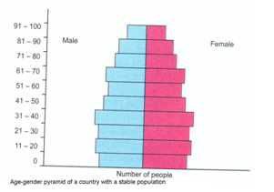
A graph showing a stable population
There is approximately the same number of young people and old people. About the same number of children is born each year compared to the number of people who die each year. Economical developed countries like Ireland have this kind of pyramid
Low birth rate
Low death rate, long life expectancy as found
in affluent countries. (Sweden and Norway)

Slide 18
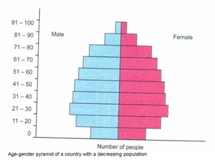
A graph showing a declining population
There are more old people than young people. Each year more people die than are born. Developed countries like Germany have this kind of pyramid. Some southern African countries, like Botswana (experiencing the effects of HIV/AIDS) are also starting to show this kind of age-gender pyramid.

Slide 19
Act 3.5.2 pg 315

Slide 20
Countries can be divided into two groups
Developed countries
They have a slow population growth (0,1% per year) some are even declining
High standard of living
Examples: North America, Europe, Japan
Developing countries
Rapid population growth (1,6% per year)
Lower standard of living
Examples: Latin America, Africa, Asia

Slide 21
Estimated population size for the future
Estimation is done as follows:
Studying present trends of population growth and calculation of the present growth rate
Extending this trend into the future to project population figures for years to come
One such projection indicates that human population would be more than 7000 million by the year 2010 and about 8000 million by 2019
Another estimation indicates the human population will reach 8000 in 2013

Slide 22
Forecasts of the human population in South Africa over the next 20 years
The rate of population increase is dropping
This is mainly due to HIV/AIDS
The birth rate has also decreased
BUT the birth rate is still higher than the death rate
There is also a big influx of uncontrolled immigrants to South Africa from Africa which masks the effect of HIV/AIDS

Slide 23
The impact of increasing human populations

Slide 24
the impact of a person, city, or country on the ecology of a local area or the whole planet. It is a measure of how much land and water a person, city or country needs and the wastes that are produced.
ECOLOGICAL FOOTPRINT

Slide 25
It refers to the area of land we require to support our lifestyle.
It shows how much productive land and water is used to produce all the resources we need and to absorb all the waste we make

Slide 26
The effect of high population growth on the environment (depletion of resources and increased pollution)

Slide 27
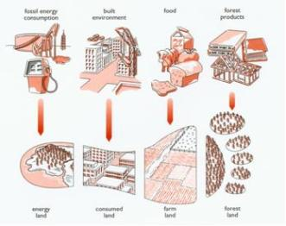
According to the Global Footprint Network, humanity uses the equivalent of 1.3 planets to provide the amount of resources we consume and absorb the waste we produce. This means it now takes the Earth one year and four months to regenerate what we deplete in a year.

Slide 28
Comparison between developed and developing countries’ ecological footprints
Developed countries have a low population growth, but high individual resource demands, far above basic requirements for survival
They have the biggest ecological footprints. Their economy requires far more land, energy and water and produce much more waste than developing countries
Developing countries have a high population growth and tend to exploit a country’s forests and other natural resources
The environment becomes degraded as the demands of the large population increase

Slide 29
Ecological Footprints
Developing countries
Developed countries
A high population growth
A low population growth
Demand on resources increase as population increase
Over consumption of resources
Heavy footprint
Heavy footprint

Slide 30
Comparison between developed and developing countries’ ecological footprints
Developed countries have a low population growth, but high individual resource demands, far above basic requirements for survival
They have the biggest ecological footprints. Their economy requires far more land, energy and water and produce much more waste than developing countries
Developing countries have a high population growth and tend to exploit a country’s forests and other natural resources
The environment becomes degraded as the demands of the large population increase
© Lizette Neethling
0828246343

Slide 31
Effects of high population growth on the environment
When population increases, the towns increase in size
This created the need to clear large areas of vegetation to create more living space
It also resulted in the exploitation of resources to satisfy the needs of such a large population
This lead to a further degradation of the environment through erosion, deforestation and global warming

Slide 32
What are we doing?

Slide 33
What will happen if this trend continue?

Slide 34
The effect of high population growth on the environment. The darker the colour, the greater the ecological footprints.

Slide 35
What can you do to save the world?

Slide 36
Sustainable: careful use of natural and human resources so that they will also be available to future generations Conservation: the management of the Earth’s resources so that it yields the greatest sustainable benefit to future generations while maintaining its potential to meet the needs of future generations

Slide 37
Human demands versus conservation in the harvesting of natural resources Abalone poaching is illegal

Slide 38
Human demands versus conservation in the harvesting of natural resources During 2010 more than 300 rhino’s have been pouched and killed for their horns in South Africa. The sad truth is that a rhino is worth more dead than alive. A rhino horn is valued at $20 000 (R14 000) per kg and a rhino horn weigh up to 5 kg. Currently a live rhino is sold at R130 000 – R300 000.

Slide 39
Ways in which over-exploitation of indigenous plants impacts on the environment.
Impact on environment
Plants can become extinct/leads to loss in biodiversity
Food chains/webs can be destroyed
Shortage of food
Could lead to degradation of the environment
Erosion of ground surface if too many plants are removed
Increase run-off of water
Destroy habitats of many organisms
Alien plant invasion
Upset the balance of oxygen and carbon dioxide/global warming

Slide 40
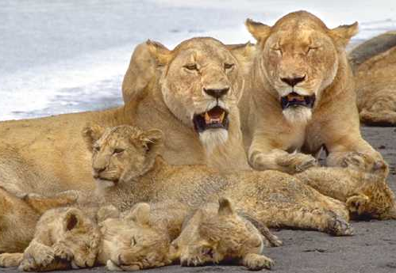
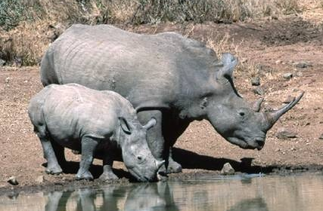
Appropriate management strategies that can reduce over-exploitation of animal resources
Sustainable hunting – over-exploitation must not be allowed
Research- done to look at reproductive cycle/cloning
Legislation- control hunting
Penalties for breaking legislation
Education/campaign - impact and
consequences of over-exploitation
Establish breeding/seed banks –
to replace animals harvested
Establish more nature reserves - to
conserve indigenous animals
Controlling exploitation- of indigenous
animals by international companies
Provision of free/cheaper food - to reduce
dependence on indigenous animals

