Slide 1
Food Security (link with population ecology dynamics)
1 human exponential population growth;
2- droughts and floods (climate change);
3- poor farming practices: monoculture; pest control,
4 loss of topsoil and the need for fertilisers;
5- alien plants and reduction of agricultural land;
6- the loss of wild varieties: impact on gene pools;
7- genetically engineered foods;
8- wastage.

Slide 2
FOOD SECURITY
Definition: having enough food, on a regular basis so as to ensure healthy living.

Slide 3
ACT. 3.6.9
1 Storage of water. Controlling flood waters. Supply water for irrigation. Source of hydro-power.
3. A layer of permeable rock filled with water. Ground water is extracted from this layer by boreholes.

Slide 4
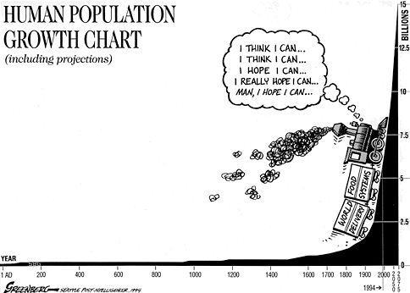
1. Exponential human growth
Increasing human populations require more food. This increases the risk of food insecurity

Slide 5
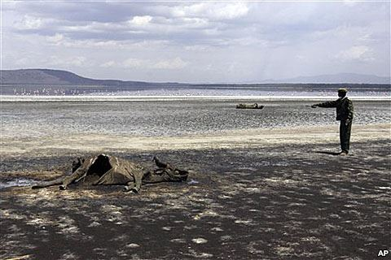
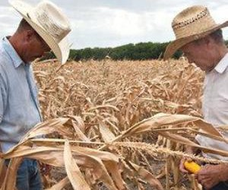
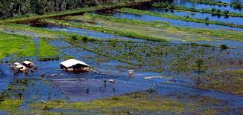
2. Drought and floods (climate change)
Drought and floods both reduce the availabilty of food.

Slide 6
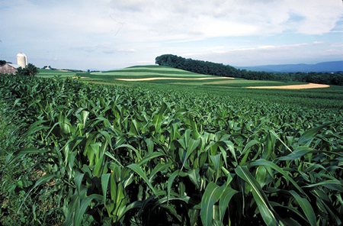
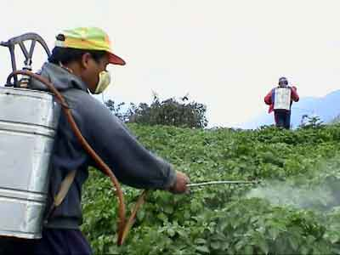
3 Poor farming practices. Monoculture
The planting of only one species (crop)
Pests can be very successful in such environments.
Pesticides- not always successful. Get washed into rivers etc.

Slide 7
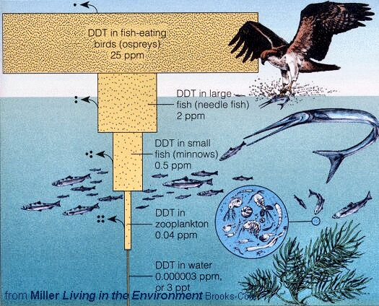
Bio accumulation (increased quantities as you move up the food chain)
Planting a variety of crops or biological control (introducing natural predators) may help.

Slide 8
4. loss of top soil
Planting the same type of crops over and over reduces the amounts of nutrients in the soil→ farmers use fertilisers. Also caused by over grazing
Over use of fertilisers:
- Causes oxygen deprivation of the soil.
- Produces GHG’s
Makes the soil the same all over.
Overgrazing also affects top soil.

Slide 9
5 Alien plants and the reduction of agricultural land
Alien plants take up space for agricultural land. They use up soil water and nutrients.

Slide 10
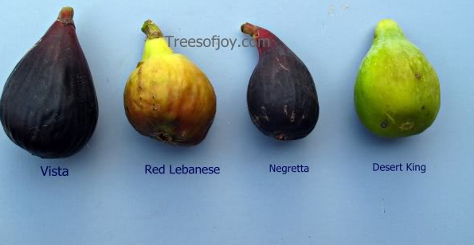
6. Loss of wild varieties: Impact on gene pools.
There is natural variation among plant species and crops.
Farmers only select one variety.
If new pests come about or climate changes drastically, all of the plants might be affected.

Slide 11
7. Genetically modified/engineered foods
Genetic engineering, the genes (for a good trait) of one plant are transferred to another plant. Plants are produced with desirable characteristics.
This biotechnology has improved food production, but it reduces wild varieties.

Slide 12
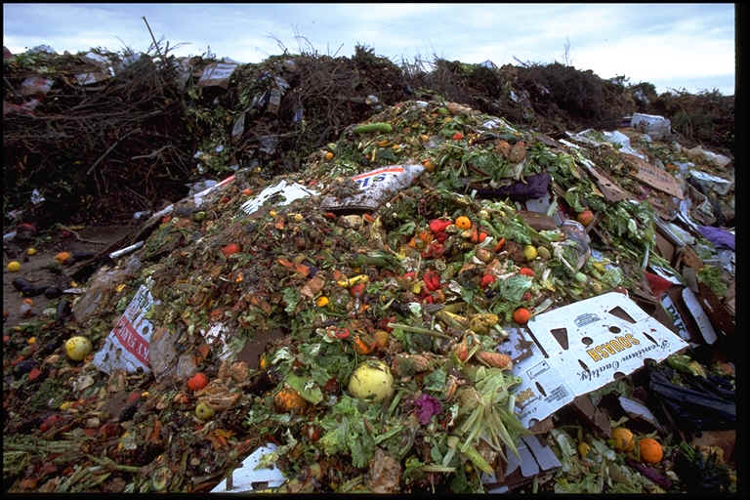
8. Food wastage
A lot of food is wasted.
During harvesting: pests, animal diseases, extremes of temp. and rainfall, machinery (immature crops) and demands of
the marketplace.
There is also
wastage during
processing and
consumption.

Slide 13
Loss of Biodiversity (the 6th extinction)
1. habitat destruction: farming methods, e.g. overgrazing and monoculture, golf estates, mining, urbanisation, deforestation; loss of wetlands and grasslands;
2. Poaching, e.g., for rhino horn, ivory and ‘bush meat’;
3. alien plant invasions: control using mechanical, chemical and biological methods; and
4. indigenous knowledge systems and the sustainable use of the environment e.g., devils’claw, rooibos, fynbos, the African potato (Hypoxis) and Hoodia.

Slide 14
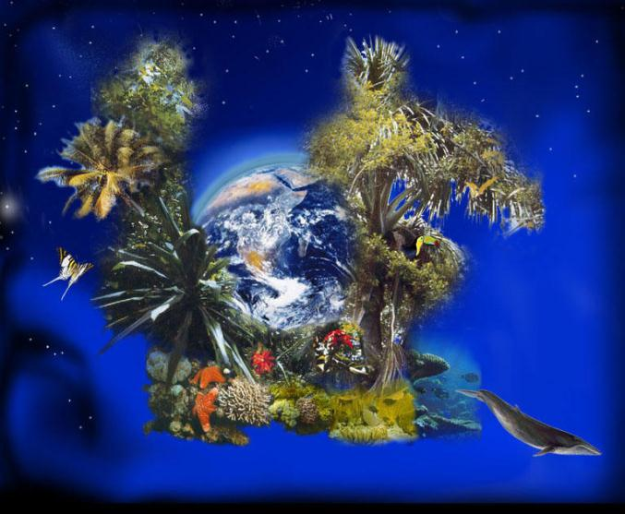
Biodiversity is the degree of variation of life forms within a given species, ecosystem, biome, or an entire planet. Biodiversity is a measure of the health of ecosystems. Biodiversity is in part a function of climate

Slide 15
The 6th mass extinction
Based on fossil evidence, most scientists agree that 5 mass extinctions have occurred.
The current loss of species (6th mass extinction) is referred to as a megafaunal extinction.

Slide 16
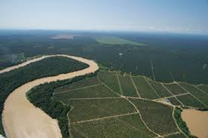
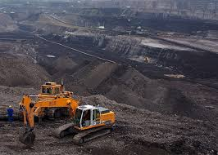
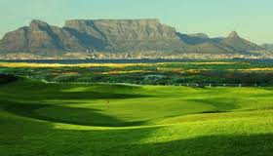
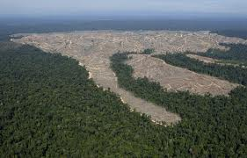
1. habitat destruction:
farming methods, e.g. overgrazing and monoculture, golf estates, mining, urbanisation, deforestation; loss of wetlands and grasslands.

Slide 17
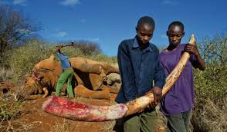
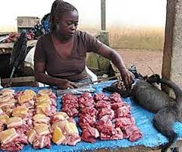
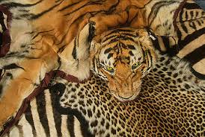
2. Poaching, e.g., for rhino horn, ivory and ‘bush meat’
Reasons for poaching pg 372.

Slide 18
Loss of Biodiversity (the 6th extinction)
Investigate: Rhino poaching in South Africa: read articles and make suggestions on how it can be prevented.

Slide 19
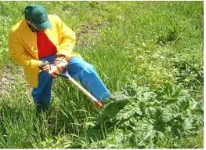
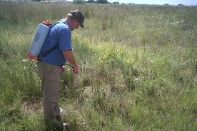
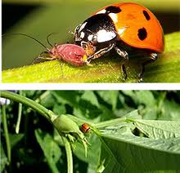
3. alien plant invasions:
Mechanical control- Physical removal. Costly and time consuming.
Chemical control- Using herbicides/pesticides. Contaminates water supplies, kill desirable organisms and some might develop resistance.
Biological control- Introducing natural predators/herbivores. The new species must not affect other species

Slide 20
4. indigenous knowledge systems and the sustainable use of the environment
Natural/ herbal remedies have less side effects, there is high demand for these species and over-exploitation.

Slide 21
DEVIL’S CLAW

Slide 22
Harpagophytum devils’ claw

Slide 23
Uses of devil’s claw
Only plant of SA in European Pharmacopoeia.
Tubers (underground stems) are used.
Relieves fever and pains.
Against hypertension.
Stimulates appetite.
Assists in digestion
Ointment for sores, rashes and boils.
Relief pain during pregnancy.

Slide 24
Hypoxis – African potato
Boosts immune system.
Aids fight against HIV/AIDS – cannot cure, however.

Slide 25
African potatoe Hypoxis
Tuber (root) used.
Boost immune system.
Stimulates formation of CD4-cells.
Decreases negative effects of chemotherapy.
Improves mobility of rheumatoid arthritis sufferers.
Supports treatment of XDR TB.

Slide 26
Hoodia Suppresses apetite
Hoodia gordonii used by San to suppress appetite in times of famine.

Slide 27
Hoodia
Hoodia hailed as new wonder slimming “drug”.

Slide 28
Rooibos tea Aspalathus linearis

Slide 29
Rooibos tea
Clanwilliam centre of rooibos tea cultivation.
Rooibos grows in poor soil.
Plant contains little nitrogen, is not eaten by cattle.

Slide 30
Use of Aspalathus
Rooibos is dried.
Green tea also produced.
Contain a lot of anti-oxidants e.g. Vit. C.
No caffein, little tannin.
Used as tea, also in cosmetics.

Slide 31
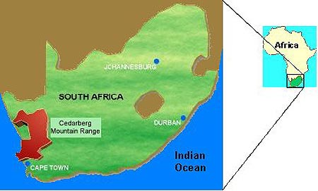
ROOIBOS TEA

Slide 33
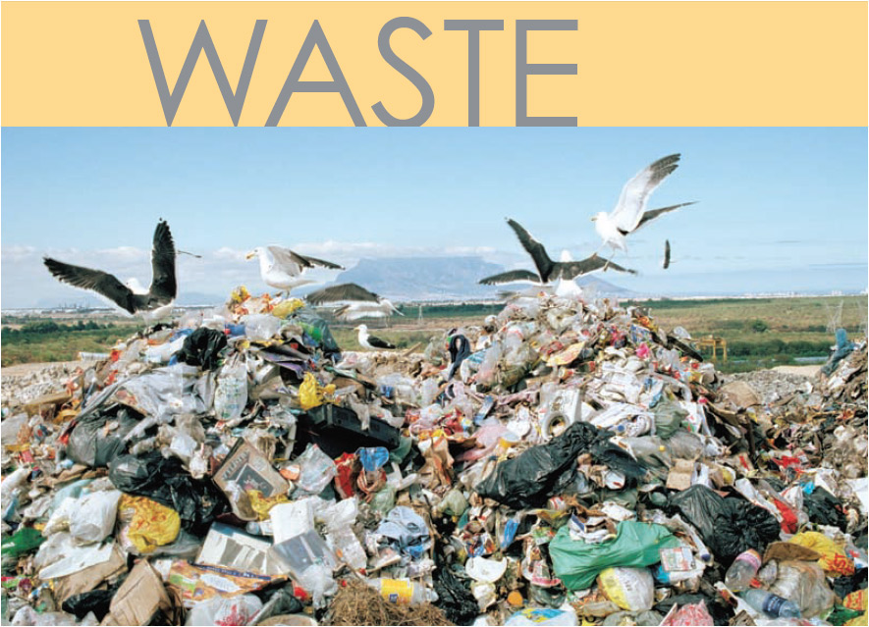

Slide 34
Solid Waste Disposal
- managing dumpsites for rehabilitation and
prevention of soil and water pollution;
- the need for recycling;
- using methane from dumpsites for domestic use:heating and lighting; and
- safe disposal of nuclear waste.

Slide 35
Solid Waste Disposal Industrial commercial and domestic waste.

Slide 36
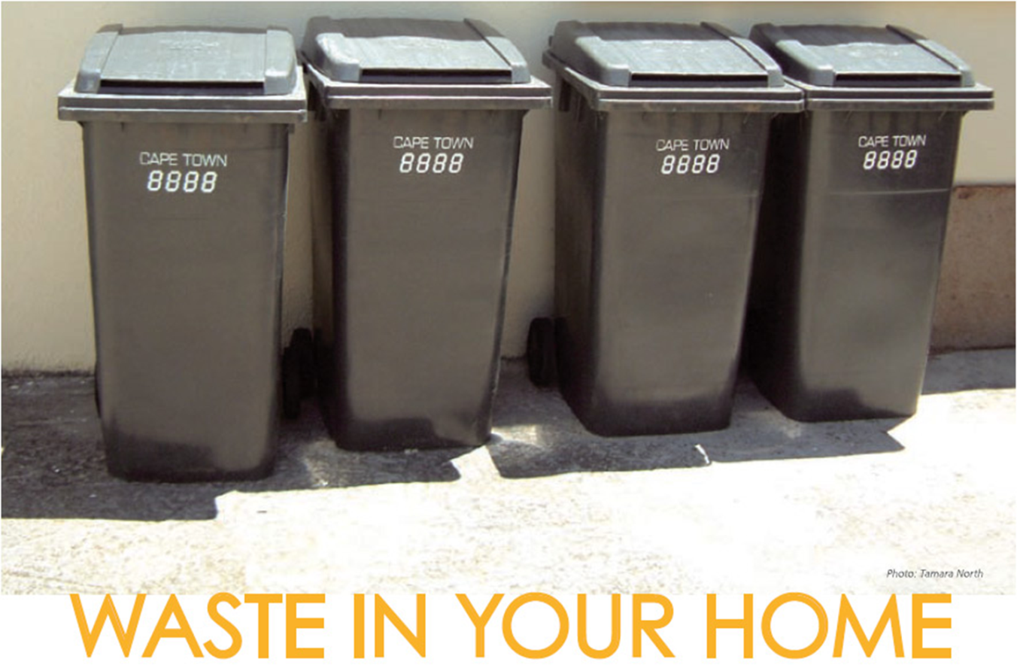
If anything in your dustbin can be reused by somebody else, recycled or repaired it should not be there!

Slide 37
Waste is Costly
The earth is a closed system.
Any nutrients and resources being taken out of the system (and buried in a landfill, or burnt) are resources lost to us.

Slide 38
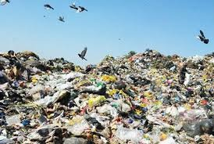
Dangers of dumpsites and landfill sites:
Home to vectors (carriers) of disease (e.g. mice)
Dust and unpleasant odours
Can pollute soil, aquifers, and water bodies
Decomposition releases GHG’s such as methane and CO2

Slide 39
Managing dumpsites for rehabilitation
Rehabilitation can prevent of soil and water pollution and allow the are to be reused.
Sort out and remove different types of waste
Cover with soil
Phytoremediation- Grow plant which remove toxins or detoxify soil
Use chemicals to remove toxins

Slide 40
Benefits of recycling
reduces the amount of waste going into landfill sites, saving airspace;
creates jobs and money for schools and organisations;
reduces pollution and litter;
saves raw materials needed to make new products;
reduces the need to import expensive raw materials;

Slide 41
Benefits of recycling
slows down the use of the world’s non-renewable (oil, coal and iron) and renewable resources (trees);
reduces energy costs in manufacturing of containers, packaging, etc.
saves water (used in packaging and product manufacture). Recycling paper uses 50% less water than paper that is made from wood pulp.

Slide 42
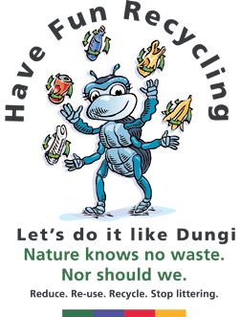

Slide 43
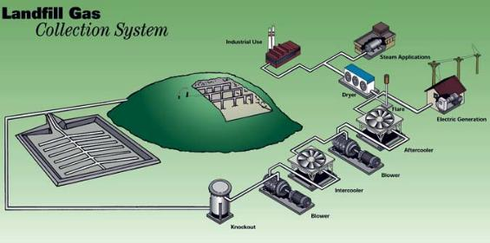
The use of methane from dumpsites for domestic use, such as heating and lighting

Slide 44
Safe disposal of nuclear waste
South Africa also uses radioactive material such as uranium to power its nuclear power station at Koeberg in the Western Cape. Unfortunately, a by-product of using uranium is nuclear waste that is still radioactive and therefore dangerous to living organisms. The nuclear waste is stored in thick steel drums and buried in trenches at special protected sites.

