Slide 1
Human Evolution

Slide 2
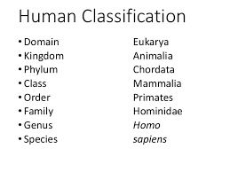

Slide 3
Evidence (Don’t need to write each)
• Anatomical differences and similarities between African apes and humans
• Fossil evidence
• Genetic evidence
• Cultural evidence

Slide 4
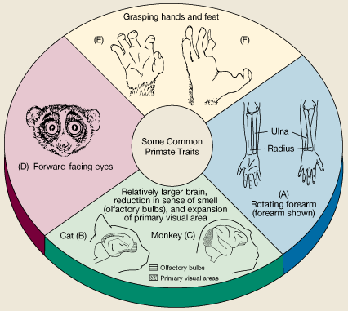
similarities between apes and humans
Flat nails instead of claws✓/bare finger tips
Opposable thumbs✓ which work in opposite direction to their fingers
Rotate hands at least 180º✓
Elbow joints allowing rotation of forearm✓
Long upper arms✓
Freely rotating arms✓
Upright posture✓
Large brains/skulls compared to their body mass✓
Olfactory brain centres reduced✓/reduced sense of smell
Parts of the brain that process information from the hands and eyes are enlarged✓
Eyes in front✓/binocular vision/stereoscopic vision
Eyes with cones✓/colour vision
Sexual dimorphism✓/distinct differences between male and female
Two mammary glands only✓

Slide 5
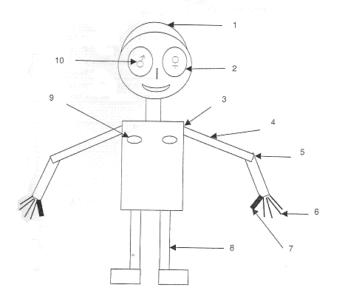

Slide 6
What are the differences?

Slide 7
Differences between apes and humans
Humans have :
Larger brain/cranium
Less protruding jaws/flat face (not prognothous)
Well developed chin
Brow ridges are not as pronounced
Forehead less sloped

Slide 8
Dentation: differences?

Slide 9
Smaller canines
Jaws with teeth on a gentle curve
No spaces between teeth

Slide 10
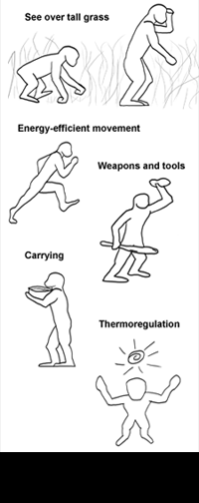
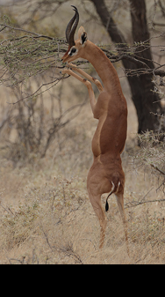
Bipedalism
2
Legs
A form of locomotion using 2 legs
Advantages
leaves hands free for other activities
Organism has a better view of surrounding as they are higher up.
A larger surface exposed to wind and a smaller surface to the sun

Slide 11
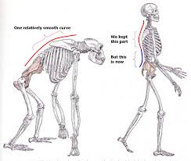
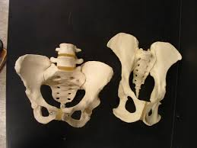
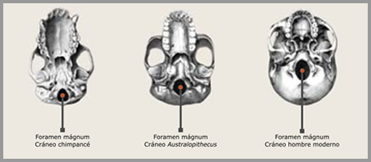
Evidence of bipedalism
Spine is s-shaped not curved (C)
Hip is short and broad to accommodate weight of upper body.
Foramen magnum is located beneath the skull not to the back of skull

Slide 12
Fossil evidence
Similarities of fossils to human skeletons have been used as evidence. Many fossil fragments have been found.

Slide 13
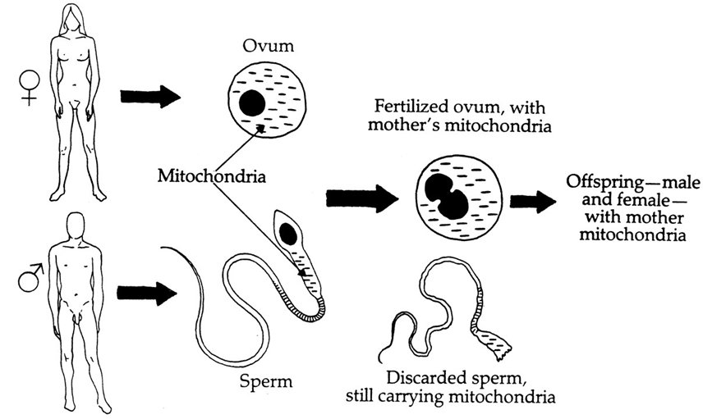
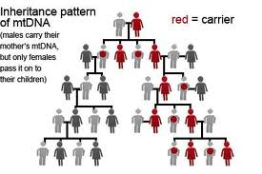
Genetic evidence
Mitochondrial DNA is only inherited from the mother
It is used to show maternal lineage
a search is made for mutations since individuals who have the same mutation must share the same common ancestor
“African Eve” ±120 000 years ago

Slide 14
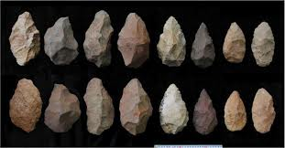
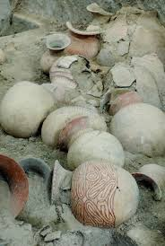
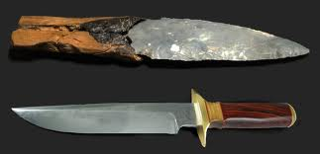
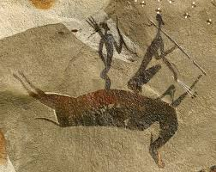
Cultural evidence
Tool making
Paintings, pots, etc

Slide 15
Out of Africa Hypothesis
All modern humans originated from a small group in Africa that migrated from there.
EVIDENCE FOR OUT OF AFRICA HYPOTHESIS:
* Fossil evidence (see worksheet on hominids)
* Mitochondrial DNA →“African Eve” ±120 000 years ago

