Slide 1
Human Endocrine System

Slide 2
Exocrine glands: release secretions through a duct (tube).
Endocrine: release secretions into blood to be transported.

Slide 3
What are hormones
Chemical messengers that are produced in one part of the body and function at another. They are usually proteins.

Slide 4
Location, hormone and function of hormone.
Hypothalamus
Pituitary Gland
Thyroid gland
Pancreas
Adrenal gland
Ovary
Testes

Slide 5
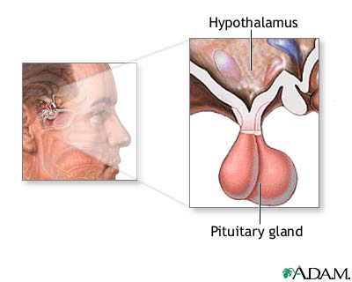
HYPOTHALAMUS: ADH (Anti-Diuretic Hormone)- aids in reabsorption of water by the kidneys. Shortage- dehydration
Excess- water retention

Slide 6
PITUITARY GLAND-
growth hormone, which stimulates the growth of bone and other body tissues and its metabolism;
prolactin, which activates milk production in women who are breastfeeding;
TSH (thyroid stimulating hormone), which stimulates the thyroid gland to produce thyroxin
For
Milk

Slide 7
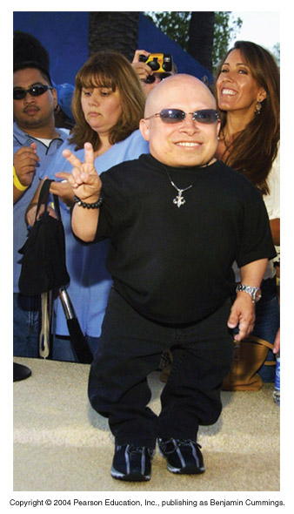
Hyposecretion (in children)
Dwarfism

Slide 8
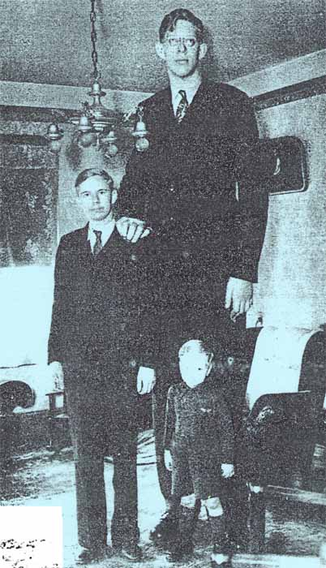
Hypersecretion (in children)
Gigantism

Slide 9
Hypersecretion (in adults)
Acromegaly

Slide 10
FSH which stimulates the development of the follicle in ovaries. Stimulates testes to produce sperm
LH which trigger ovulation and causes the formation of the corpus luteum. Stimulates production of testosterone

Slide 11
Summary of pituitary gland functions

Slide 12
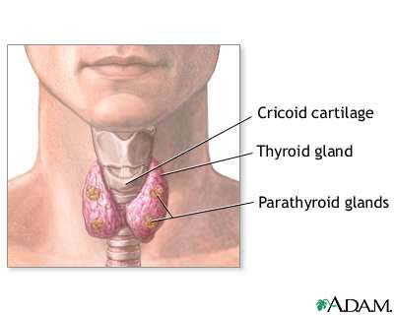
THYROID GLAND
Thyroxin- controls the body’s metabolism and thus the rate at which chemical reactions occur in the body. (controlled by TSH)

Slide 13
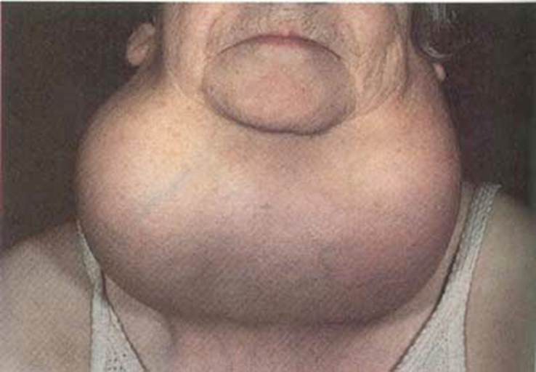
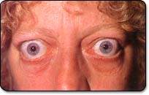
Hyperthyroidism (over secretion) Symptoms: weight loss, nervousness, tremors, excessive sweating, increased heart rate and blood pressure, protruding eyes, and enlarged thyroid gland (goiter).
Hypothyroidism (under secretion) slows body processes and may lead to fatigue, a slow heart rate, dry skin, weight gain, constipation, and, in kids, slowing of growth and delayed puberty.

Slide 15
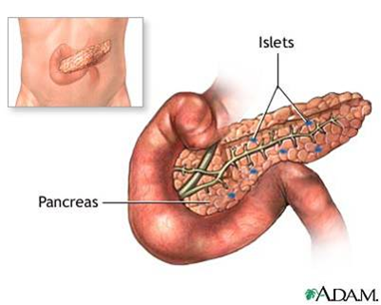
PANCREAS/ISLETS OF LANGERHANS
Insulin- decreases blood sugar level by converting glucose into glycogen to be stored in the liver and muscle tissue.
Glucagon- increases blood sugar level by converting glycogen into glucose.
Insulin
glucose glycogen
glucagon

Slide 16
Under-secretion (insulin) results in diabetes.
Symptoms: excessive thirst, hunger, frequent urination, and weight loss. Also kidney problems, nerve damage, blindness, and early coronary heart disease and stroke.
Type 1 diabetes. This happens when the pancreas fails to produce enough insulin. Treatment is an injection of insulin.
Type 2 diabetes. In this disease the body is unable to respond to insulin normally. control blood glucose levels by dietary changes, exercise, and oral medications. Some may require insulin injections

Slide 17
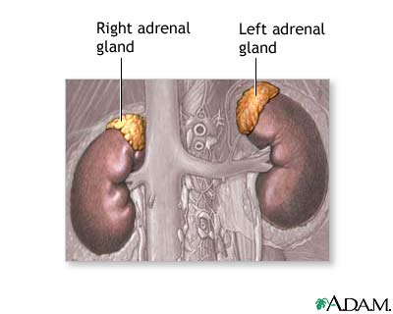
ADRENAL GLAND
Adrenalin – preparation for emergency situations. Increases heart rate, blood pressure, conversion of glycogen to glucose, blood flow to strategic organs, breathing rate and cellular respiration rate. It also allows for dilation of pupils, decrease in blood flow to intestines and skin (same as sympathetic nervous system).
Al
s
t
Al st
Aldosterone- increases reabsorption of sodium and water in the kidneys. This increases blood volume and also blood pressure.

Slide 18
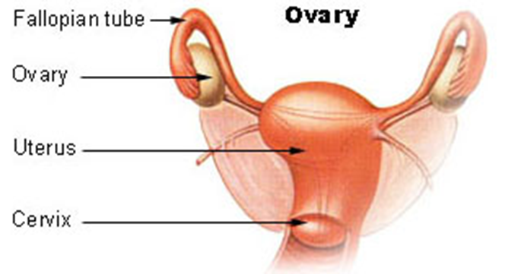
OVARIES
Oestrogen- secondary sex characteristics at puberty, causes thickening of the endometrium in preparation for implantation also prepare breasts for lactation (milk production)
Progesterone Further thickens the endometrium. Helps to maintain pregnancy.

Slide 19
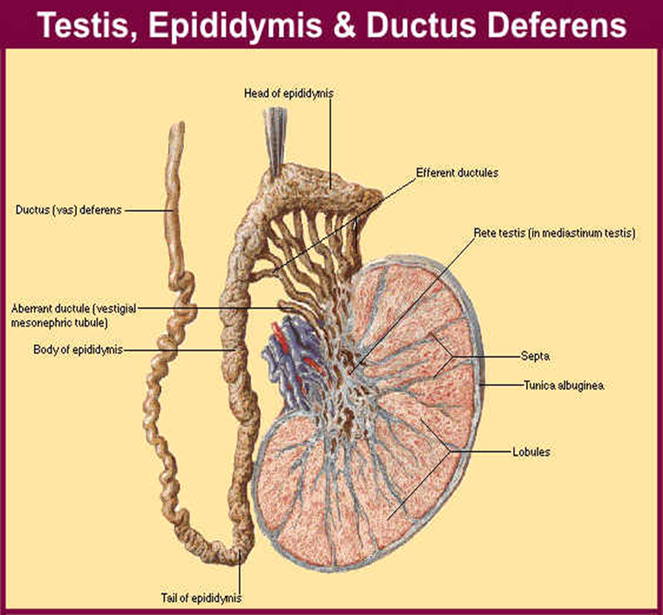
TESTES
testosterone spermatogenesis, and male secondary sexual characteristics

Slide 20
Negative feedback
The response to a change causes the opposite of the change.

Slide 21
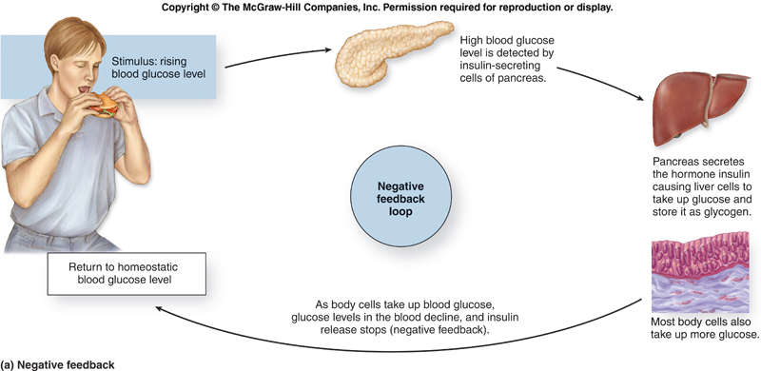
Negative feedback mechanism

Slide 22
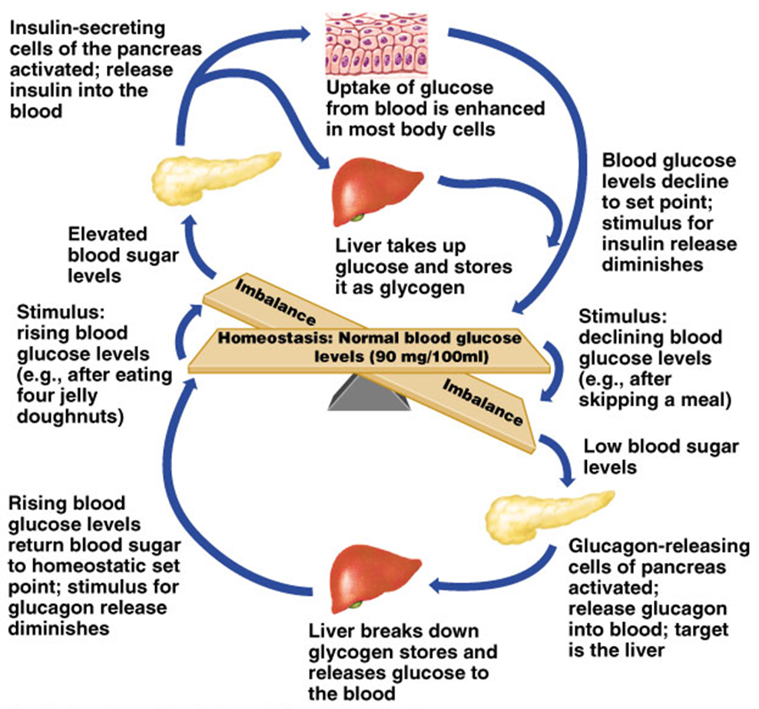

Slide 23
Negative feedback mechanism using TSH and thyroxin
The pituitary secretes thyroid-stimulating hormone (TSH) when the level of thyroxin (hormone secreted by the thyroid) falls below optimum.
This hormone is carried to the thyroid and stimulates its cells to produce more thyroxin which is released in the blood.
As the concentration of thyroxin rises to an optimal level and still continues to rise, the thyroxin level inhibits the production of TSH.
This causes reduced stimulation of the thyroid gland's cells and results in reduced production of thyroxin.

Slide 24
