Slide 1
Homeostasis
Same
State
maintaining a constant, internal environment within narrow limits, despite changes that take place internally and externally.

Slide 2
The conditions within cells depend on the conditions within the internal environment (tissue fluid).
Glucose , Carbon dioxide, Water, Salts, etc need to be kept constant within narrow limits.

Slide 3
General sequence of events in a negative feedback mechanism
Step 1: An imbalance is detected.
Step 2: A control centre is stimulated.
Step 3: Control centre responds.
Step 4: Message sent to target organ/s.
Step 5: The target organ responds.
Step 6: It opposes/reverses the imbalance.
Step 7: Balance is restored.
Can you use these steps to show regulation of glucose and thyroxin?

Slide 4
The regulation of carbon dioxide levels in the internal environment
When the CO2 level in the blood increases above normal levels:
Step 1 CO2 levels in the blood increase above normal levels
Step 2 Receptor cells in the carotid artery in the neck are stimulated
Step 3 To send impulses to the medulla oblongata in the brain
Step 4 Medulla oblongata stimulates breathing muscles (intercostal muscles and diaphragm) and heart
Step 5 Breathing muscles contract more actively – increases the rate and depth of breathing. The heart beats faster.
Step 6 More CO2 is taken to and exhaled from the lungs
Step 7 The CO2 level in the blood returns to normal

Slide 5
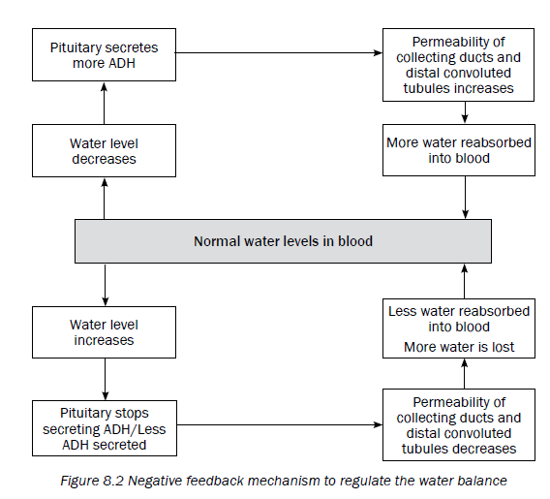
The regulation of water balance in the internal environment (osmoregulation)

Slide 6
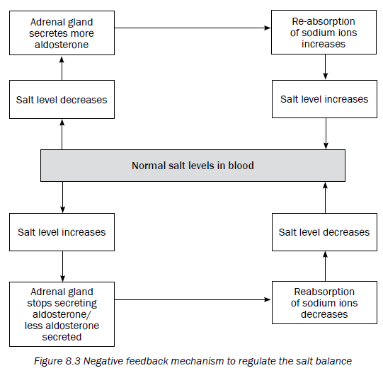
The regulation of salt balance in the internal environment

Slide 7
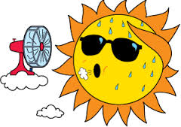
Temperature regulation
Keeping body temperature as close to 37 ̊C as possible to enable the body to function normally.
Control centre= hypothalamus
Target organ= skin (sweat glands and blood vessels)

Slide 8
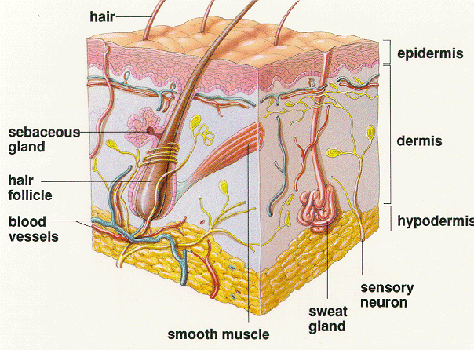
Skin

Slide 9
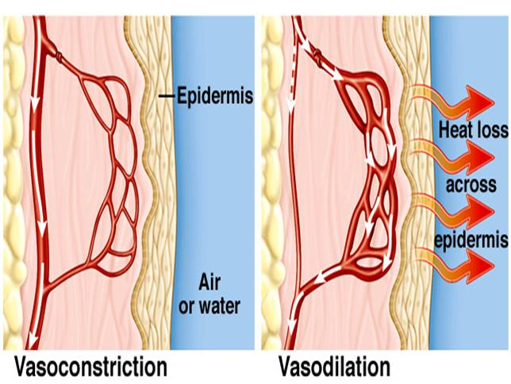
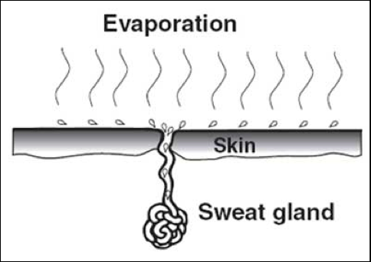
 | Hot day | Cold day
Control centre stimulated | Hypothalamus | Hypothalamus
Target organ | Skin | skin
Blood vessels to surface of skin | Dilate (vasodilation) | Constrict (vasoconstriction)
Blood flow to surface of skin | More | Less
Heat loss | More | Less
Blood to sweat glands | More | Less
Amount of sweat released and evaporated | More | Less
Cooling of skin | More | Less

Slide 10
