Slide 1
Excretion
The removal of harmful metabolic wastes

Slide 2
The gut
Not an excretory organ because waste produced are not metabolic wastes
Undigested and indigestible substances as faeces

Slide 3
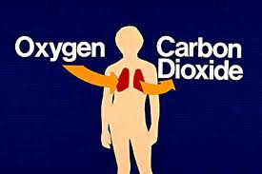
The lung
CO2 excreted by exhalation

Slide 4
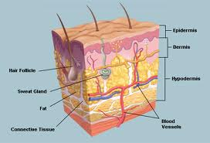
The skin
Excretes mainly water, also excess salts and urea (nitrogenous waste)

Slide 5
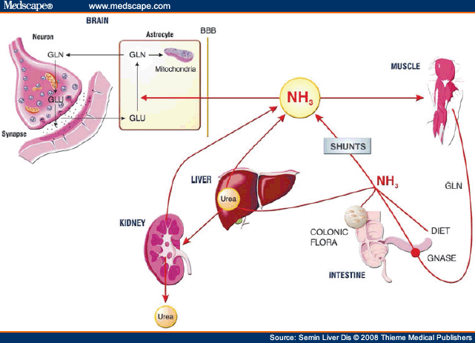
The liver
Excess amino acids → urea (de-amination) → kidneys

Slide 6
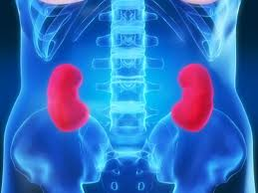
kidneys
Urea and uric acid + water + salts = urine →bladder → urination

Slide 7
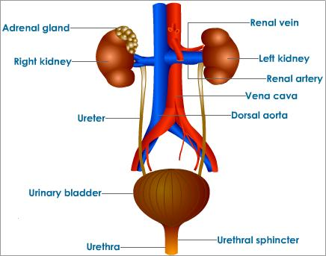
Urinary system (pg241-242)

Slide 8
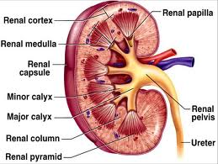
INTERNAL STRUCTURE (PG 242/3)

Slide 9
The nephron (smallest functional unit of the kidney)
DRAW AND LABEL A NEPHRON (similar to pg 243)

Slide 10
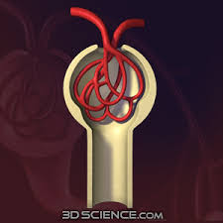
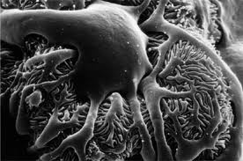
Malpighian body (242-244)
Glomerulus
Bowmans capsule
Podocytes

Slide 11
Renal tubules
Proximal convoluted tubule → descending limb (loop of Henle) → hair pin bend → ascending limb → distal convoluted tubules → collecting ducts

Slide 12
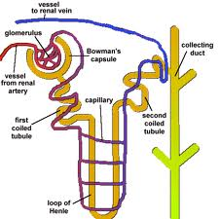
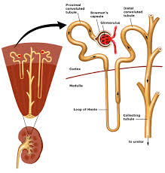
STRUCTURE OF NEPHRON

Slide 13
Activity 2.5.2 pg 245-246

Slide 14
Blood supply to nephron
Renal artery → afferent arteriole → glomerulus → efferent arteriole → 2nd capillary network → venules → renal vein → heart.

Slide 15
Functioning of the kidney

Slide 16
Blood to the kidney
Blood has water, salts, normal corpuscles and plasma, useful substances (post-digestion) and harmful substances (nitrogenous waste)

Slide 17
Glomerular filtration
Afferent is wider than efferent arteriole→ pressure.
Water, glucose, amino acids, urea, uric acid and salts move through podocytes → called glomerular FILTRATE → renal tubules.

Slide 18
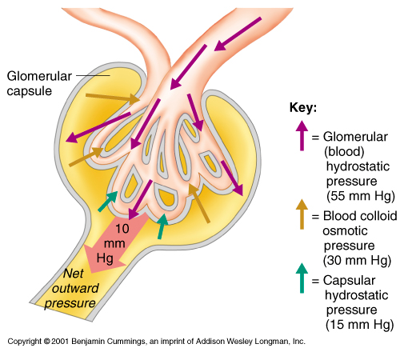

Slide 19
Tubular re-absorption
Proximal convoluted tubules- Useful substances (e.g. glucose) and some water
Sodium ions are pumped into the renal medulla. This causes water to move by osmosis out of the loop of Henle, distal convoluted tubules and the collecting ducts

Slide 20
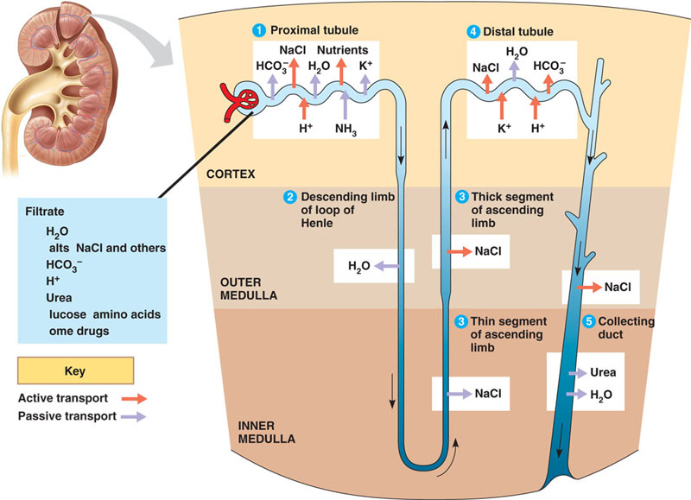

Slide 21
Osmoregulation by adh (pg 250-251)
Anti-diuretic hormone has a negative feedback mechanism.
See back of book homeostasis

Slide 23
Tubular excretion
Wastes (e.g. ammonia, creatinine, ions [K, H, Na and bicarbonate] and some drugs) are excreted from the blood to the tubules
Kidneys regulation of pH see pg 253.
Regulation of sodium (salt) in blood see pg 253-254
Aldosterone from the adrenal gland causes sodium to be reabsorbed.
See back of book

Slide 24
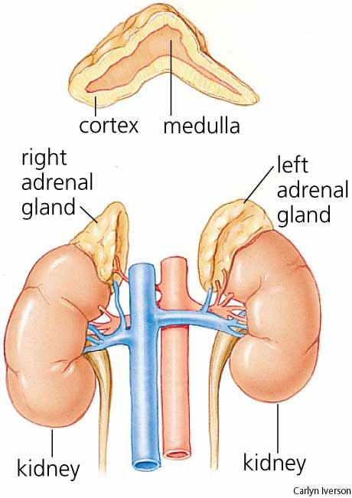

Slide 25
Urine to bladder and out
After re-absorption and excretion, urine → pelvis → ureter →bladder → urethra → exterior.

Slide 26
Functions of the kidney
Excretion of wastes
Regulation of salt content
Regulation of blood pH
Osmoregulation

Slide 27
Structural suitability of the kidney pg 257

Slide 28
Kidney stones
Undissolved salts form crystals, these can block tubes within the kidney causing pain.
Treatment: Surgery to remove or shockwave therapy to break down.

Slide 29
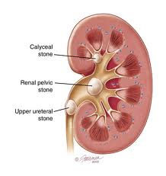
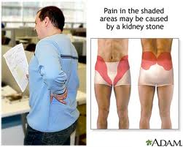
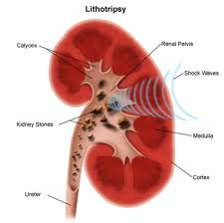
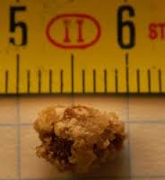

Slide 30
Infections
Caused by bacteria
Symptoms: fever, blood in urine, frequent and burning urination.
If not treated it can spread to the kidney
Treatment: antibiotics.

Slide 31
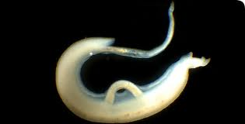
bilharzia
Cause: Parasite Schistosoma
Two hosts in life cycle, certain aquatic snails and humans
Symptoms: itchy skin when infected. Eggs in bladder cause blood in urine.
Prevention: don’t excrete near water.

Slide 32
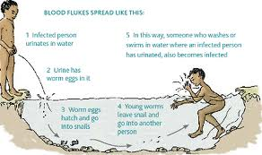
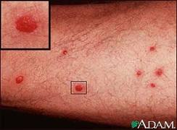
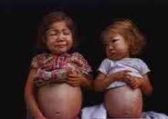

Slide 33
Injury to kidney
Cause: injury to back, e.g. accident, fall, weight lifting etc.

Slide 34
Kidney/renal failure
When kidneys don’t perform their functions
Acute kidney failure: sudden
Chronic kidney failure: develops slowly
Cause: high blood pressure and diabetes.
Symptoms: can be without symptoms until functioning at 25%
If functioning <= 15% → very ill
Treatment: dialysis / kidney transplant

Slide 35
Dialysis
Haemodialysis: Blood is filtered by a machine see diagrams pg 262

Slide 36
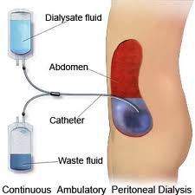
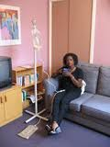
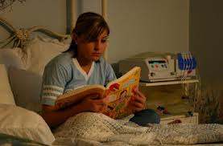
Peritoneal dialysis (Pg 261):

Slide 37
Kidney transplant
Kidney obtained from a matched donor. It is inserted as close as possible to the kidney that is damaged.

