Slide 2
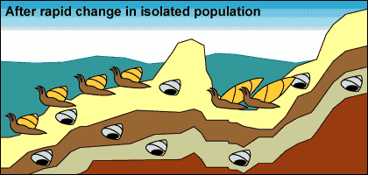
Punctuated equilibrium

Slide 3
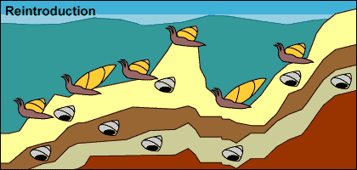
Punctuated equilibrium
Sea level rise, reuniting the isolated molluscs with their sister lineage

Slide 4
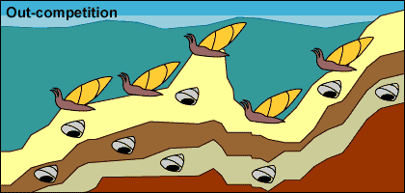
Punctuated equilibrium
Expansion and stasis: The isolated population expand into its past range, the isolated branch might outcompete their ancestral population ,causing it to go extinct like it is shown in this example

Slide 5
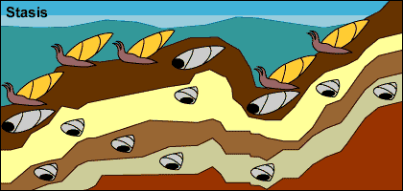
Punctuated equilibrium
Larger population size and large range move back to step 1 stasis with fossil preservation

Slide 6
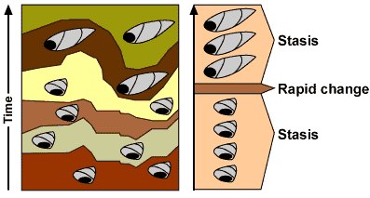
Punctuated equilibrium
This process would produce the following pattern in the fossil record:
Evolution happens in sharp jumps associated with speciation events

Slide 7
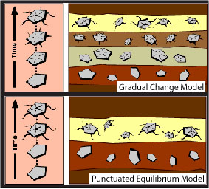
Punctuated equilibrium versus gradualism in the fossil record

Slide 8
Speciation: Formation of new species
Species : a group of organisms that have similar characteristics and are able to interbreed to produce fertile offspring.
Population : organisms of the same species occupying the same area at the same time
What conditions will
Organisms not be of the
same species?

Slide 9
Speciation and extinction
Speciation- The formation of a new species from a parent species. It increases biodiversity.
Extinction- When all members of a species die out.

Slide 10
2 parts:
Geographic isolation (separation by a geographic barrier)
Reproductive isolation (being unable to reproduce)

Slide 11
PROCESS OF SPECIATION
• If a population of a single species becomes separated by a geographical barrier (sea, river, mountain, lake),
• then the population splits into two populations.
• There is now no gene flow between the two populations.
• Since each population may be exposed to different environmental conditions,
• natural selection occurs independently in each of the two populations
• such that the individuals of the two populations become very different from each other
• genotypically and phenotypically.
• Even if the two populations were to mix again, they will not be able to reproduce with each other due to reproductive isolating mechanisms.
• They have thus become different species.

Slide 12
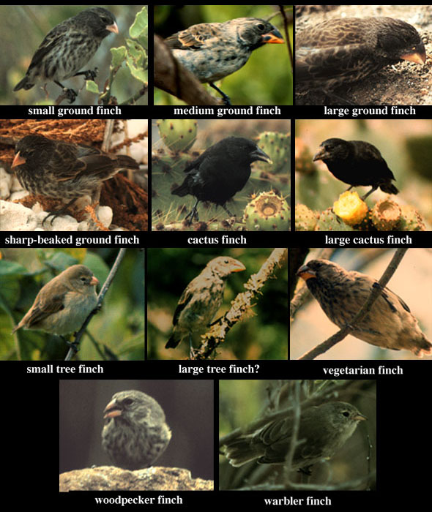
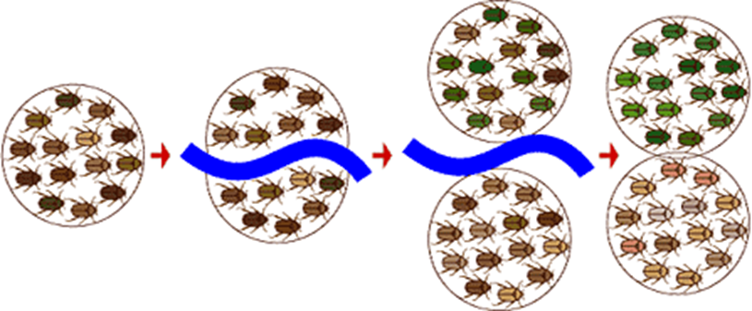
E.g. the finches of Galapagos.

Slide 13
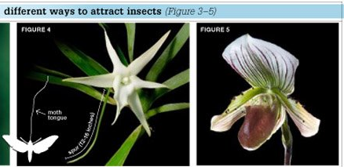
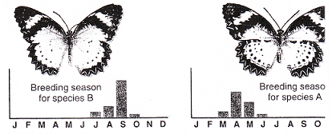
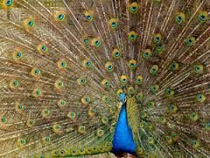
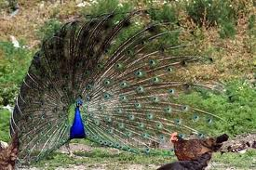
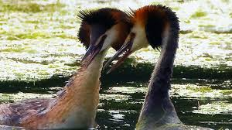
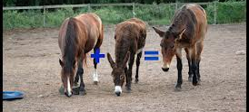
Mechanisms of reproductive isolation
Mechanism | Example 1
Adaptation to different pollinators | Two species of orchid have different length nectar tubes and are pollinated by different species of moths.
Breeding at different times of the year
Species-specific courtship behaviour
Infertile offspring

Slide 14
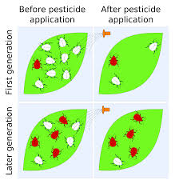
Evolution in present times pg332-337
e.g. DDT application

