Slide 1
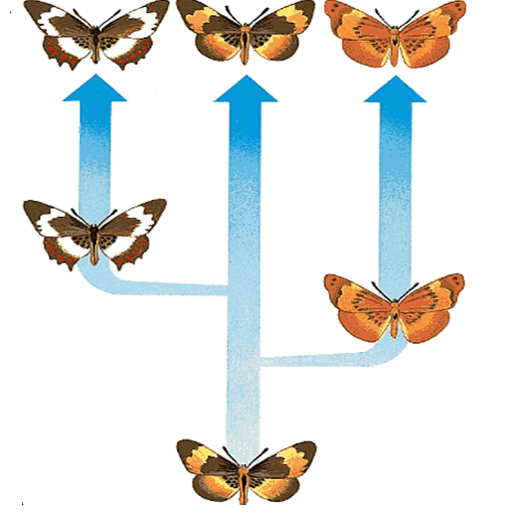
PUNCTUATED EQUILIBRIUM

Slide 2
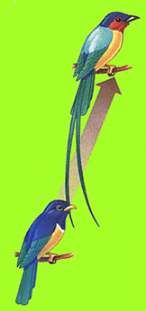
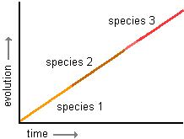
Graph of Gradual Evolution
Punctuated Equilibrium
Some biologists claim that most evolutionary change takes place as a result of a series of very small changes (‘gradualism’).
http://anthro.palomar.edu/synthetic/images/graph_of_phyletic_gradualism.gif

Slide 3
Others claim that there were long periods with no or little change and then short periods of rapid change (‘punctuated equilibrium).
Punctuated equilibrium predicts that a lot (rapid) of evolutionary change takes place in short periods of time tied to speciation events

Slide 4
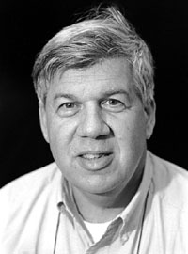
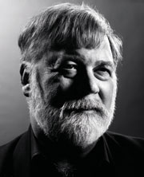
THE PUNCTUATED EQUILIBRIUM MODEL
Stephen J
Gould
Gould and Eldredge formulated this model (1972)
They observed that the fossil record gives a different picture of evolution
They claim that there were long periods of stasis (4-10 million years) involving little evolutionary change
Then occasional rapid formation of new species (5,000 - 50,000 years).
Niles Eldredge
© 2008 Paul Billiet ODWS

Slide 5
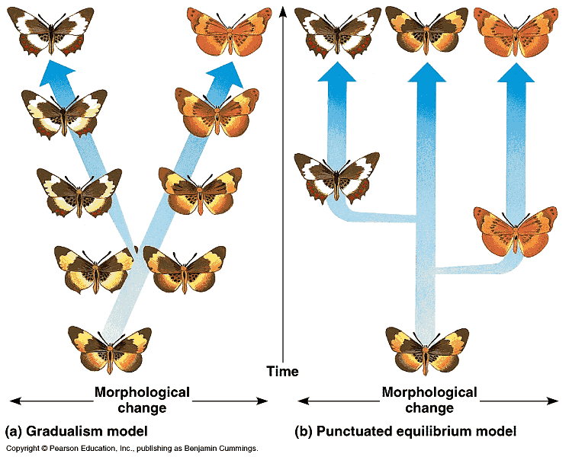
Two models

Slide 6
Punctuated Equilibrium (CAPSp.61)
Punctuated equilibrium is an important but often-misinterpreted model of how evolutionary change happens.
Punctuated equilibrium does not:
Suggest that Darwin's theory of evolution by natural selection is wrong.
Mean that the central conclusion of evolutionary theory, that life is old and organisms share a common ancestor, no longer holds.
Imply that evolution only happens in rapid bursts.

Slide 7
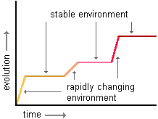
There are different phases in Evolution
Stasis (Gradualism)
Rapid change
(Punctuated equilibrium)
http://anthro.palomar.edu/synthetic/images/graph_of_punctuated_equilibrium_2.gif

Slide 8
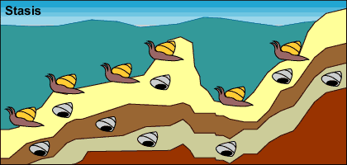
Punctuated equilibrium
Living ,dying and being fossilized - little observable evolution

Slide 9
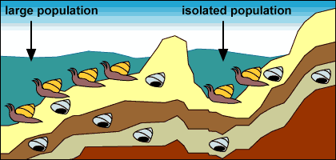
Punctuated equilibrium
Isolation – lake forms and isolate small population

Slide 10
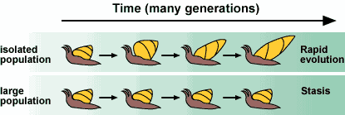
Punctuated equilibrium

