Slide 1
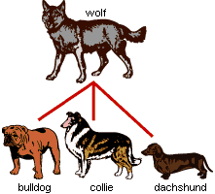
Artificial selection

Slide 2
Artificial selection
Occurs when people (not nature) select individuals with desirable traits to mate and produce offspring with these traits
This is also called selective breeding.

Slide 3
What is required:
V = Variation:
I = Inheritance:
S = Selection
T = Time:

Slide 4
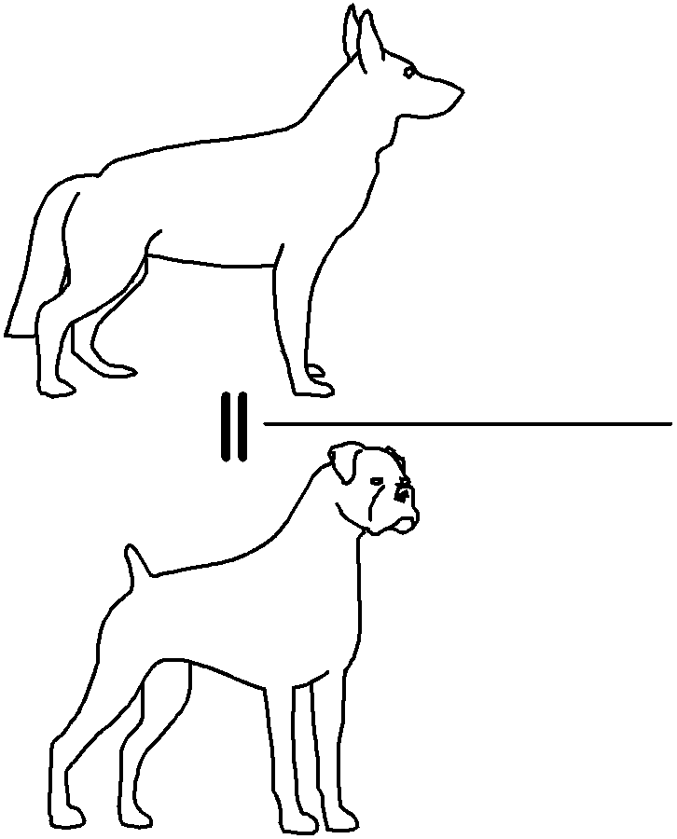
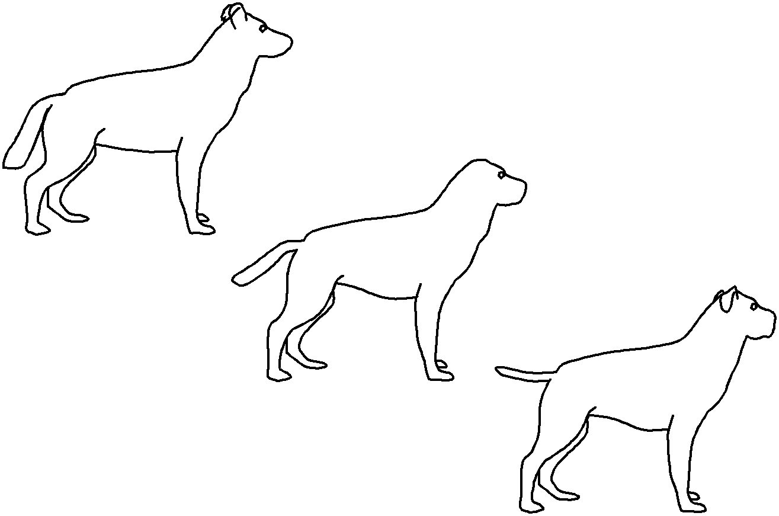
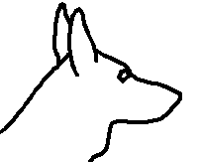
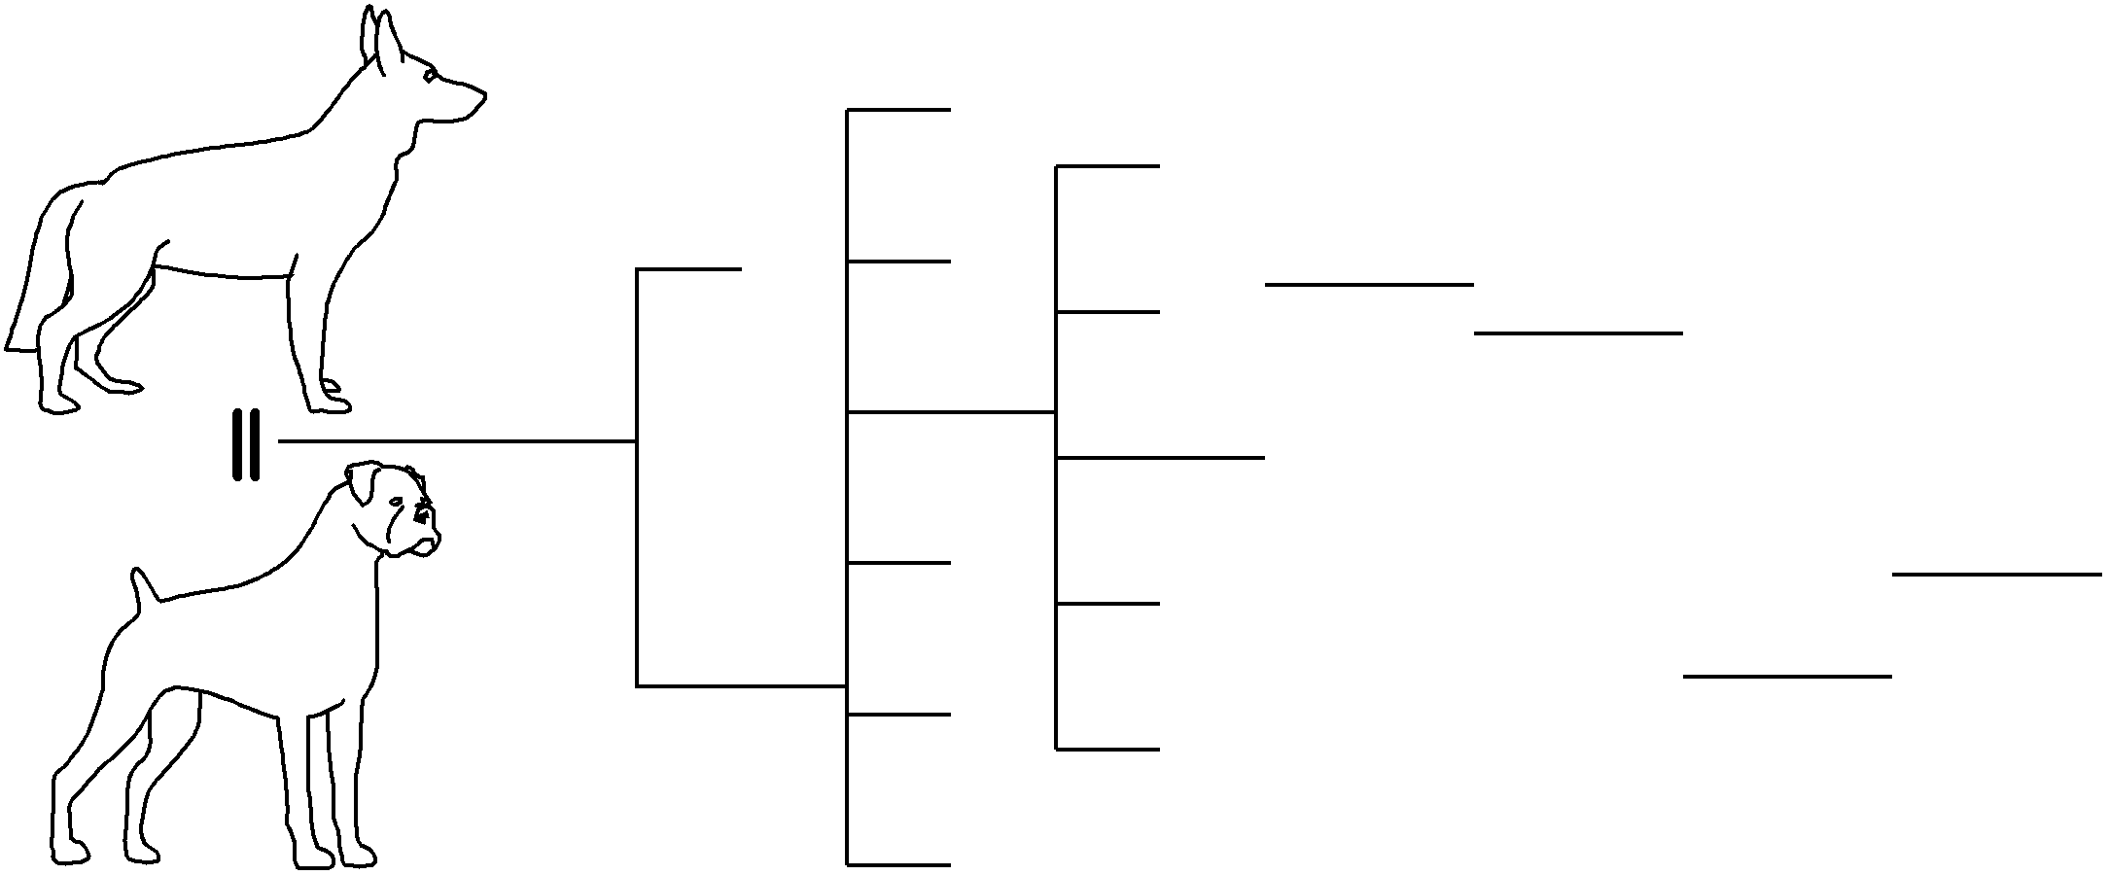
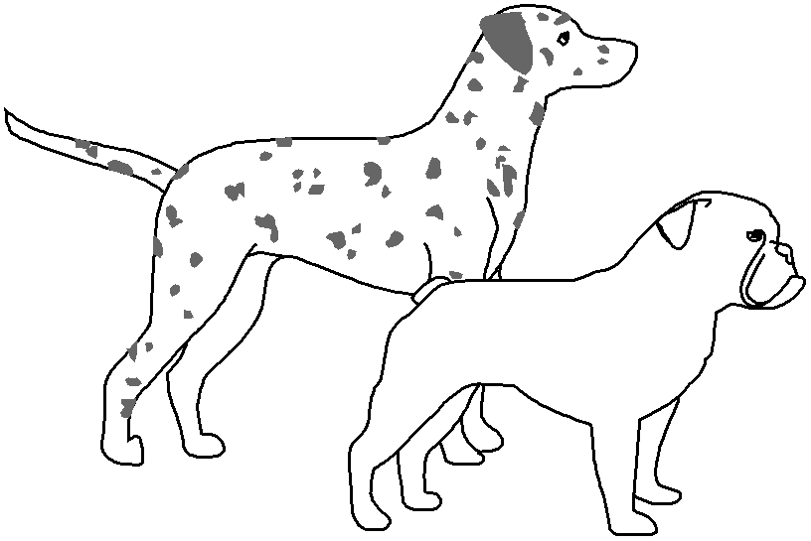

Slide 5
Introduction
Dogs are parts of a single species
There are over 400 different breeds of dogs
A breed is a subspecies. It takes many generations to get a new breed
Many breeds today are a result of
artificial selection/selective breeding

Slide 6
Example to show artificial selection
400 years ago there was no such thing as a foxhound! How did they get here?

Slide 7
How to Get an American Foxhound and Why
English fox hound X French hound
Great speed Excellent smell

Slide 8
The Result of the crossing
American fox hound which is an excellent hunter with great speed and excellent sense of smell

Slide 9
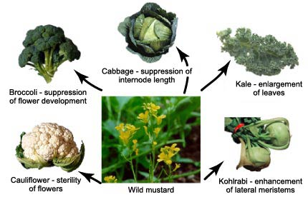
An example of a crop species
Farmers and breeders allowed only the plants and animals with desirable characteristics to reproduce, causing the evolution of farm stock. This process is called artificial selection because people (instead of nature) select which organisms get to reproduce.

Slide 10
Similarities between natural selection and artificial selection
Both require:
Variation of trait
Inheritability of the trait
Selection of some individuals to breed and not others
Change in the traits of generations.

Slide 11
Differences between natural selection and artificial selection
Natural selection | Artificial selection
Selection by the environment | Selection by humans
Within a species | Includes cross-breeding
Slow process | Faster process
Natural populations | Domestic populations

