Slide 1
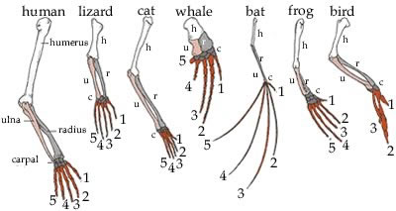
Modification by descent (homologous structures)
When there is a similarity of the formation of a body part or organ due to a common evolutionary origin, it is termed a homologous organ.

Slide 2
Biogeography
Different but closely related species in similar biomes across the world have similar features in adapting to that biome, indicating that they probably developed from a common ancestral species
Linked to continental drift.

Slide 3
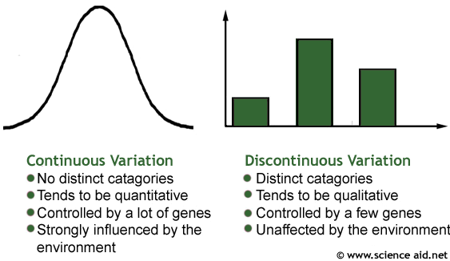

Slide 4
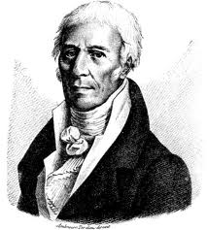
LAMARKISM
Jean Baptiste de Lamarck (1744–1829)
‘Law’ of use and disuse
What is used will become more developed. If a structure is not used, it will become less developed and disappear.
'Law' of the inheritance of acquired characteristics
Characteristics obtained by an individual during their lifetime can be passed on to its offspring.

Slide 5
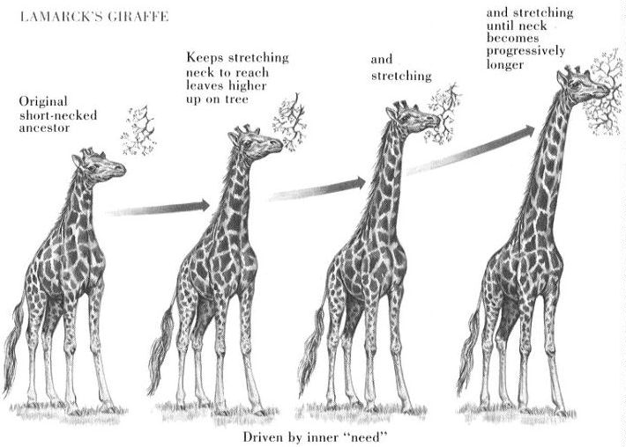
How did Lamarck explained the long necks of giraffes?
Lamarck
- All giraffes had short necks✓ originally
- Giraffes frequently stretched✓/used their necks to reach
- for leaves of tall trees✓
- necks become longer✓
- The long necks acquired✓ in this way
could be passed on to the next generation✓ /were inherited
Snake

Slide 6
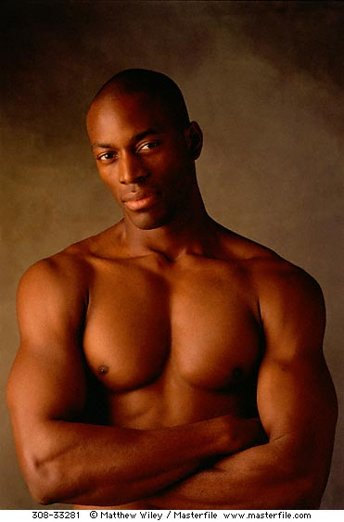
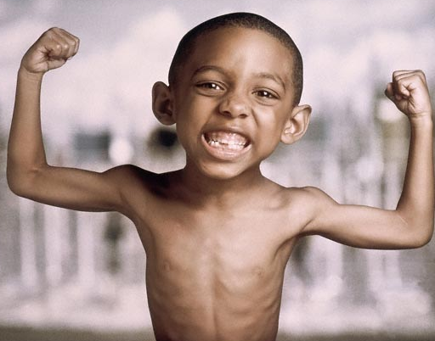
Reasons for Lamarck's theory being rejected.
There is very little evidence to support his idea that acquired characteristics✓are not inherited✓/do not cause any change to the DNA of an organism's gametes (sperms or ova)
Organisms did not evolve because they want✓
to evolve✓ instead randomly in response to the environment /Lamarck believed in determinism (internal drive of organisms to change)

Slide 7
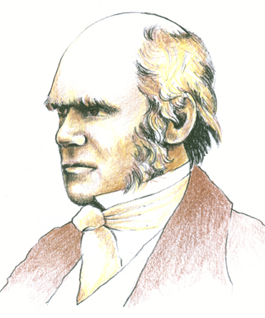
DARWINISM
Charles Darwin (1809–1882 )
The observations upon which Darwin based his theory:
• Organisms of a species produce a large number of offspring
• The offspring show a great deal of variation
• Of the large number of offspring produced, only a few survive
• Characteristics are inherited from surviving parents to offspring

Slide 8
Darwin's theory of evolution by natural selection
Organisms produce a large number of offspring.
• There is a great deal of variation amongst the offspring.
• Some have favourable characteristics and some do not.
• When there is a change in the environmental conditions or if there is competition, then organisms with characteristics which make them more suited, survive,
• whilst organisms with characteristics that make them less suited, die.
• The organisms that survive, reproduce
• and thus pass on the favourable characteristic to their offspring.
• The next generation will therefore have a higher proportion of individuals with the favourable characteristic.
• This is called natural selection.

Slide 9
How would Darwin account for the long necks of the giraffes
As a result of genetic variation✓ in the giraffe population
some giraffes have longer necks✓ than others
Environmental change✓/competition for resources occurred causing those with shorter necks to die✓
and those with longer necks to survive✓
This is natural selection✓/survival of the fittest
The genes✓/genotype for longer necks
were passed on to subsequent generations✓ most of which now have long necks

Slide 10
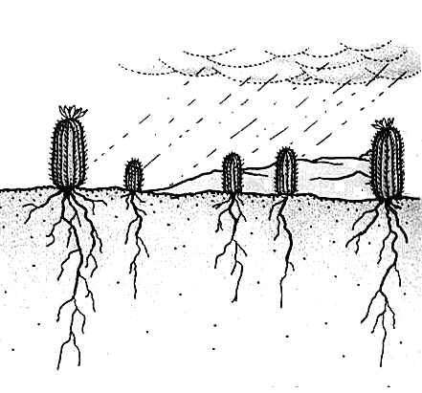
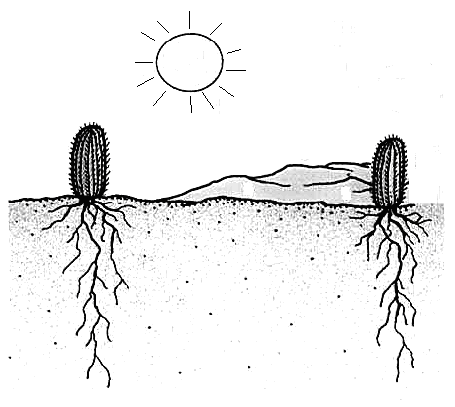
Natural selection
From a comparison of pictures A and B, describe the feature of the cacti that have enabled them to survive long periods of hot, dry weather conditions.
Name the mechanism put forward by Darwin to explain his theory of evolution that is illustrated in these diagrams.
A
B
C
Roots
Offspring
Time
The structural adaptation of cacti over time

Slide 11
Outline differences between de Lamarck and Darwin's theories
Lamarck’s | Darwin’s
Variation of offspring brought about individuals in the population changing | Offspring inherit variation
Individuals want to change | Environmental factors working randomly
Change because of adaptation to environment | Natural selection – best suited to the environment to survive
Individuals in the population change | The population as a whole changes
Changes brought about by adaptation to the environment are inherited from parent to offspring | Characteristic are passed on from generation to generation to enable individuals to survive in the environment

