Slide 1
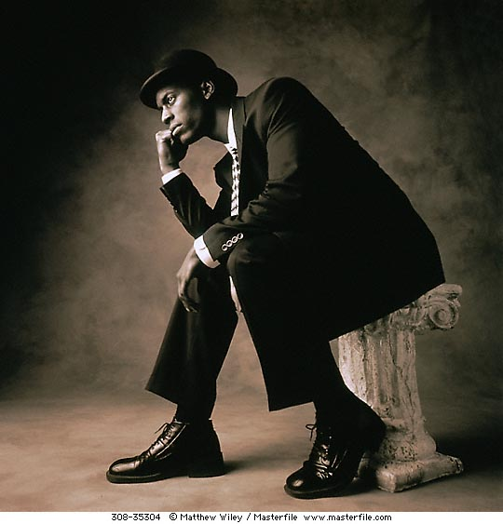
The word “theory” in everyday speech
“My theory is that AIDS was created in a laboratory for biological warfare”
Thoughts, ideas or opinions which don’t have to supported by facts
• INTRODUCTION

Slide 2
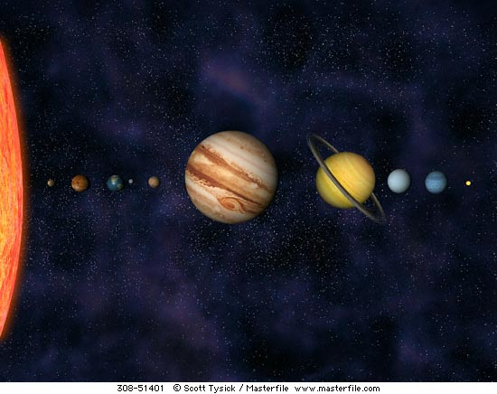
What is a scientific theory?
An explanation which can be supported by facts, laws and tested hypotheses.
Examples:
Heliocentric theory (the Earth revolves around the sun)
Atomic theory (structure of matter)
Most scientists accept that the theory of evolution has the same factual basis as the two theories above.
• INTRODUCTION

Slide 3
The Theory of Evolution is regarded as a scientific theory since various hypotheses relating to evolution have been tested and verified over time.

Slide 4
EVIDENCE FOR EVOLUTION
Fossil record
Modification by descent (homologous structures)
Biogeography
Genetics

Slide 5
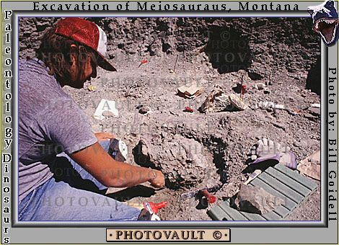
Fossil record
The word fossil is derived from Latin and is defined as the imprint, traces or preserved remains of an organism that once lived. Do you remember how fossils are formed and dated from grade 10?

Slide 6
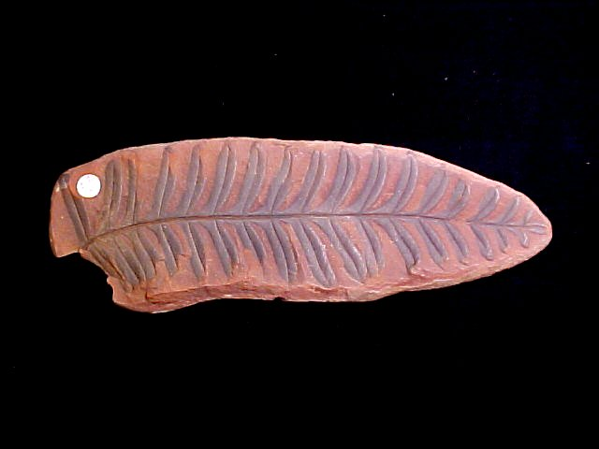
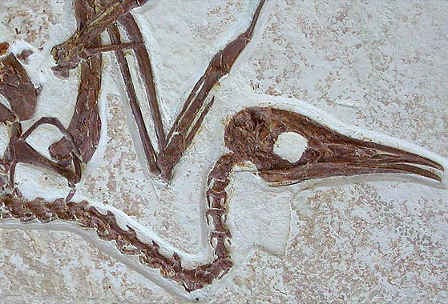
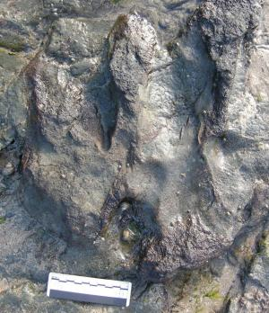
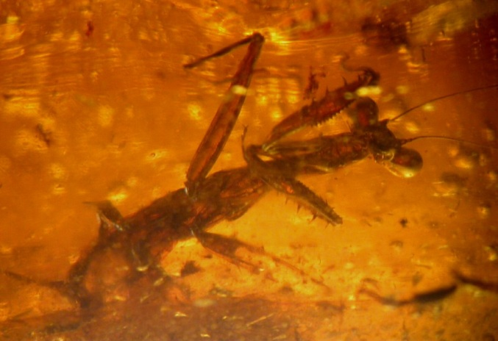
Fossils provide evidence of life’s history. The geological time scale.
Trace fossil

