Slide 1
EVIDENCE FOR EVOLUTION
Fossil record
Modification by descent (homologous structures)
Biogeography
Genetics

Slide 2
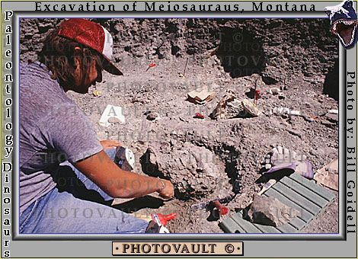
Fossil record
The word fossil is derived from Latin and is defined as the imprint, traces or preserved remains of an organism that once lived. Do you remember how fossils are formed and dated from grade 10?

Slide 3
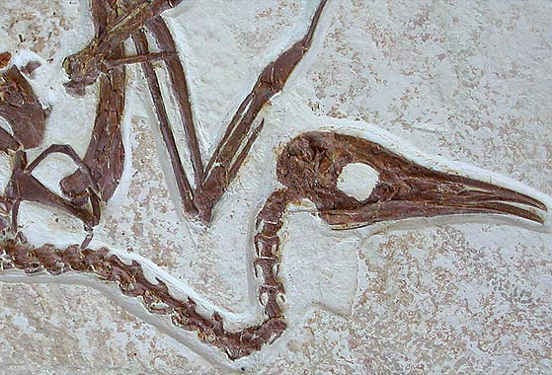
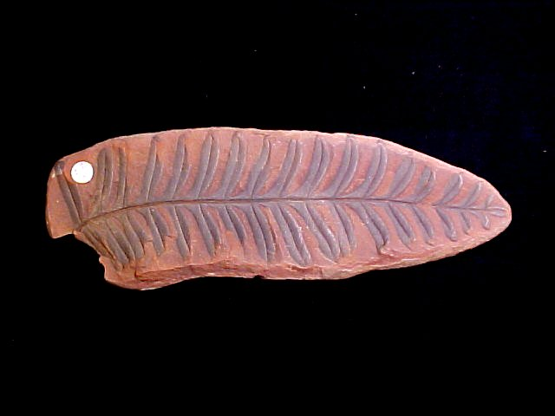
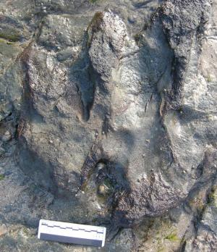
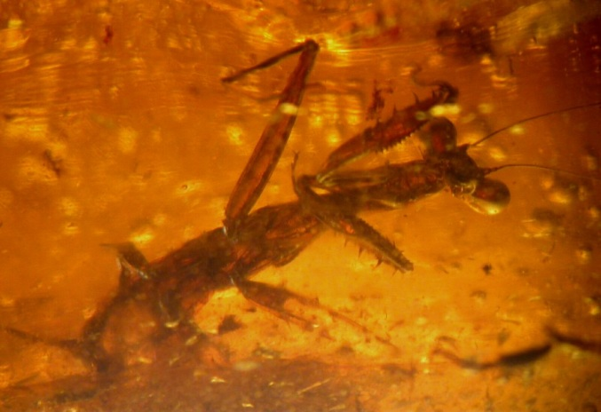
Fossils provide evidence of life’s history. The geological time scale.
Trace fossil

Slide 4
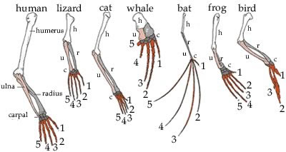
Modification by descent (homologous structures)
When there is a similarity of the formation of a body part or organ due to a common evolutionary origin, it is termed a homologous organ.

Slide 5
Biogeography
Different but closely related species in similar biomes across the world have similar features in adapting to that biome, indicating that they probably developed from a common ancestral species
Linked to continental drift.

Slide 6
List the sources of variation in populations.
Genetics
Organisms with large amounts of similar DNA sequences are more related.
Random assortment/segregation/
recombination of chromosomes during meiosis in the formation of gametes
Crossing over
Chance/random fertilisation of gametes/sexual reproduction
Mutation
Outbreeding/Gene flow
OR meiosis

