Slide 1
EVOLUTION

Slide 2
Observation and Inference
Let’s do a little exercise…

Slide 3
Dinosaur tracks are common occurrences in the southern and eastern U.S.
Here is a section of tracks that were recently uncovered. Can you answer the following questions?

Slide 4
What is the size and nature of the organisms?
Were the tracks made at the same time?
How many animals were involved?
Can you reconstruct the events that occurred?

Slide 5
In what direction did the animals move?
Did they change speed or direction?
Was the soil moist or dry?
In what type of rock were the prints made?

Slide 6
The following summer some more digging revealed more of the track. What additional information have you gained that allows you to refine your answers?

Slide 7
Were the tracks made at the same time?
How many animals were involved?
Can you reconstruct the events that occurred?
In what direction did the animals move?
Did they change speed or direction?

Slide 8
In the final summer of the excavation one last part of the footprint trail was uncovered. Does this section provide additional information to refine your hypothesis?

Slide 9
So what happened?
What part of your hypothesis is observation? What part is inference? What part is conjecture?

Slide 10
This is how science is done.

Slide 11
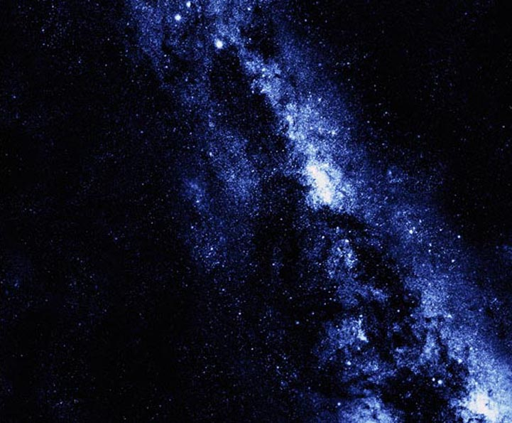
What is evolution?
All things we see today arose from things that existed in the past
but they look different because things change over long periods of time
Applies not only to life forms on Earth, but also to all the planets that make up our galaxy (milky way) and all the galaxies that make up the universe
• INTRODUCTION
Notes:
They look diff because things change over time…
Applies also to the galaxy and the universe

Slide 12
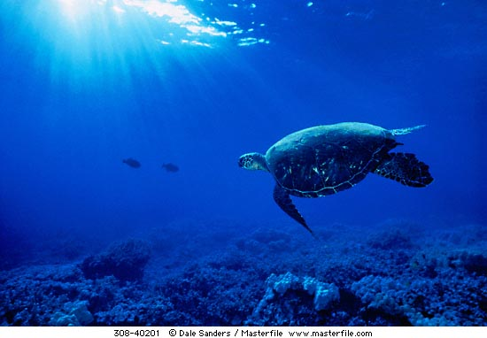
Biological Evolution as “descent with modification”
Biological evolution refers to the changes that life forms have undergone over long periods of time – distinct from the evolution of the Earth itself.
Biological Evolution means that all
present-day forms of life …
have descended from, and are
related to, those that lived in the past
may look different because they became
modified from one generation to another
Sometimes the modifications are so great that it is difficult to see the similarities between the modern form and its ancestor
• INTRODUCTION
Notes:
Biological evolution refers to the changes that life forms have undergone over long periods of time – distinct from the evolution of the Earth itself.
Biological Evolution means that all present-day forms of life …
have descended from, and are related to, those that lived in the past
may look different from those that they descended from because they became modified from one generation to another
Sometimes the modifications are so great that it is difficult to see the similarities between the modern form and its ancestor

Slide 13
Hypothesis vs theory
Hypothesis: a testable statement that can be used to build inferences and explanations

Slide 14
The word “theory” in everyday speech
“My theory is that AIDS was created in a laboratory for biological warfare”
Thoughts, ideas or opinions which don’t have to supported by facts
• INTRODUCTION

Slide 15
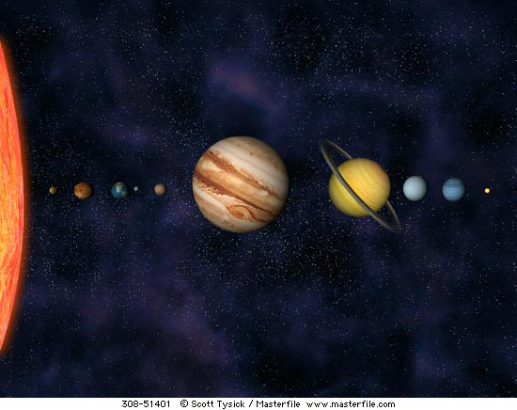
What is a scientific theory?
An explanation which can be supported by facts, laws and tested hypotheses.
Examples:
Heliocentric theory (the Earth revolves around the sun)
Atomic theory (structure of matter)
Most scientists accept that the theory of evolution has the same factual basis as the two theories above.
• INTRODUCTION

Slide 16
The Theory of Evolution is regarded as a scientific theory since various hypotheses relating to evolution have been tested and verified over time.

