Slide 1
Cells: the basic unit of life

Slide 2
Every living thing is made up of cells.
Cells group together to form tissue
Tissue groups together to form an organ
Organs group together to form organ systems
Organ systems group together to form organisms
Although cells might look different in plants and animals, they are similar in certain aspects.

Slide 3
Initially, very little was known about cells.
Box-like compartments
Due to technological advancements, we have a detailed knowledge database.
For 1000s of years – only macroscopic structure was known.
In 1665 Robert Hooke looked at cork cells with a simple lens
In 1675 Anton van Leeuwenhoek saw bacteria with a simple microscope
Since then new and more powerful versions were developed.
Thus developed “The Cell Theory”
Every living organism is made up of cells, very much the way bricks made a building
Every cell comes from another cell

Slide 4
Structure, care and use of a microscope
Page 61 – 65
Magnification
Page 65 – 67
Separate note to be given

Slide 5
Homework ☺
Draw, label AND annotate:
figure 1.2.2 (the microscope)
Page 62

Slide 6
Cell structure and function
Cells are made up of various compounds
Each cell may contain tiny organs – organelles
Remember:
Cells – tissue – organs – organ systems – organism
Most cells are microscopic
While a minor amount of cells are macroscopic
To measure microscopic cells – cm or m is not adequate
1 micron (µm) = 1/1000 mm
1000 micron = 1 mm
1 nanometre (nm) = 1/1000 µm
1000 nm = 1 µm

Slide 7
Cell structure and function
Cells exist in almost every shape possible as well as no shape at all.
The shape of a cell usually corresponds to the role of the cell
Table 1.2.3 - page 68

Slide 8
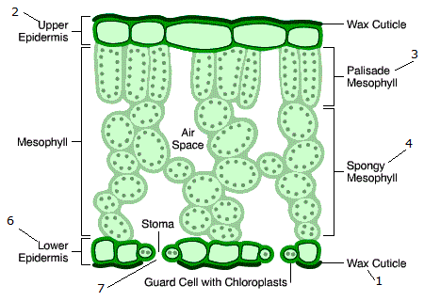
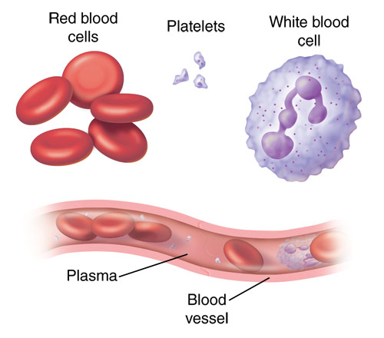
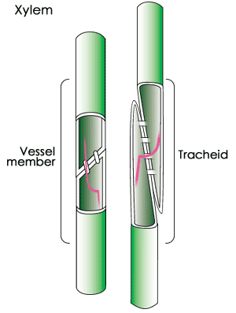

Slide 9
Relationship among components on a plant and animal cell
page 69
Figure 1.2.5 – components of a plant cell
Figure 1.2.6 – components of an animal cell
what do you notice between the two?
Similarities?
Differences?

Slide 12
Homework ☺
Draw:
Figure 1.2.5
Page 69
Figure 1.2.6
Page 69
Figure 1.2.7
Page 70
Figure 1.2.8
Page 70

Slide 13
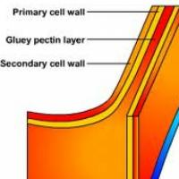
Structure of EACH cell component
The cell wall
May be made up of three parts:
Middle lamella – thin membranous layer (meristematic) separates 1 cell from another
Primary wall – formed inside the middle lamella – made of cellulose
Secondary wall – found inside the primary wall of specialised cells. May be made of suberin or lignin
The cell wall functions to:
Enclose the cell contents
Protect the inner layers of plants
Provide rigidity
Provide shape
Provide permeability
Middle lamella forms jelly like cement to bind cells together
Middle lamella

Slide 14
Structure of EACH cell component
The protoplasm
Refers to the living material in plant and animal cells.
Made up of cytoplasm, nucleus and all inclusions
The cytoplasm
Includes all contents of the cell - the fluid sol, the semi solid gel and all inclusions
Some of these inclusions are membrane bound – organelles – each of which have a specific function

Slide 15
Structure of EACH cell component
The cell membrane
Outer boundary of the cytoplasm
Approx 5 – 10 nm – so thin that it has not ever been viewed
The structures we see in the text are just models/theories put forward by scientists
The Fluid Mosaic Model – widely accepted theory
Put forward in 1972 by Singer and Nicholson
Two sheets of phosolipids bound together
Some proteins span the two layers
Some proteins span only part of it
Pores of approx 1 nm occur which allow for substances to pass through
The main function is to control movement of substances by being selectively permeable

Slide 18
Homework ☺
Activity 1.2.2
Page 73
Worksheet
To be completed at the back of your note book

Slide 21
Importance of osmosis
Responsible for entry and exit of water
As water enters, it brings useful substances
As water leaves, it takes harmful waste
Water is used for many purposes:
Main constituent in blood
Transporting of substances (useful and waste)
Medium for chemical reactions
Providing turgor pressure
Providing shape to invertebrates especially for the hydrostatic skeleton

Slide 22
Active transport

Slide 23
Cytoplasmic organelles and inclusions
Many structures within the cytoplasm.
These are called organelles
These are:
Membrane-bound organelles
Enclosed by a membrane
Have double membrane

Slide 24
Mitochondria
Found scattered in the cytoplasm
Found in both plant and animal cells
Can vary in number (due to activity of cell)
Are known as the ‘powerhouse’ of the cell as cellular respiration occurs here.
During this process, energy is released
Structure:
Generally rod shaped
1.5nm long & 0.5nm in diameter
Hollow on the inside
Two membranes
Outer
Inner – projections internally called cristae
Contain own DNA, RNA and apparatus to synthesise proteins

Slide 25
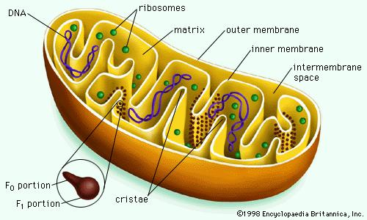

Slide 26
Plastids
Small, disk shaped, ovoid or irregularly shaped
Found only in plant cells
Three types:
Cloroplasts
Chromoplasts
Leucoplasts
Traps light for photosynthesis

Slide 28
Plastids
Chromoplasts:
May be red, orange and yellow
Due to pigments known as carotenes and xanthopylls
Found in brightly coloured parts of plants
Leucoplasts:
Colourless
Found in parts not exposed to sunlight
Store food in different forms such as starch, lipids and proteins

Slide 29
Plastids
Chloroplasts:
Disk shaped
4 – 10 microns in length
Enclosed by double membrane
Plate-like membranes called lamellae
Suspended in liquid stroma
Lamellae are stacked on top of each other to form a grana
Chlorophyll is embedded within lamellae
Enzymes which control photosynthesis, as well as ribosomes and starch granules are contained within the stroma

Slide 30
Endoplasmic Reticulum
Is a system of tubes enclosed by a membrane
Found in plant and animal cells
Tubes appear to be continuous with nuclear membrane
Acts as a communication system
Materials may be transported through the tubes from one part to the other
Two types:
Rough ER - due to attached ribosomes
Smooth ER – lack of ribosomes

Slide 32
Golgi Apparatus
Also called dictysomes
Found in plant and animal cells
Appear to be broken tips of ER
Have been found to be numerous in secretory cells
Likely to have secretory function

Slide 34
Ribosomes
Very small, grainy structures
Found in plant and animal cells as well as in bacteria
Occur on the ER, loosely in the cytoplasm, in plastids and mitochondria
Made up of protein and rRNA
The site at which proteins are manufactured

Slide 35
Vacuoles
Fluid-filled organelles
Found in plant and animal cells (usually absent in animal cells)
Occupies large percentage of cell
Tonoplast surrounds vacuoles
Filled with cell sap
Cell sap is a soln made of water together with dissolved substances
Contains anthocaynins – pigments
Cell sap creates turgor pressure
Gives cell its swollen/full appearance

Slide 37
Lysosomes
Roundish structures (vesicles)
Mainly in animal cells
Also in plant cells but are not easily viewed
Fuse with food vacuoles, enzymes then digest food
Called intracellular digestion

Slide 39
Centrosomes
Made up of small tubular bodies or microtubules
Occur near the nucleus
Mainly occur in animal cells
Centosomes have a function during cell division. (mitosis)

Slide 41
Nucleus
Round or oval body
Found in plant and animal cells
Relatively large
Made up of nucleoplasm, chromatin network and necluolus – enclosed by nuclear membrane

Slide 42
Nucleus
Nuclear membrane:
Double membrane containing pores
Pores control entry and exit of substances
Nucleoplasm:
Referred to as the nuclear sap
Contains all stubstances produced within the nucleus
Sugars, nitrogen bases, phosphates, nucleotides and enzymes.
Chromatin network:
Entangled threads of chromosomes
Nucleoli:
Functions to produce nucleic acids (do not need to know)

Slide 43
Nucleus
Has the following function:
Controls all functioning of the cell
Controls production of enzymes
Chromatin network (chromosomes) are responsible for carrying hereditary information from parent to offspring

Slide 45
Self study
Differences between plant and animal cells
Page 82 – table 1.2.4
Homework ☺
Activity 1.2.5
Page 78
Activity 1.2.6
Page 82
Activity 1.2.7
Page 83
Activity 1.2.8
Page 85
Luckily this is only due for Friday
☺☺

