Slide 1
Biodiversity of plants

Slide 2
Properties of kingdom Plantae
Cell walls
Chloroplasts/plastids
Multicellular

Slide 3
Grouped based on presence/absence of…
Vascular tissue (xylem and phloem)
True leaves and roots
Seeds or spores
Fruit

Slide 4
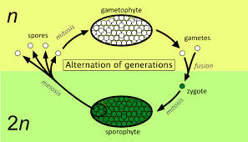
Dominant generation
Plant alternate between gametophyte generation(haploid-half no. of chromosomes) and sporophyte (diploid- full set of chromosomes) generations.

Slide 5
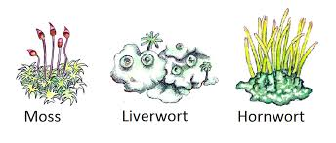
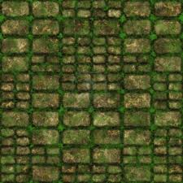
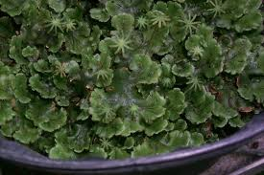
BRYOPHYTES (Moss, liverworts and hornworts)

Slide 6
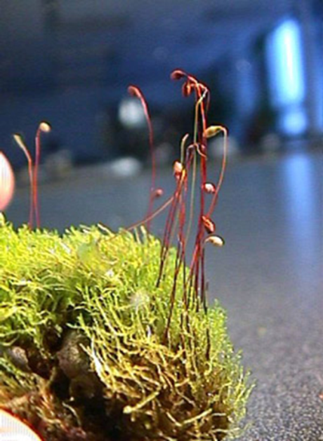
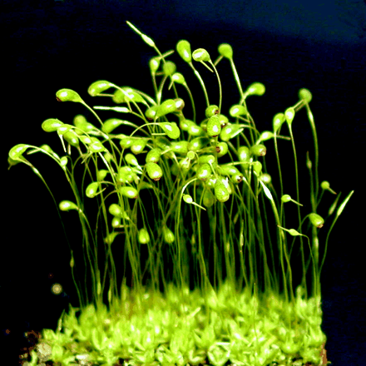
Characteristics
Are non-vascular
Are thallus (no true roots, leaves or stems)
Reproduce by spores (no seeds)
No fruit
Dominant Gametophyte generation (Larger and longer living)
Depend on water for sexual reproduction.
Asexual reproduction by spores in dry conditions.

Slide 7
See videos

Slide 8
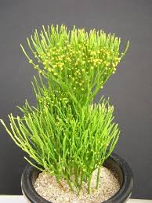
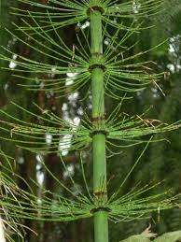
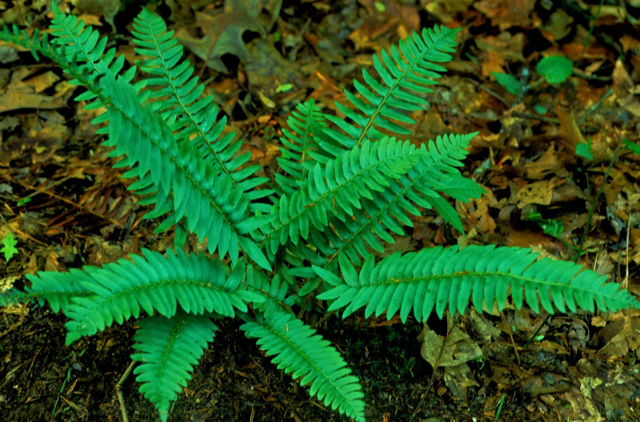
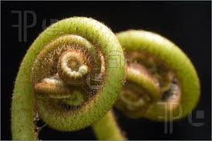
PTERIDOPHYTES (Ferns, horsetails and whisk ferns)

Slide 9
Characteristics
Are vascular
Have true roots, leaves and stems (Not thallus)
Reproduce by spores (no seeds)
No fruit
Dominant Sporophyte generation
Depend on water for sexual reproduction.
Asexual reproduction by spores in dry conditions.

Slide 10
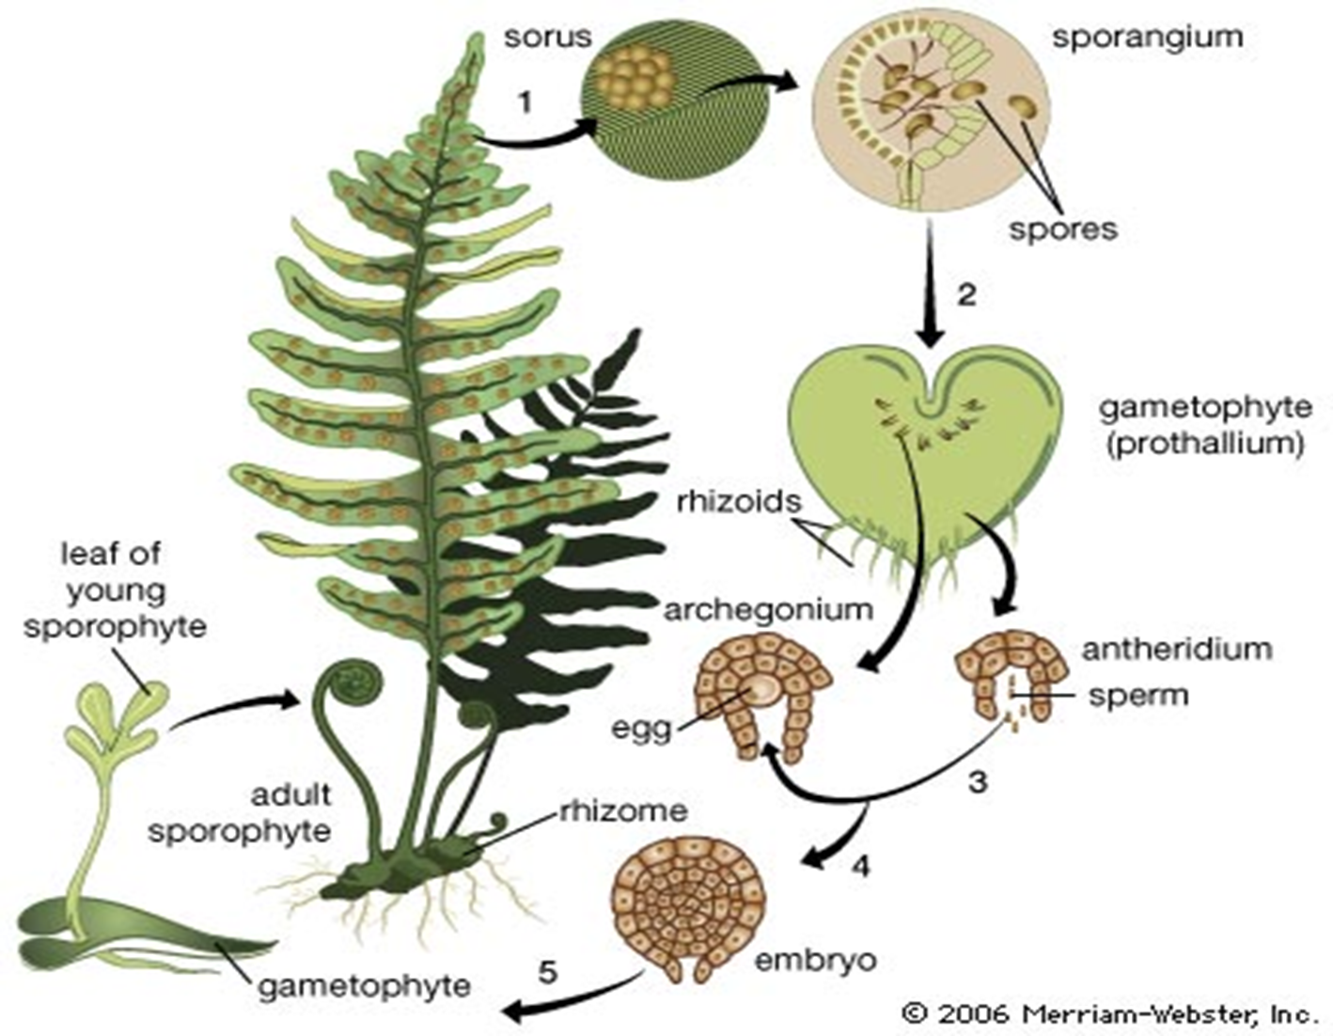

Slide 11
Act. 1.2.3. pg 59 No 1 and 4

Slide 12
SpermatophytEs
(Seed bearing plants)

Slide 13
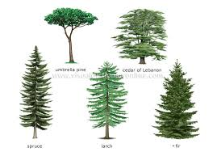
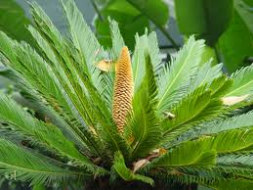
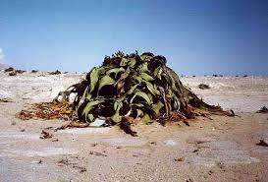
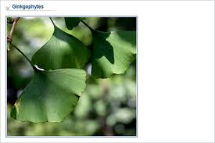
GYMNOSPERMS (Conifers, cycads, gnetophytes and ginkgophytes)

Slide 14
Characteristics
Vascular
Not thallus
Have seeds
No fruit, seeds borne on cones
Dominant Sporophyte generation. Separate male and female gametophyte generation and the gametophyte is enclosed by the sporophyte.
Do not depend on water for sexual reproduction.

Slide 15
Life cycle of the Pine

Slide 16
Cones of Pine

Slide 17
Male Cones
Female Cones

Slide 18
Act 1.2.4 pg 61

Slide 19
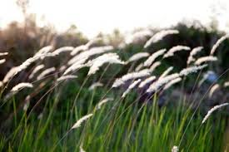
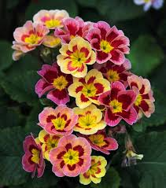
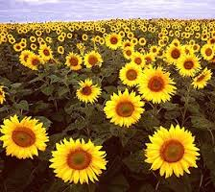
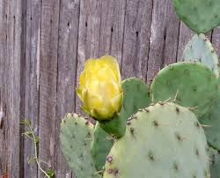
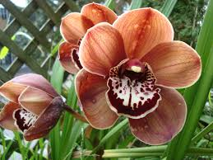
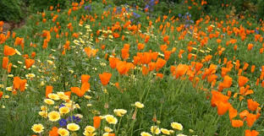
ANGIOSPERMS

Slide 20
Characteristics
Vascular
Not thallus
Have seeds
seeds enclosed by fruit
Dominant Sporophyte generation. Separate male and female gametophyte generation and the gametophyte is enclosed by the sporophyte.
Do not depend on water for sexual reproduction.

Slide 21
Act 1.2.6 pg 64

Slide 22
PROGRESSIVE DEVELOPMENT OF LAND PLANTS pg 65
Increased size of plant
Increased sporophyte and decreased gametophyte.
Decreased dependence on water for sexual reproduction
Act 1.2.7 pg 67 (based on fig 1.2.6)

