Slide 1
BIODIVERSITY OF ANIMALS

Slide 2
What is a phylum?
In biology, phylum ( plural: phyla) is a taxonomic rank below kingdom and above class.
phyla can be thought of as grouping organisms based on general specialization of body plan.

Slide 3
6 phyla we are learning

Slide 4
Key Features of Animals body plan pg 85
ingest food
multicellular
no cell walls
classified largely based on:
1. Body symmetry and cephalisation
2. Number of tissue layers in the embryo
3. Coelom and blood systems
4. Number of openings of gut

Slide 5
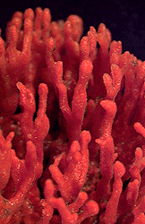
1. Symmetry and cephalisation (pg 86-87)
Asymmetrical- no symmetry
No symmetry

Slide 6
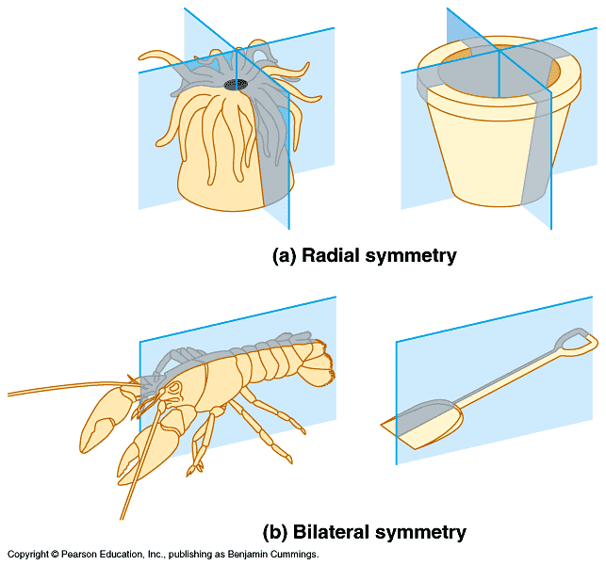
Radially symmetrical- Symmetrical in any vertical plane through the centre. Organisms with this body plan have organs equally distributed. There is no front, back, left or right of the organism
Advantage is that they can collect food from all directions and they can react to danger from all directions. Important for sessile (don’t move) and planktonic (float with current) organisms.

Slide 7
Regions of an organism
Dorsal =top
Ventral = bottom
Anterior= front
Posterior= back

Slide 8
Bilaterally symmetrical-
Symmetrical in one plane only. Developed due to accumulations of sense organs at one anterior end (cephalisation) and dorso-ventral differentiation.
Organisms with this type of symmetry are capable of complex movements.

Slide 9
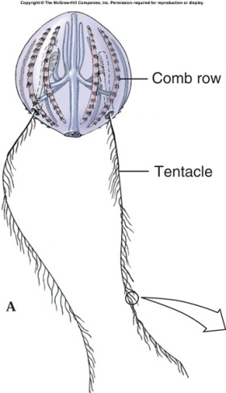
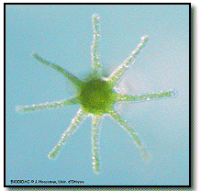
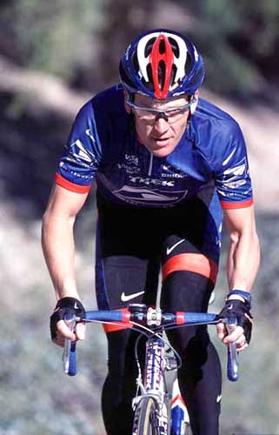
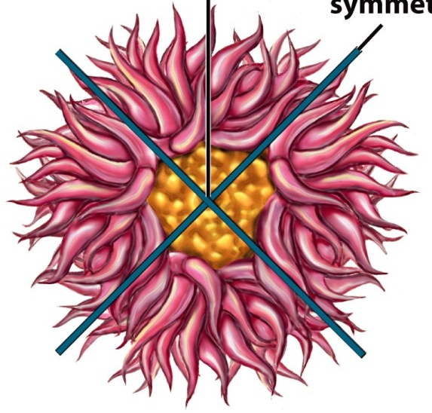
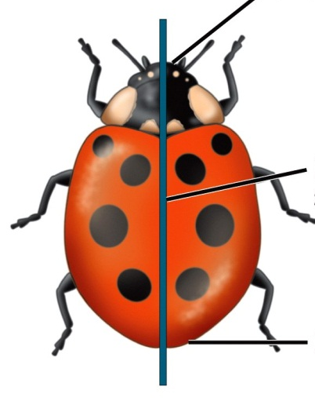
Identify the symmetry

Slide 10
2. Number of tissue layer in embryo

Slide 11
Number of tissue layer in embryo
Before differentiation, cells are arranged in germ layers
Diploblastic (2 germ layers)- outer ectoderm and inner endoderm.
Triploblastic (3 germ layers)- outer ectoderm, inner endoderm and middle mesoderm.
Ectoderm → outer covering of animal
Endoderm → digestive tract and related organs
Mesoderm → muscles and other organs.

Slide 12
3. Coeloms and blood systems (pg 88-89)
Coelom- a body cavity (fluid filled space) found within the mesoderm. (Not in diploblastic animals)
Triploblastic organisms may have:
no coelom (acoelomate),
have false coeloms (pseudocoelomate)
true coeloms (coelomate).

Slide 13
Acoelomate
Have no body cavity (coelom)

Slide 14
Pseudocoelomate
A pseudocoelom is lined by mesoderm on only one side

Slide 15
Coelomate animals
The body cavity is completely lined by the mesoderm.

Slide 16
Functions of the coelom:
Space for development of internal organs
Allows gut to work separately from the body wall
Fluid can act as a hydrostatic skeleton
Fluid acts as a shock-absorber to protect organs.

Slide 17
The presence of a coelom, prevents diffusion of gases, food and wastes.
Organisms with coeloms have overcome this by having transport and excretory systems.

Slide 18
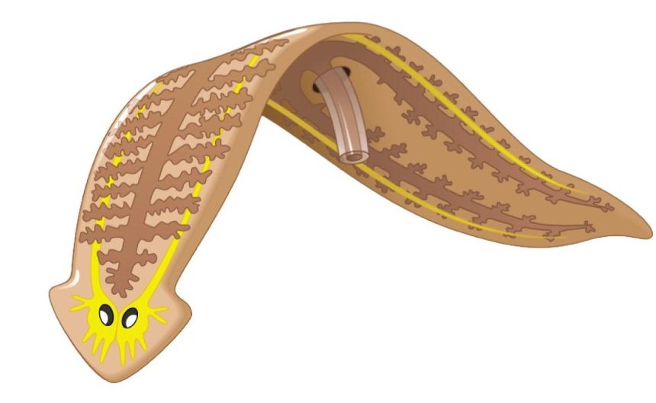
Number of openings (pg 89-90)
BLIND GUT – One opening to ingest and egest food.
There will be mixing of digested and undigested food.

Slide 19
Number of openings (pg 89-90)
THROUGH GUT- 2 openings (mouth and anus)
Food moves in one direction.
Different regions of the gut are specialized.
Digestion can take place continuously.

Slide 20
HOMEWORK
Activity 1.3.2 pg 90

Slide 21
Pg 101 act.1.3.8
***NOTE: Make 1st column the longest
PHYLUM | Symmetry | Cephalisation | No. of tissue layers (embryo) | Type of gut | Coelom | Blood system
Porifera
PHYLUM

Slide 22
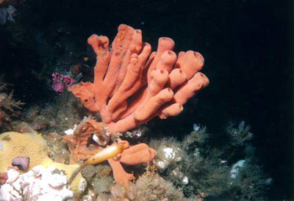
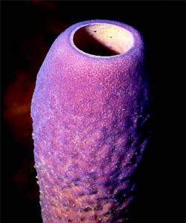
PHYLUM PORIFERA (Sponges) pg 90-91
HABITAT:
Sedentary – attached to submerged object e.g. rocks.
Fresh water or marine

Slide 23
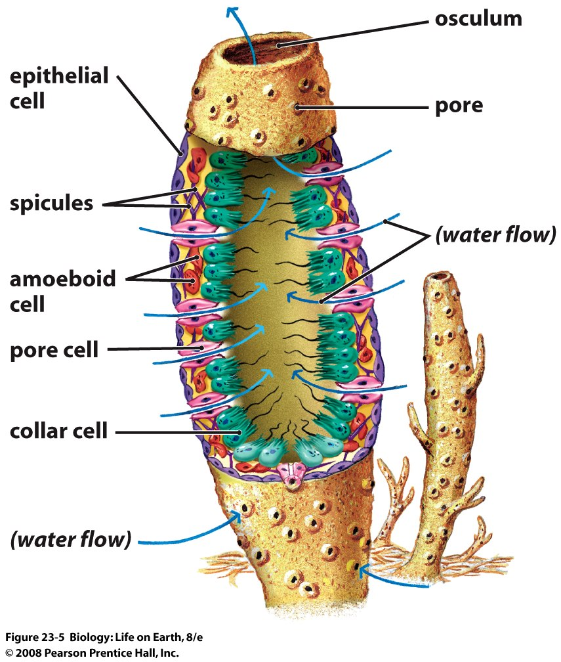
PHYLUM PORIFERA (Sponges)
STRUCTURE:
Asymmetrical
Has two layers of cells not considered as tissue.
No digestive openings or gut. Use pores and spongocoel
No body cavity (diploblastic)

Slide 24
Relationship between body plan and mode of living (pg 103)
Porifera feed through pores therefore they don’t need a digestive opening
Also don’t need radial symmetry
Since it is sedentary, it does not need bilateral symmetry nor cephalisations. → ASYMMETRICAL
They are simple organisms so need just two germ layers → DIPLOBLASTIC
Diploblastic it can’t have a coelom (no mesoderm)
No need for transport system because all cells are in contact with water, diffusion is effective.

Slide 25
MOVIE TIME

Slide 26
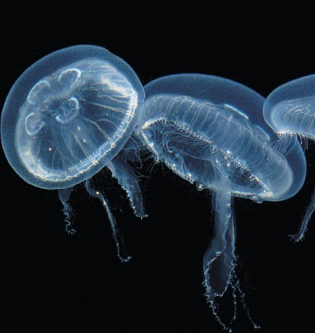
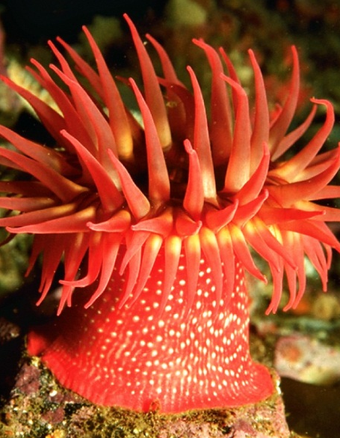
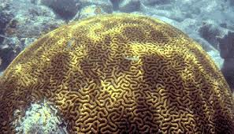
PHYLUM CNIDARIA (Jelly fish, sea anemones and corals) pg 92-93
HABITAT:
Some are sedentary, others free-swimming and others have both stages in their life cycles.

Slide 27
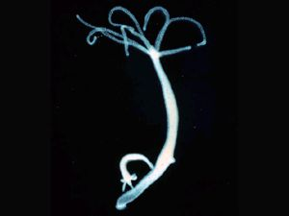
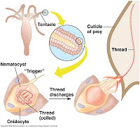
PHYLUM CNIDARIA
STRUCTURE:
Radially symmetrical
Has a blind gut (single digestive opening)
Diploblastic with a non cellular jelly like mesoglea in between.
Have cnidocytes (stinging cells)→defence and catch prey.
Diploblastic → No Coelom

Slide 28
CNIDARIA Relationship between body plan and mode of living (pg 104)
Radial symmetry because it has a central mouth/anus with tentacles around it.
Simple organisms →Diploblastic
Diploblastic so cant have a coelom (no mesoderm)
No need for transport system because all cells are in contact with water, diffusion is effective.

Slide 29
MOVIE TIME

Slide 30
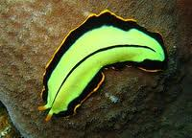
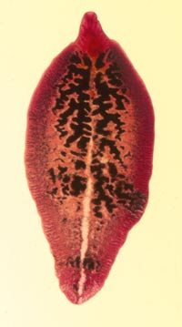
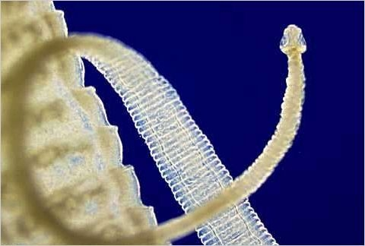
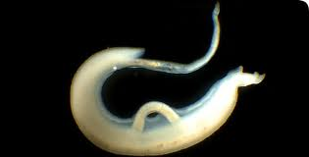
PHYLUM PLATYHELMINTHES (FLATWORMS) (pg 93-94)
Dorso-ventrally flattened
Habitat:
Free-living forms aquatic or damp environments.
Parasitic forms in a primary and secondary host.

Slide 31
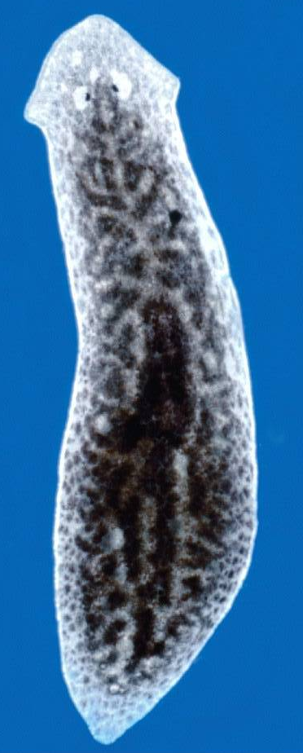
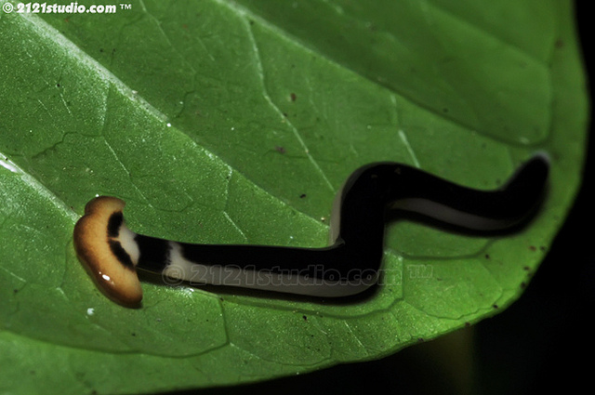
PHYLUM PLATYHELMINTHES
STRUCTURE
Have cephalisation
Bilaterally symmetrical
Most have one digestive opening
Are triploblastic and acoelomate
Reasons why no transport system (pg 94-95)

Slide 32
Relationship between body plan and mode of living (flatworms pg 104)
Most free-living forms have eyes on top (dorso-ventrally differentiated). Also cephalisation because move to new environments → Bilateral symmetry.
Lots of movement → Need muscles → Need mesoderm (Triploblastic)
Acoelomate → no need for transport system.

Slide 33
HOMEWORK TIME!
ACT 1.3.3 pg 93

Slide 34
MOVIE TIME X 2

Slide 35
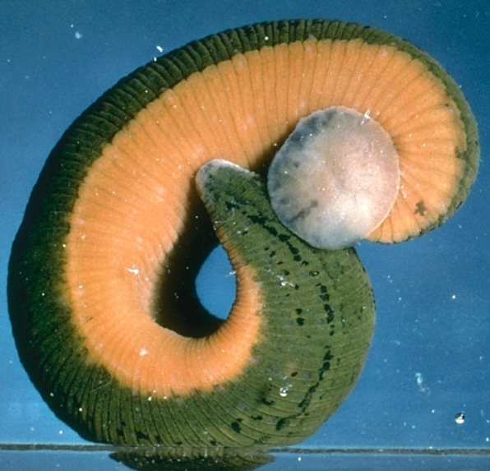
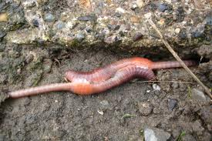
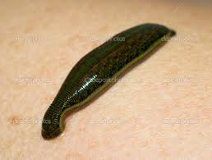
PHYLUM ANNELIDA (Segmented worms (pg 95-96)
e.g.s Earthworms , bristle worm and leeches
HABITAT:
Most are aquatic, but earthworms live in moist soil
Most are free-living, some leeches are ecto-parasites

Slide 36
PHYLUM ANNELIDA (Segmented worms (pg 95-96)
STRUCTURE
Cephalisation and dorso-ventral differentiation therefore are bilaterally symmetrical.
Triploblastic and coelomate. (see 3rd paragraph pg 96)
Due to coelom, diffusion not effective for transport so have blood system and excretory system (nephridia)
Have a through gut.

Slide 37
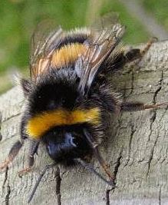
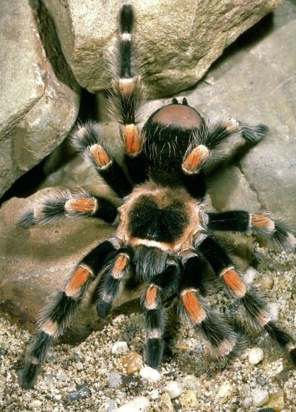
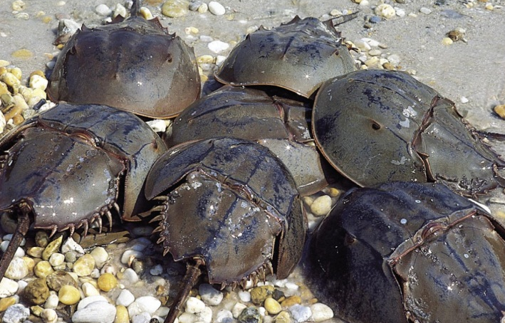
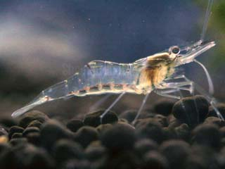
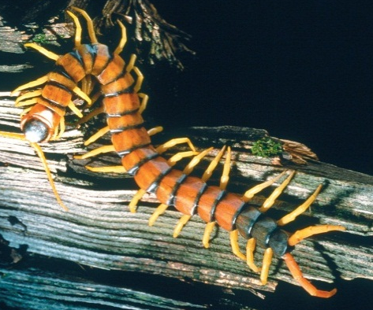
PHYLUM ARTHROPODA (Insects, crabs, spiders, centipedes and milipedes) (pg 97-98)
“Jointed legs”
Phylum with the largest number of species
HABITAT
All habitats (Aquatic, terrestrial, underground, in the air or as parasites)

Slide 38
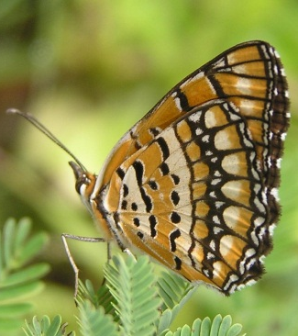
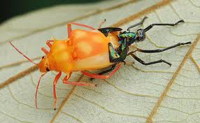
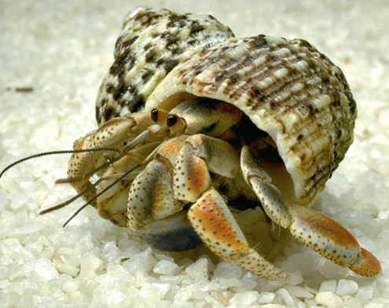
PHYLUM ARTHROPODA
STRUCTURE:
Have an exoskeleton (made of chitin) with jointed appendages (advantages and disadvantages of exoskeletons: pg 97-98)
Bilateral symmetry
Through gut
Triploblastic and coelomate
Open blood system with haemocoel.
Read last paragraph pg 98

Slide 39
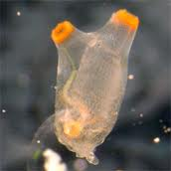
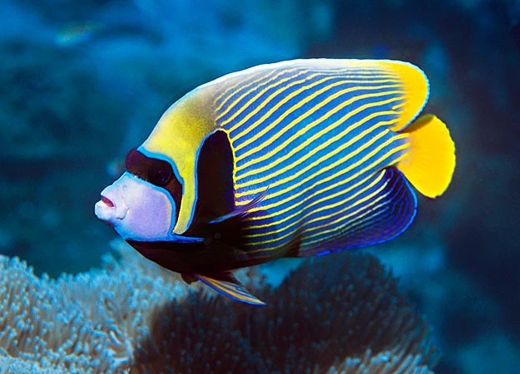
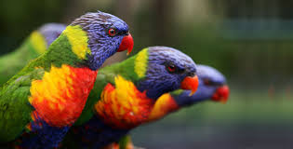
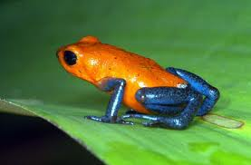
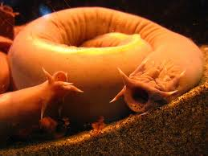
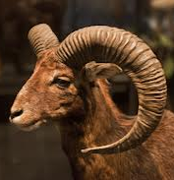
PHYLUM CHORDATA (Fish, frogs, pg 99-100 birds, reptiles and mammals)
Have a dorsal notochord
Include vertebrates and invertabrates

Slide 40
PHYLUM CHORDATA
STRUCTURE
Bilateral symmetry
Triploblastic
Coelomate
Through gut
Transport systems

Slide 41
Relationship between body plan and mode of living (pg 105) Annelida, arthropoda and chordata
They eat a variety of foods, thus their digestive systems are specialised into different parts → Through guts
Cephalisation → bilateral symmetry.
They move therefore need muscles → Triploblastic
Coelom allows body wall to work independently of the gut.
Coelom prevents diffusion → Have blood systems.

Slide 42
ACTIVITY 1.3.10 Pg 106

Slide 43
ROLE OF INVERTEBRATES IN AGRICULTURE AND ECOSYSTEMS pg 107

Slide 44
ROLE OF INVERTEBRATES IN AGRICULTURE AND ECOSYSTEMS pg 107
HARMFUL
USES

Slide 45
ROLE OF INVERTEBRATES IN AGRICULTURE AND ECOSYSTEMS pg 107
e.g bees and other insects
Pollination
HARMFUL
USES

Slide 46
ROLE OF INVERTEBRATES IN AGRICULTURE AND ECOSYSTEMS pg 107
e.g bees and other insects
Pollination
HARMFUL
USES
Earthworms
Soil
Decomposition
Feed on dead vegetation
Aeration
When they burrow
Enrichment
Casts.

Slide 47
ROLE OF INVERTEBRATES IN AGRICULTURE AND ECOSYSTEMS pg 107
e.g bees and other insects
Pollination
HARMFUL
USES
Parasites
e.g. ticks
Earthworms
Soil
Decomposition
Feed on dead vegetation
Aeration
When they burrow
Enrichment
Casts.

Slide 48
ROLE OF INVERTEBRATES IN AGRICULTURE AND ECOSYSTEMS pg 107
e.g bees and other insects
Secondary hosts
of diseases
Pollination
HARMFUL
USES
Parasites
e.g. ticks
Earthworms
Soil
Decomposition
Feed on dead vegetation
Aeration
When they burrow
Enrichment
Casts.

Slide 49
ROLE OF INVERTEBRATES IN AGRICULTURE AND ECOSYSTEMS pg 107
Transmit disease
between organisms
e.g bees and other insects
Secondary hosts
of diseases
Act as vectors
of disease
Pollination
HARMFUL
USES
Parasites
e.g. ticks
Earthworms
Soil
Decomposition
Feed on dead vegetation
Aeration
When they burrow
Enrichment
Casts.

Slide 50
ROLE OF INVERTEBRATES IN AGRICULTURE AND ECOSYSTEMS pg 107
Transmit disease
between organisms
e.g bees and other insects
Secondary hosts
of diseases
Act as vectors
of disease
Pollination
HARMFUL
USES
Parasites
e.g. ticks
Earthworms
Pests
Soil
Decomposition
Feed on dead vegetation
Aeration
When they burrow
Enrichment
Casts.

