Slide 1
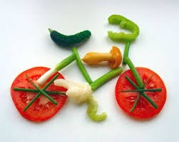
Animal nutrition

Slide 2
Sub-processes of nutrition
Ingestion- taking food in.
Digestion- breaking food down
Absorption- soluble substances taken into blood.
Assimilation- from the blood to various cells.
Egestion- undigested and indigestable substances taken out of the body.

Slide 3
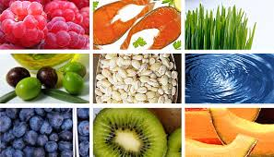
Importance of food
Source of energy
Growth
Provides regulatory substances (e.g. vitamins, minerals and water).

Slide 4
Sources of food
Anything on the lower level of the food pyramid/chain

Slide 5
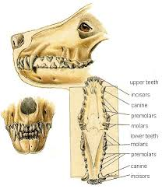
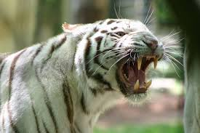
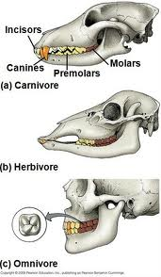
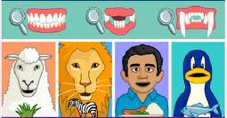

Slide 6
Suitability of teeth for diet pg 142
 | Incisor | Canines | Molars and premolars
Herbivore | Broad and flattened for cutting | Absent or short. (sometimes long for defence) | Flattened
Carnivore | Short and pointed for tearing | Long and curved to kill prey | Sharp, jagged and blade shaped
Omnivore | In-between | Long, pointed and curved | Sharp and blade shaped or flattened.
See pg 148 types of teeth and function

Slide 7
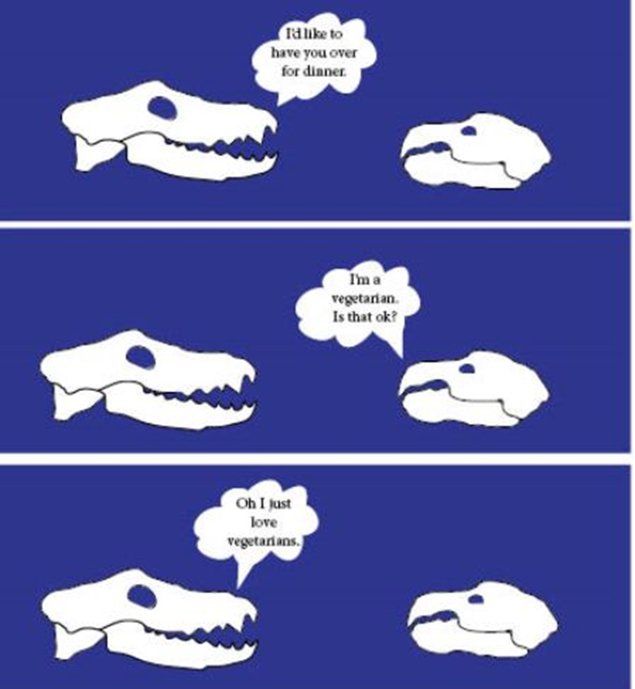

Slide 8
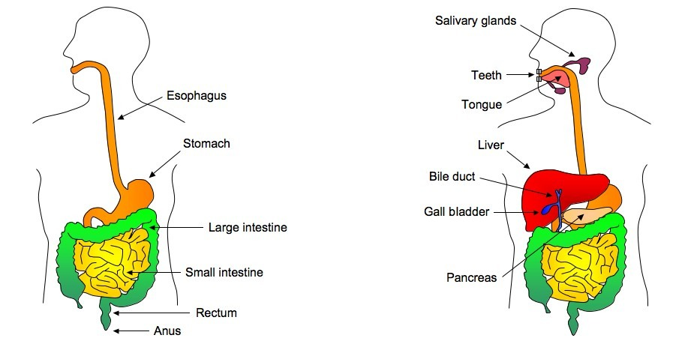
STRUCTURE of the digestive system (pg143)
Consists of:
Alimentary canal and associated organs
See pg 143

Slide 9
Mouth and mouth cavity (Alimentary canal) pg143-144

Slide 10
Tongue (associated organ)
Made of muscle
5 Functions (pg 147)

Slide 11
Teeth (associated organ)
Human dental formula:
2 incisors. 1canine. 2premolars. 3molars
2 incisors. 1canine. 2premolars. 3molars
Formula is for half of the jaw.
Pg 147-148

Slide 12
Tooth decay and fluoride
Read blocks on pg 149.

Slide 13
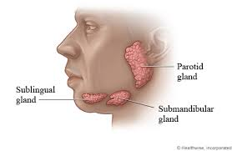
Salivary glands (associated organ)
Exocrine glands (have ducts) that secrete saliva.
Saliva moistens food and contains digestive enzymes (carbohydrases).

Slide 14
The pharynx (Alimentary canal) pg 144
Behind the mouth cavity.
Leads to the trachea (breathing passage) and the oesophagus.
When swallowing occurs, the epiglottis (cartilage flap) closes the opening of the trachea (glottis) to prevent choking.

Slide 15
The oesophagus (Alimentary canal)
Muscular tube that moves food from the pharynx to the stomach by peristalsis.

Slide 16
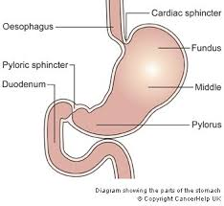
The stomach (Alimentary canal)
Found beneath the diaphragm.
Has cardiac sphincter (valve) on the top and the pyloric sphincter at the bottom.
Contains acid and digestive enzymes.

Slide 17
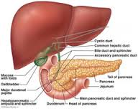
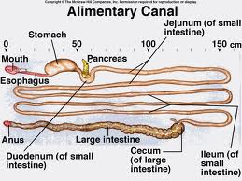
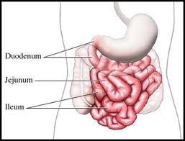
Small intestine (Alimentary canal) pg 144-146
2.5 - 4.5 m long
Duodenum- first part, common bile duct and pancreatic duct enter here.
Jejunum- short
Ileum- longest part leading to the large intestine.

Slide 18
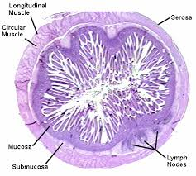
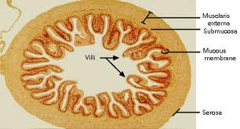
Section of the small intestine pg 145
Serosa- on the outside
Muscular region for peristalsis.
Longitudinal and circular muscles
Submucosa- connective tissue, with blood vessels, lymph and nerves.
Mucosa- inner layer of columnar epithelial cells with mucus secreting goblet cells. Folded to form villi.

Slide 19
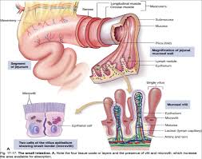

Slide 20
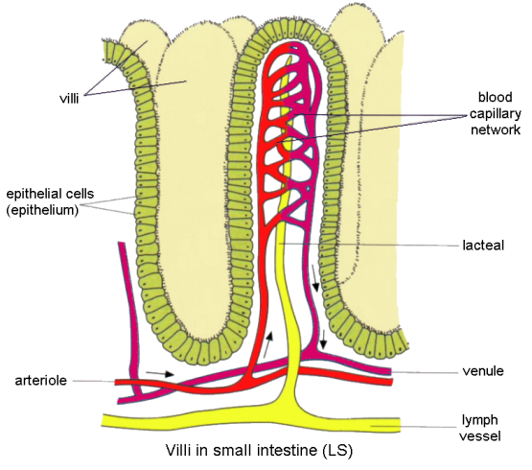
The villus
Single layer of columnar epithelial cells
Has goblet cells to secrete mucus
Core of connective tissue
Has a lacteal (lymph vessel)
Blood capillaries surround the lacteal.
Crypts of Lieberkuhn and Brunner’s gland secrete alkaline mucus.

Slide 21
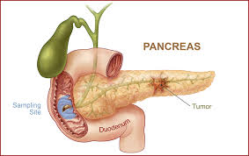
The pancreas (associated organ) pg 149
It secretes pancreatic juice (with digestive enzymes) via the pancreatic duct and then the hepato-pancreatic duct. This is released into the duodenum. Islets of langerhans (cells) secrete insulin and glucagon (hormones) that regulate the glucose level.

Slide 22
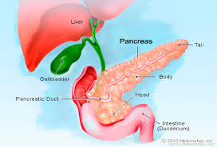
The Liver (associated organ) pg 149-151
Has a larger right lobe and a smaller left lobe.
Hepatic duct (from liver cells) joins the cystic duct (from the gall bladder) to form the common bile duct which joins with the pancreatic duct to form the hepato-pancreatic duct.
Y
Z
X

Slide 23
Functions of the liver
Secretes bile that is stored in the gall bladder.
Changes excess glucose into glycogen or fat and stores it.
Stores minerals such as iron and vitamins.
De-amination of excess amino acids into urea
Detoxifies harmful substances making them harmless

Slide 24
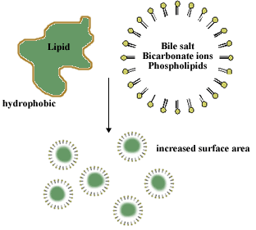
Bile
It is a yellow green alkaline liquid that has no enzymes.
Functions
Contains water that keeps food fluid.
Alkaline salts neutralise stomach acid.
Is slightly antiseptic- preventing the decomposition food in the small intestine.
Emulsifies fats (breaks into small droplets for increased S.Area)
Help in the absorption of fat and fat-soluble vitamins (A,D,E &K)

Slide 25
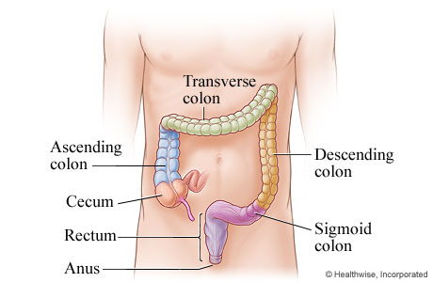
Large intestine (pg 147)
Caecum, colon and rectum.

Slide 26
ACT .2.2.5 pg 152-153 no 1-7 only
Note: you might have to read a few pages further to get some answers.

Slide 27
PROCESSES/FUNCTIONS

Slide 28
DIGESTION
Breaking down on large insoluble to small and soluble substances.
MECHANICAL
With the use of muscles, it increases the surface area for the action of enzymes
CHEMICAL
By enzymes using hydrolysis (water is needed).
Proteases- Proteins → amino acids
Carbohydrases- polysaccharides → monosaccharides
Lipases- Fats → fatty acid and glycerol

Slide 29
Role of water in the movement of food.
Increases liquidity of food and it keeps tissues of the alimentary canal moist.
It is taken in as liquid and it is added with saliva, gastric juice, pancreatic juice, bile and intestinal juice.

Slide 30
In the mouth...
Mastication (chewing)
Mechanical digestion increasing S. Area
Mixes food with saliva
Saliva
Water and mucus soften and lubricate food.
Creates correct pH for enzymes
Contains carbohydrases.

Slide 31
Oesophagus peristalsis (pg155)

Slide 32
In the stomach...
In the presence of proteins, gastrin (hormone) is secreted and it stimulates the release of gastric juice.
Gastric juice contains
Proteases
Water
Mucin (mucus)
Hydrochloric acid (antiseptic and changes pH)
Peristalsis moves food in different directions, mixing it with gastric juice.

Slide 33
In the small intestine...
When the presence of food is detected, secretin (hormone) is secreated which stimulates the pancreas to release pancreatic juice.
Peristalsis moves food along and mixes it with intestinal juice, pancreatic juice and bile.

Slide 34
Pancreatic juice
Contains:
Water
Sodium bicarbonate (alkaline)
Carbohydrases
Proteases
Lipases

Slide 35
Act 2.2.5 pg 153 no 8-15

Slide 36
Bile (functions already done)

Slide 37
Intestinal juice
Glands and crypts produce alkaline mucus- lubricates and protects
Columnar cells produce carbohydrases, proteases and lipases
Peristalsis moves food and mixes it with digestive juices.

Slide 38
Summary of chemical digestion table pg 158

Slide 39
Swimming after eating see block on page 156

Slide 40
Act 2.2.6 pg 159

Slide 41
ABSORPTION
In the stomach
A small amount of glucose, ions of inorganic salts, and alcohol are absorbed

Slide 42
In the small intestine
Glucose- Absorbed by villi by active transport into the blood capillaries.
Amino acids- same as glucose
Fatty acids and glycerol- bile makes it more soluble, then it is absorbed into the villi by diffusion then moves into the lacteal
Vitamins- fat soluble are absorbed passively and water soluble vitamins are absorbed actively or passively.
Minerals- both actively and passively
Water 95% absorbed by osmosis

Slide 43
In the large intestine
Water, certain ions and vitamins are absorbed.

Slide 44
The efficiency of absorption (pg 161)
Long tube
Large surface area
Thin surface
Transport available
Columnar epithelial cells have microvilli and mitochondria.

Slide 45
TRANSPORT AND ASSIMILATION pg 161-162
Digested fats → villus →lacteal → lymphatic vessels → left thoracic duct → heart
Other nutrients → villus → capillaries → hepatic portal vein → liver (storage and de-amination) → inferior vena cava → heart.

Slide 46
EGESTION aka DEFAECATION
Removal of undigested and indigestible material through the anus
Constipation occurs because food lacks bulk for peristalsis/ faeces dries out

Slide 47
Roughage
Food stuff high in fibre (lignin and cellulose) is called roughage
Roughage functions
Adds bulk to waste, stretching the colon → peristalsis
Cellulose absorbs water → stops faeces drying out
Fibres prevent poisonous substances from being absorbed.

Slide 48
Act 2.2.8 pg 164

Slide 49
Nutrition and homeostasis
Homeostasis- maintaining a constant internal environment.
Homeo stasis
Same
State

Slide 50
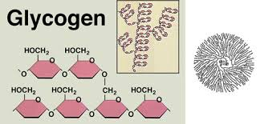
Blood sugar level pg 166
Glucose Glycogen
Insulin
Glucagon

Slide 51
Video

Slide 52
Blood sugar level pg 166

Slide 53
Diabetes (diabetes mellitus)
Insulin cannot be produced and blood glucose level increases
Symptoms
Excess glucose in urine/blood, extreme thirst, weight loss, non healing of wounds, etc. pg 167

Slide 54
Type 1
Pancreas stops producing insulin. Starts at <30 years. Patients need insulin injections
Type 2
Insulin is produced but is defective or in small quantities.
85-90% of diabetics.
Most >40 years old
Can be controlled with diet and exercise.
Tablets and insulin might also be used

Slide 55
Milk and sleep pg 165

Slide 56
Act 2.2.9 pg 168-169. No 1-3,5 and 7

Slide 57
A balanced diet
All organic and inorganic nutrients are required (see pg 169 fig 2.2.12)
55% carbohydrates, 30% fats and 15% proteins.

Slide 58
Act 2.2.11 B only. Pg 172-173

Slide 59
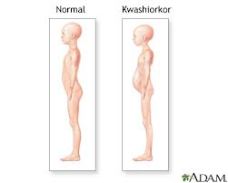
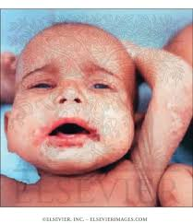
Malnutrition
Kwashiokor
Unbalanced diet, lack of protein
Symptoms (pg 173)
Swollen belly
Stick like limbs
Skin with sores
Swollen face
Swollen liver, poor quality blood
Slow brain development.

Slide 60
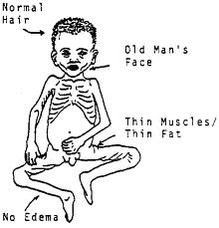
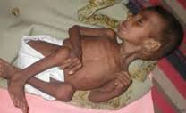
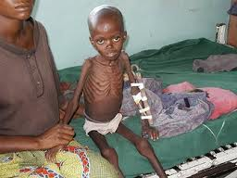
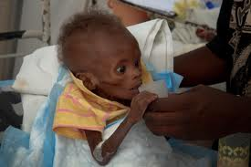
Marasmus
Lack of food/starvation
Symptoms
Face with deep set eyes
Thin muscles
Very little fatty tissue

Slide 61
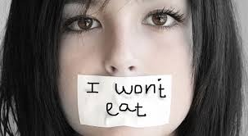
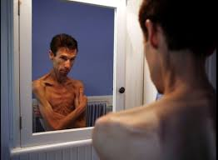
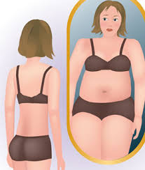
Anorexia
A person refuses to eat for psychological reasons.

Slide 62
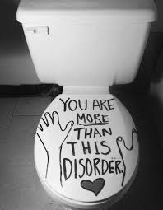
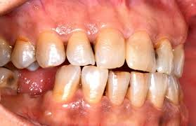
Bulimia
A person eat a lot, then feels guilty and induces vomiting or takes laxatives.

Slide 64
Obesity
Too much carbohydrates and fats. Become overweight. Increased risk of diabetes, hypertension, strokes and cardiovascular diseases.
Controlled by diet and exercise.

Slide 65
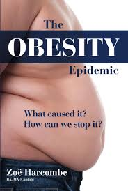
Sorry, these pics could not fit on the previous slide.

Slide 66
Dietary supplements (pg175-176)
Anti-aging supplement- Plant extracts that protect DNA and repair DNA. Vit. E and folic acid can also help.
Sports supplement- Avoid banned substance, a dietician can assist.
Vegetarian supplements- ensure that you have sufficient minerals and vitamins.
Pregnancy supplements- iron, calcium and folic acid.

Slide 67
SPORT DIET- more carbohydrates.
How to increase carbohydrates pg 177.

Slide 68
DIET AND CULTURE
VEGETARIANISM- Types pg 178 fig 2.2.4
HALAAL- Only food permissible by religion. Pg 178
KOSHER- food consumed allowed by jewish law.

Slide 69
Effect of drugs and alcohol
VERY IMPORTANT FOR SOME OF YOU pg 181

Slide 70
