Slide 1
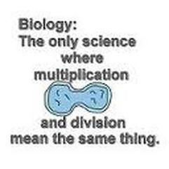
Cell division
mitosis

Slide 2
A cell can divide in one of two types:
Mitosis – grade 10
Meiosis – grade 12
In mitosis, a mother cell divides to form TWO identical daughter cells
No change in chromosome number or genetic information takes place
Takes place to form/produce body cells (somatic cells
In meiosis, a mother cell undergoes division to form FOUR different daughter cells that each have half the genetic material of the mother cell plus each cell is different from each other
Takes place to form sex cells(gametes)

Slide 3
The cell cycle
Is a series of events that occur to duplicate a cell
Cell division in a eukaryotic cell can be divided up into two stages:
Interphase
Mitosis and cytokinesis
The cell cycle is vital as it is the processes that all cells undergo to transform from a single-celled organism into a multicellular organism
As well as the process that cells undergo to renew themselves. Such as renewing skin, hair, organs etc.

Slide 4
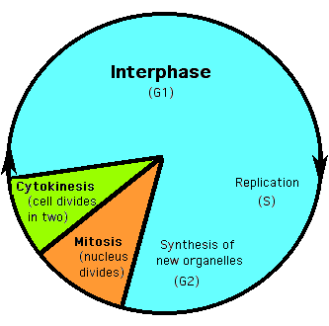
The cell cycle

Slide 5
What is mitosis?
The process by which a single cell divides to form two identical daughter cells
each cell has the same number and type of chromosomes
They are genetically alike
Mitosis is important because:
Growth in size occurs due to mitosis
Repair of damaged or replacement of old cells occur due to mitosis
Brings about asexual and vegetative reproduction in some plants and lower organisms

Slide 6
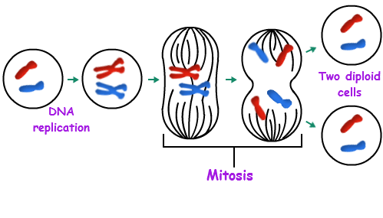

Slide 7
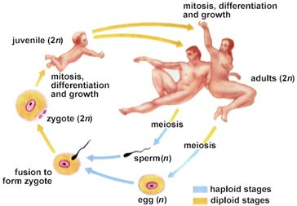

Slide 8
HOMEWORK
Draw, label and annotate all of the 5 phases involved in mitosis. Use a blank double page. Make the different chromosomes different colours, and carry these colours through the phases.

Slide 9
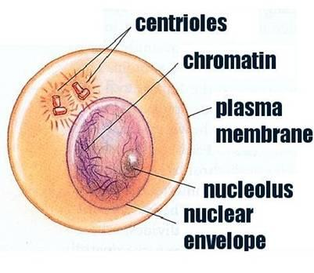
INTERPHASE
In preparation for the division of the nucleus, DNA replicates so that the genetic material is doubled in the Chromatin Network.

Slide 10
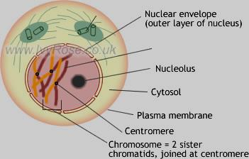
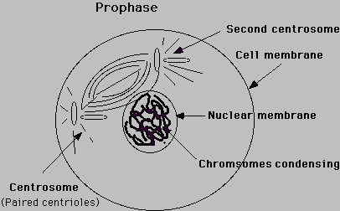
PROPHASE
The Chromatin Network unwinds to form visible chromosomes. Each chromosome is actually made up of 2 identical parts called chromatids (because of DNA replication). The centrosome splits and starts moving to the poles. The nuclear membrane and the nucleolus starts to disappear.

Slide 11
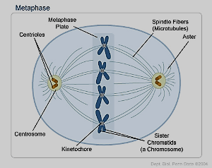
METAPHASE
The chromosomes arrange themselves along the middle of the cell in a single row, attached to the spindle fibres

Slide 12
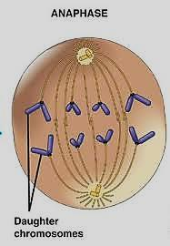
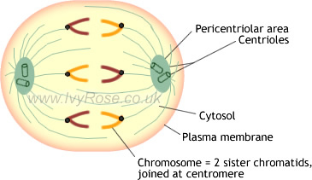
ANAPHASE
When the spindled fibres contract, the two chromatids are pulled apart towards opposite ends of the cell causing the chromosomes to split at the centromeres. Each chromatid is actually a single stranded chromosome, since DNA replication took place.

Slide 13
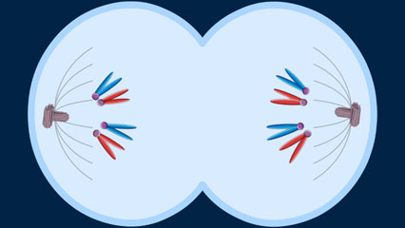
TELOPHASE
chromatids
Two groups of chromosomes are now present – one at each end of the cell. Thus we have 2 nuclei within which we have the same number and kind of chromosomes as the original.
The division of the cytoplasm, called cytokinesis, then takes place forming 2 identical cells.

Slide 14
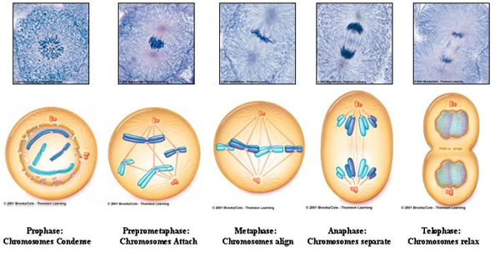
The process of mitosis
https://www.youtube.com/watch?v=VlN7K1-9QB0

Slide 15
HOMEWORK Activity 1.3.2 Page 95 Everything including pie chart!!!

Slide 16
CYTOKENISIS
Cytoplasm + splitting
Chromosomes reappear as chromatin.
Division of cell into 2 identical halves called daughter cells.
In plant cells cytokinesis occurs by the laying down of a new cell wall in the equatorial region of the cell.
The cell plate is at the equator to divide the cell.
In animal cells we have a CLEAVAGE FURROW.
The cleavage furrow splits the cell to form 2 new daughter cells.

Slide 17
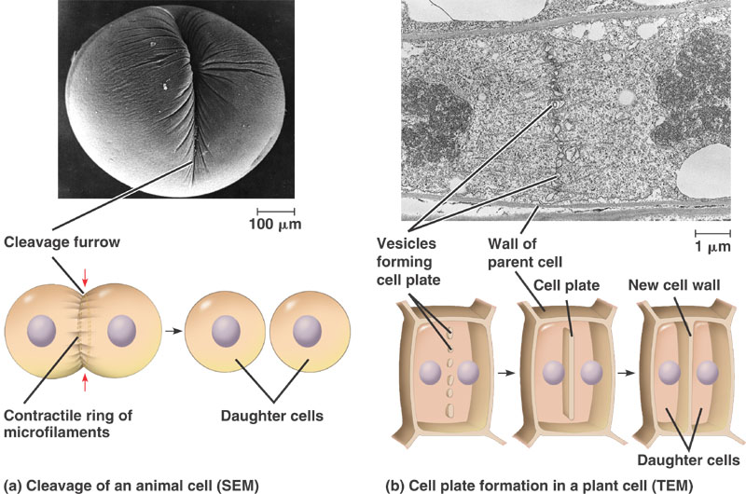
Difference between plants and animal cells
Table on page 90

Slide 18
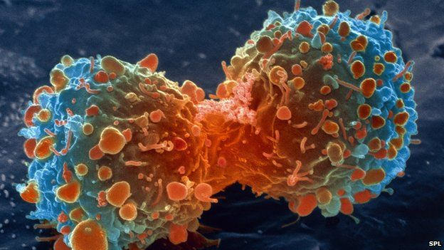
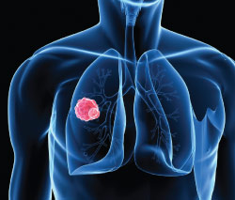
Cancer
Normally, a single cell undergoes many divisions to form numerous cells.
These cells then under go chemical and physical changes – the differentiate or become specialised to become various tissues and stop dividing.
Sometimes, these dividing cells behave abnormally. They divide uncontrollably.
This continual division of cells results in the formation of a clump of cells (dividing and undifferentiated) which is known as a tumour.

Slide 19
Two types of tumours exist:
Benign:
Tumours that have stopped growing
Do not affect neighbouring tissues/organs
Is not cancerous
Malignant :
Tumours that continue growing
Invade and affect neighbouring tissue/organs
Cells tend to break off and enter the circulatory system

Slide 20
WHAT CAUSES CANCER?
Cancer may arise from the mutation of a normal gene.
Any agent that causes cancer is called a CARCINOGEN (cancer causing agent) eg.
Radiation (from sun, x-rays, atomic weapons)
Smoking (chemicals, tar form cigarette)
Hormonal imbalances
Certain processed foods
Exposure to certain pollutants such as industrial wastes, car exhaust fumes,
Pesticides
Viruses (although not considered major cause of human cancer)
Constant irritation over long period of time (eg. Cancer of mouth and lips as result of pipe smoking)

Slide 21
Causes of cancer
Cancer causing agents (carcinogen)
Carcinogens do not always cause cancer
People that get cancer after exposure probably have an inherited susceptibility
Beliefs and attitudes toward cancer:
Fear of the disease
Uncertainty regarding the treatment
General reluctance of men to ask for help
Types of cancer:
Carcinoma – skin and epithelial tissues of organs and glands
Sarcoma – bone, cartilage and muscles
Leukaemia – blood and lymphatic system

Slide 22
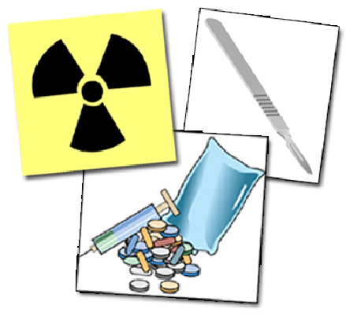
Treatment of cancer
Standard treatment:
Radiotherapy – involves use of radiation
Chemotherapy – usage of various chemicals in combination
Surgery – can be used to remove the tumour in its early stages
Cryosurgery – freezing temperatures
Alternative treatments: (pg 93)
Using the ‘cancer bush plant’ used for treatment of pancreatic cancer and for improvement of life of those with breast cancer.

Slide 23
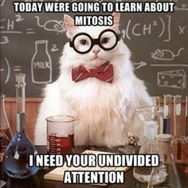
Homework ☺
Activity 1.3.1
Page 94

Slide 24
End of cell division

