Slide 1
Life at molecular level
The Chemistry of Life

Slide 2
Chemistry of life
Summary layout
Minerals
Inorganic compounds

Slide 3
Elements
Remember all compounds are made up of elements.
Elements are pure substances.
Elements come together to form compounds.
There are two types of compounds.
These are organic and inorganic compounds.

Slide 4
Inorganic compounds
These are compounds that do not contain the element carbon 12.
Examples of inorganic compounds are water and carbon dioxide.

Slide 5
Organic compounds
These are compounds that contain the element carbon 12.
Examples are carbohydrates, proteins and fats.

Slide 6
minerals
Minerals are inorganic substances that are required by living organisms.
They are required by both plants and animals.
Minerals can be put into two groups depending on the organisms needs.
These two groups are:
Micro-elements
Macro-elements

Slide 7
Macro- and micro-elements
Macro-elements are elements that are required in large quantities by living organisms.
Micro-elements are elements that are required in small quantities by living organisms.
A mineral maybe either a macro- or micro-element depending on the organisms needs.
The table on the next slides discusses some of these minerals.

Slide 8
Functions of some minerals and their deficiency diseases.
Mineral | Function |  | Deficiency
Sodium (Na) | plants | Maintains osmotic balance in plants | Reduced plant growth
 | animals | Has a role in the functioning of nerves and muscles Regulates the secretion of HCl in the stomach | Muscle cramps
Potassium (K) | plants | Needed for: Photosynthesis Protein synthesis, activation of plant enzymes Regulation of the stomata | Lower drought resistance Excessive water lose disease
 | animals | Regulation of : Blood pressure, nerve functions, muscle control, cellular respiration | Low oxygen levels Muscular cramps Lung failure

Slide 9
Functions of some minerals and their deficiency diseases
Mineral | Function |  | Deficiency
Calcium (Ca) | plants | Used for the formation of the middle lamella of cell walls Also maintains the permeability of cell walls | Poor plant growth Growing parts of plant die
 | animals | Required for bone and teeth formation. Used in blood clotting | In children causes rickets
Phosphorous (P) | plants | needed for cell membrane formation and for the formation of nucleic acids Used for the formation of ATP | Leaves fall off prematurely Brown spots develop on leaves
 | animals | Used for the formation of cell membranes, nucleic acids, ATP and bone and teeth | Rickets in children

Slide 10
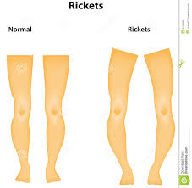
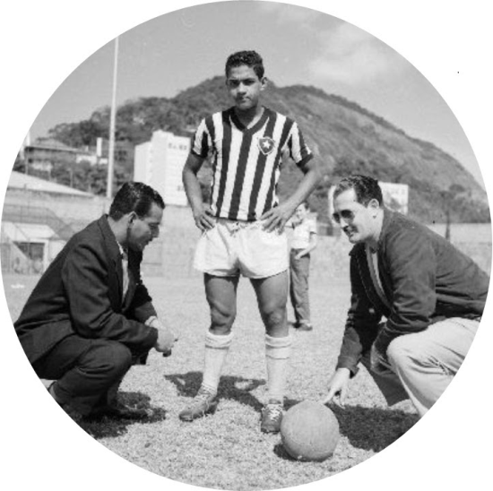
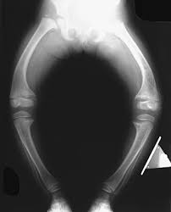
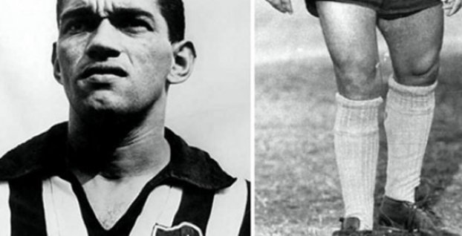

Slide 11
Functions of some minerals and their deficiency diseases
Mineral | Function |  | Deficiency
Iron (Fe) | plant | Used in the formation of chlorophyll | Leaves become yellow due to the lack of chlorophyll. This is called chlorosis
 | animals | Used for the formation of haemoglobin | anaemia
Iodine (I) | plants | Used in photosynthesis | Photosynthesis decreases causing a decrease in growth and death of the plant
 | animals | Used in thyroxin formation | Causes enlargement of the thyroid gland. This disease is called goitre.

Slide 12
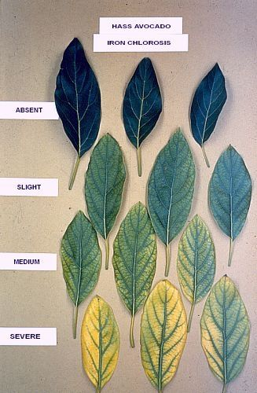
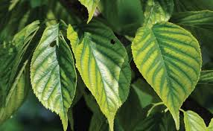
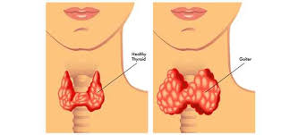
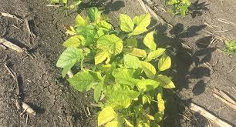
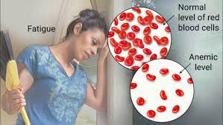
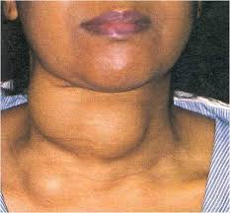
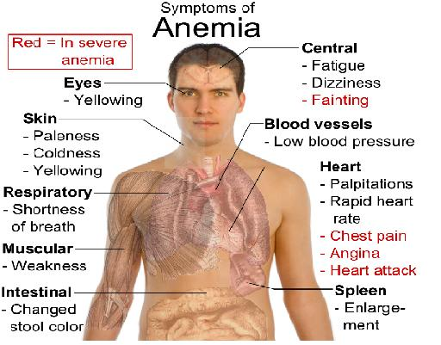
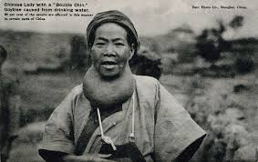

Slide 13
Functions of some minerals and their deficiency diseases
Mineral | Function |  | Deficiency
Nitrogen (N) | plants | Used by plants for the formation of amino acid, nucleic acids and chlorophyll | chlorosis
 | animals | Required for protein synthesis and nucleic acids | Kwashiorkor in children
Magnesium (Mg) | plants | Used to make the central atom of chlorophyll molecule | Chlorosis
 | animals | Used for bone and teeth formation and for nerve and muscle functioning | Muscle cramps

Slide 14
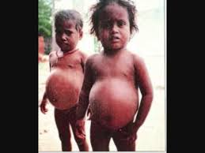
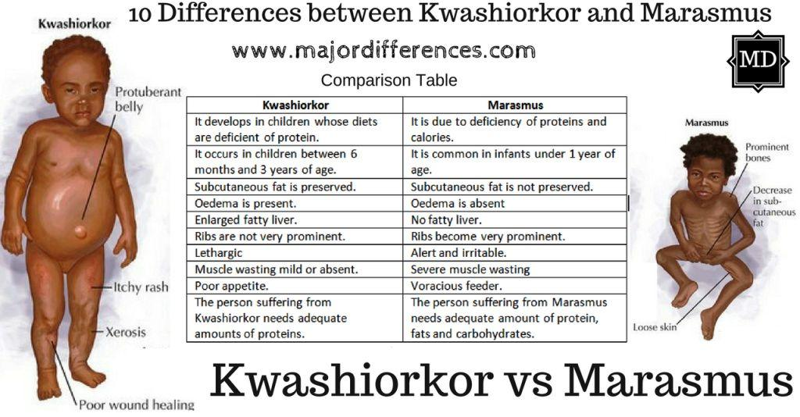

Slide 15
Something for you to do.
Use the table to answer the following questions.
Explain what is meant by…
1.1 osmosis
1.2 protein synthesis
Describe the…
2.1 chlorophyll
2.2 haemoglobin
2.3 amino acids

Slide 16
Something for you to do.
Explain why chlorosis occurs when there is an iron and nitrogen deficiency.
Name the gland that secretes thyroxin.

Slide 17
solution
1.1 osmosis is the movement of water from a region of high concentration to a region of low concentration across a differentially permeable membrane.
1.2 protein synthesis is the process during which proteins are made.
2.1 chlorophyll is a green pigment found in plants and is used to give plants the green colour and trap sunlight.
2.2 haemoglobin is a red pigment found in the red blood cell, its function is to give blood the red color and to transport gases.

Slide 18
Solution:
2.3 amino acids are the building blocks of proteins.
Both iron and iodine is used to make chlorophyll, if these minerals are deficient then the plant cannot make enough chlorophyll and the leaves will lose their green colour.
Thyroid gland

Slide 19
The need for fertilizer in over used soil
In order for plants to grow they need nutrients.
These nutrients come from both the soil and air.
Nutrients enter the soil when dead plants and animals decay.
In order to achieve this richness of soil, decomposition should be encouraged.
Farmers can achieve this in two ways.

Slide 20
The need for fertilizer in over used soil
These two ways are…
To leave the soil fallow
To plough back dead plants into the soil.
Can you explain what is meant by fallow?
If the land is used constantly there is no time for the land to be left fallow or for natural nutrient recycling to occur.
Therefore the soil may become very infertile.

Slide 21
The need for fertilizer in over used soil
So the farmer may use synthetic fertilizers to replace the lost nutrients.
These fertilizers may contain phosphates and nitrates.
When it rains these fertilizers may be washed out into to the rivers.
The nutrient content of the river increases.
This increased nutrient content causes a rapid growth of plant and algae in the water.
This is called eutrophication.

Slide 22
The need for fertilizer in over used soil
The increased plant growth especially the algae covers the surface of the water, preventing sunlight from reaching the plants lower down in the water.
These plants will die and the aquatic organisms that depend on these plants will also die.
The dead plant and animal matter begin to rot and attract bacteria to the water.
Can you explain why the bacteria are attracted to the area?

Slide 23
The need for fertilizer in over used soil
The increased bacteria uses more oxygen and this decreases the oxygen content of the water.
This results in more plants and animals dying.

Slide 24
Solution:
Fallow means that the farm lands should be left without planting crops.
Bacteria are attracted to the area because the area has a high concentration of dead organic matter, which the bacteria will decompose.

Slide 25
EUT ROPHICATION
Excess fertilisers → water system → nutrients (N and P) → rapid growth of algae (algal blooms) →Block sunlight → plants die → decomposition → oxygen is used up → animals die.

Slide 27
Inorganic compounds
The main inorganic compounds required by living organisms are water and mineral salts.

Slide 28
Mineral salts
Many minerals that are required by living organisms occur in the form of salts.
These minerals are therefore referred to as mineral salts and not just minerals
Some examples of such salts are sodium chloride, nitrates and phosphates.
The nitrates contain nitrogen and the phosphates contain phosphorous.

Slide 29
water
Water can exist naturally in three states, solid, liquid and gas.
It is the only substance like this on Earth.
In its solid state it exists as ice found in the polar ice caps, as a liquid it is called water and is found in the rivers, lakes and oceans and finally as a gas it is called water vapour and occurs in the atmosphere.

Slide 30
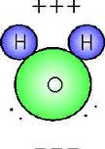
water
One molecule of water is made up of two hydrogen atoms and one oxygen in the arrangement shown below.

Slide 31
Importance of water
The human body is made up of 60-75% water.
70-95% of the cell is made up of water.
Water makes life on Earth possible.

Slide 32
Functions of water
It is used during digestion to break down large insoluble substances into smaller soluble substances.
It is a medium for all chemical reactions in the cell.
It is used to transport food along the alimentary canal and mineral salts in plants.
Dissolve the waste substance in the body to form urine and sweat.

Slide 33
Terminology TEST
Pure chemical substances of one type.
Made up of two or more elements combined.
Are compounds that do not contain the element carbon 12.
Inorganic substances that are required by living organisms are elements that are required in large quantities.
The rapid growth of the population of living organisms, usually aquatic plants, due to increased supply of nutrients.

Slide 34
Answers
1 Elements
2 Compounds
3 Inorganic compounds
4 Macro-elements
5 Eutrophication

Slide 35
homework Activity 1.1.1pg 39

Slide 36
Organic compounds
Compounds that contain the element Carbon together with Hydrogen.
Carbohydrates:
Made up of C, H and O only.
H is usually double the amount of O
Three types:
Monosaccharide – simple sugar, glucose and fructose
Disaccharide – 2 mono’s, maltose sucrose, lactose
Polysaccharide – more than 2 mono’s, cellulose, glycogen
3 main functions:
Source of energy
Storage form of energy (glycogen and starch)
Provide building material for cells (cellulose)

Slide 37
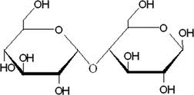
Mono-, di- and polysaccharides

Slide 38
Lipids
Fats and oils
Made up of C, H and O and may contain P
Ratio of H:O is greater than 2:1
Made up of 2 smaller molecules – glycerol & fatty acids
1 glycerol + 3 fatty acid = 1 fat molecule + 3water
Can be of two types:
Saturated – cannot take any more H (solid at room temp)
Unsaturated (oils) – can accept more H (liquid at room temp)

Slide 39
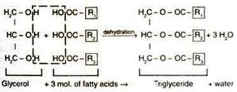

Slide 40
Lipids have the following functions:
Store a lot of energy
Packing tissue between organs
Reduce heat loss
Phospholipids makes cell membranes
Saturated fats, cholesterol and heart disease
Diet high in saturated fats
Form deposits in blood vessels

Slide 42
Proteins
Must have the elements C, H, O and N
Some may contain S, P and/or Fe
Made up of smaller units known as amino acids (monomers)
Can be easily changed by very high or very low temperatures or pH differences
High temperature – denatures proteins
Low temperature – deactivates proteins
Proteins have the following functions:
Stores energy
Used to form parts of the cell
Enzymes (type of protein) control many biochemical functions

Slide 43
Homework Act 1.1.6 pg 46

Slide 44
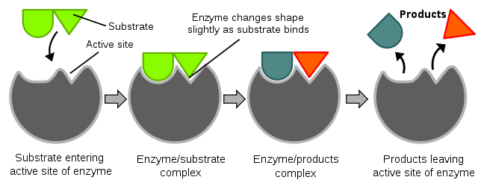
Enzymes
Special group of proteins – organic catalysts
Functions include:
Speeding up reactions without being used
Control/regulate reactions
Lock and key theory

Slide 45
Optimum rate
Optimum (best) rate is the rate at which the most product is formed in the shortest space of time.
According to the graph as the temperature increases, the rate of reaction also increase, until the temperature is about 37⁰C then enzyme activity is at it maximum. This temperature is called the optimum temperature. Then as the temperature increases further then enzyme activity starts to decrease because the temperature is too high and the enzymes become denatured.

Slide 46
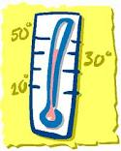
effect on temperature on enzyme activity
When the enzyme becomes denatured the shape of the enzyme changes.
This means that the substrate can no longer fit into the enzyme.
This cause the chemical reaction to either slow down or stop.

Slide 47
Effect of ph on enzyme activity
The graph shows that the enzyme activity peaks at a certain pH.
This pH is called the optimum pH.
If the pH is lower or higher than this optimum pH, then enzyme activity decreases, because the enzyme becomes denatured.
Optimum temperature/pH

Slide 48
Enzymes cont.
Use of enzymes in industry:
Very cheap/economical as they do not get used up
Do not need high temperatures to function
Small amounts are required for a large yield
Uses:
Meat tenderisers
Hair removal creams
Making of beer, wine vinegar , chocolates and syrups etc
Used in washing powders
Amylases (break down starch)
Proteases (break down ______)
Lipases (break down ________)

Slide 49
Activity 1.1.10 pg 52-53

Slide 50
Nucleic acids
Chromosomes contained in the nucleus of each cell contains
DNA – Deoxyribo-Nucleic Acid
RNA – Ribo-Nucleic Acid (can be located outside the nucleus)
No one has actually seen DNA
In 1953 two scientists – Watson & Crick – developed a model to try and explain the behaviour and have been awarded a Nobel Prize in 1962.
DNA is made up of monomers called nucleotides joined together.
A specific length of DNA makes a gene
A gene:
Carries a code for the production of a specific protein
Carries a code for the production of a specific enzyme
Control the inheritance of characteristics (code of life)

Slide 51
Vitamins
Complex organic compounds found in very small quantities in natural foods
Required for the normal functioning of the body
Absorbed from food during digestion
A normal, healthy diet usually gives us all the vitamins we require for normal functioning
If an unbalanced diet is followed, a vitamin deficiency might develop which could have detrimental consequences.
Table 1.1.2 – page 55
Know this VERY WELL

Slide 52
Vitamin | Function | Sources | Deficiency disease and their symptoms
Vitamin A | Essential for the correct functioning of the eye. | Liver, milk, milk products, fruit and vegetables | Night blindness: difficulty in seeing in dim light
Vitamin B | Acts as a co-enzyme in cellular respiration | Whole grains of cereals, nuts, meat and yeast. | Beri-beri: stunted growth and heart disorders
Vitamin C | Maintains intercellular substance in cartilage, bone & dentine. May acts as a catalyst in cell respiration | Citrus fruit, guavas, tomatoes, potatoes. | Scurvy: bleeding gums, under the skin especially at the joints. Poor healing of wounds.

Slide 53
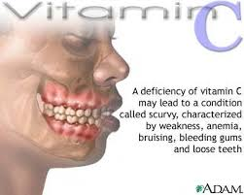
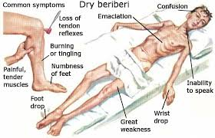
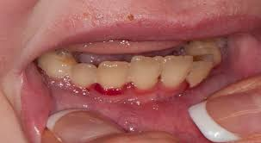
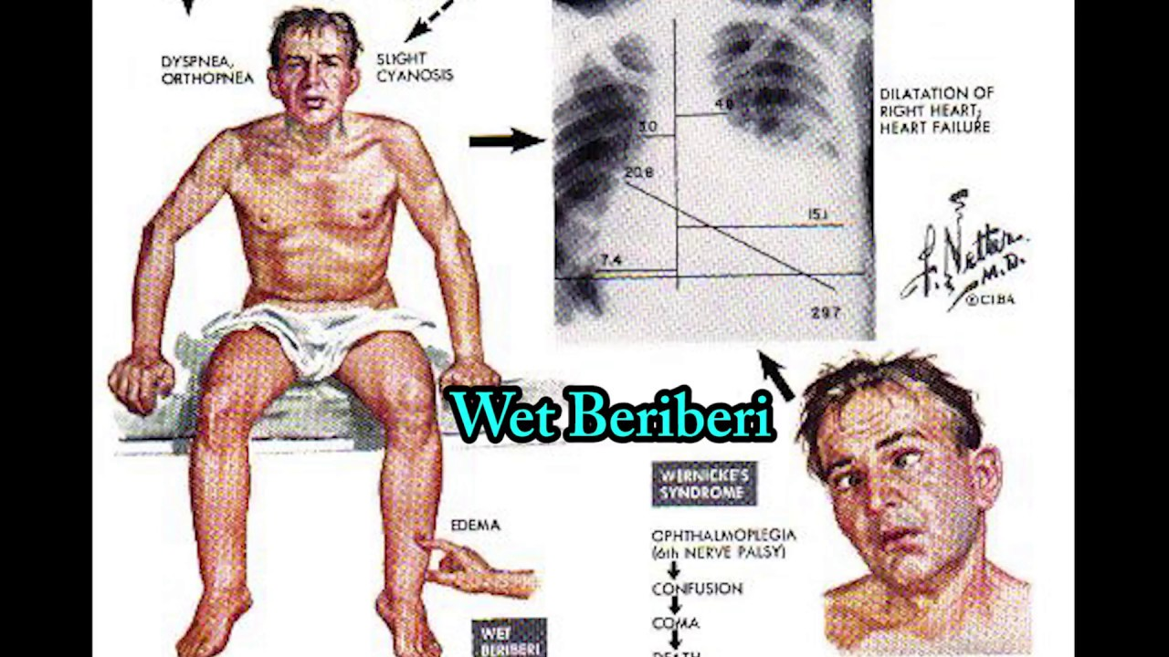
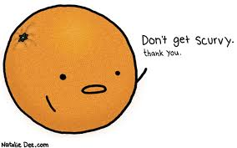

Slide 54
Vitamin | Function | Sources | Deficiency disease and symptoms
Vitamin D | Increases absorption of calcium & phosphate salts. | Diary products, egg yolk | Rickets in children: abnormal bone formation. Osteomalacia in adults: compressed vertebrae, bow-shaped legs, swollen joints.
Vitamin E | Prevents oxidation of unsaturated fatty acids | Leafy green vegetables | Excessive bleeding-known as haemorrhage

Slide 55
Activity 1.1.11 pg 56

Slide 56
Activity 1.1.12 pg 57-58

