Slide 1
Support systems in animals

Slide 2
Three types of skeletons
In animals, we identify three different skeletal types:
Hydrostatic skeleton
Exoskeleton
Endoskeleton

Slide 3
Hydrostatic skeleton
Consists of a fluid –filled cavity that is surrounded by muscles.
The fluid exerts pressure within the cavity which gives the animal its shape.
Through muscle contractions, fluid is pushed in organised directions and the animal moves
Movements such as swimming, digging and crawling are obtained in this way.
This type of skeleton occurs in animals with soft bodies.

Slide 4
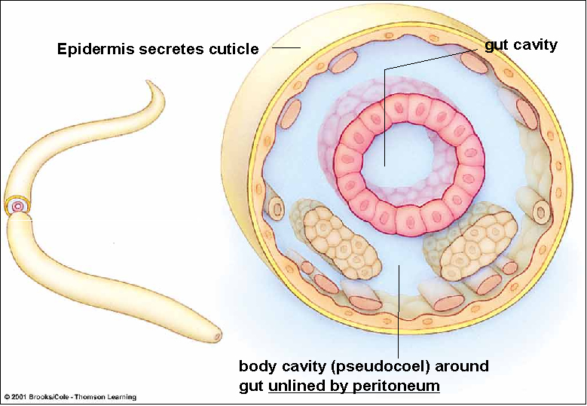
Hydrostatic skeleton

Slide 5
Advantages and Disadvantages
Do not need specialised support system as animals live in fluid filled environment or contain fluid within their bodies.
Can NOT support fast movements.
Animals need to be in aquatic or moist environment. (desiccate)
The size of growth is limited.
Does not provide protection.

Slide 6
Exoskeleton
Is an external skeleton usually found in invertebrate animals such as arthropods.
Made up of a polysaccharide known as Chitin and sometimes is hardened with calcium carbonate

Slide 7
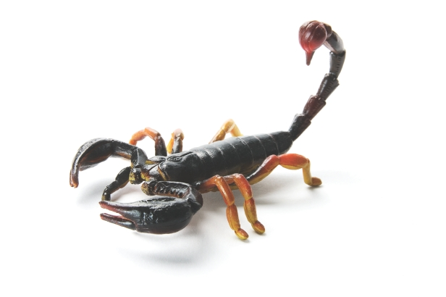
Exoskeleton

Slide 8
Advantages
It provides support and protection to vital organs and tissues
Inside, a place for attachment of muscles is provided which allows for rapid movements.
It has joints where the skeleton is thin and flexible.
Prevents animal from drying out or loosing too much water.

Slide 9
Disadvantages
It limits the size of the animal.
The larger the animal, the larger and heavier the exoskeleton.
Chitin can not expand or stretch, therefore the animal must shed its exoskeleton during periods of growth.
During this shedding, the animal is left with a soft exoskeleton which makes the animal vulnerable to attacks.
Process of shedding is known as Moulting/ecdysis
An exoskeleton is impermeable to gases therefore special openings to allow gas to reach respiratory organs are required.

Slide 10
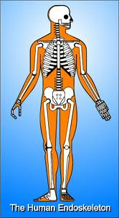
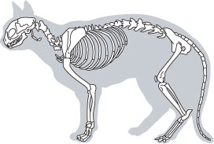
Endoskeleton
Is an internal skeleton consisting mainly of bone and cartilage.
Found in vertebrate animals.

Slide 11
Advantages
Bone and cartilage are living tissue that grow together with the organism.
It protects internal organs such as brain, heart and lungs.
It provides structural support and gives the body shape.
It provides a place for attachment of muscles which makes locomotion possible.
Joints at the ends of bones makes the body flexible, together with the muscles, make locomotion efficient.
Joints also allow for independent movement of bones.
Since bone is a living tissue, it is able to grow with the organism

Slide 12
Disadvantages
Not many disadvantages of an endoskeleton.
Which is why all most evolved and larger animals have an endoskeleton.
However, endoskeletons do not serve as an external protection against heat and cold.
What are vertebrate and invertebrate animals?

Slide 13
Vertebrate animals
Animals that have a vertebrate column (spine) are known as vertebrate animals.
They have an internal skeleton consisting of bone and cartilage.
They are from the phylum Chordata.
Fish, amphibians, reptiles, birds and mammals.

Slide 14
Invertebrate animals
Animals that do not have a vertebral column.
Do not have an internal skeleton.
In simple terms, all invertebrates either have a hydrostatic skeleton or a exoskeleton.

Slide 15
The human skeleton
Functions include:
Movement
Protection
Support
Mineral storage
Hearing
Blood cell formation

Slide 16
Structure of the skeleton
A human skeleton weighs between 8 and 15kg
It is made up of 206 bones which are divided into two main sections:
An axial skeleton
An appendicular skeleton
Axial skeleton – skull, vertebral column, ribs and sternum
Protects internal organs
Allow for flexible movement
Allows for attachment of other bones
Appendicular skeleton – pectoral girdle, pelvic girdle, upper and lower limbs.

Slide 17
You need to be able to label the diagram!!!

Slide 19
The axial skeleton
Consists of the skull, vertebral column and ribcage.
Forms the central axis that keeps the body upright.
All the other parts of the endoskeleton are attached to the axial skeleton.
It protects the brain, sense organs, spinal cord, heart and lungs.

Slide 20
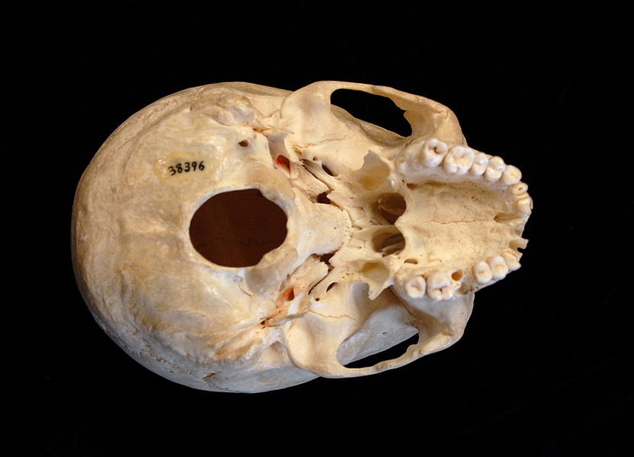
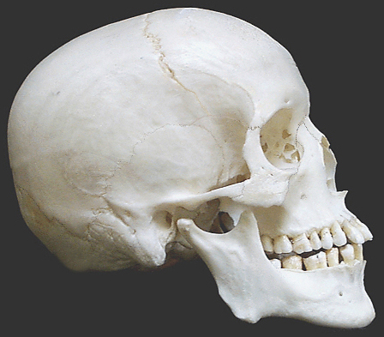
The skull
Consist of two groups of bones:
Cranium
Facial bones

Slide 21
The cranium consists of 8 flat bones that are immovably joined to each other with serrated sutures.
It surrounds the brain and protects it.
The opening at the bottom called the foramen magnum allows the spinal cord to pass through.
An articular condyle, located on either side of the foramen magnum which articulates with the first cervical vertebra. (atlas)

Slide 22
The facial bones consist of 15 irregular bones that form the forehead, cheekbones, nose, and the two jaws.
All these bones are immovable except the lower jaw.
On the edges of the two jaws, teeth sockets are found into which the teeth fit.
Adults have 32 teeth which are not part of the skeleton

Slide 23
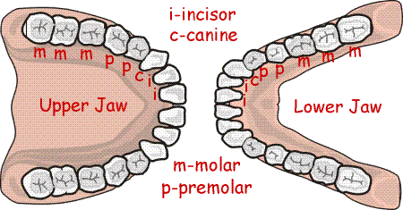
Dental formula

Slide 24
Vertebral column
Consists of 33 bones known as the vertebrae.
Joined together by ligaments.
The bones are arranged one on top of the other to form a flexible column.
Five different types of vertebrae are found:
7 cervical vertebrae
12 thoracic vertebrae
5 lumbar vertebrae
5 sacral vertebrae
4 vertebrae that form the coccyx

Slide 25
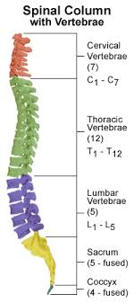

Slide 26
All vertebrae are structurally alike.
Each vertebra consists of a:
Centrum (body)
Neural arch
Processes (outgrowths) – for attachments of muscles and ligaments
Between the neural arch and centrum, the spinal canal (foramen) is formed
This canal surrounds and protects the spinal cord and is connected to the foramen magnum

Slide 27
Three outgrowths are visible – the neural spine and two transverse processes.
Articular surfaces occur on the vertebra to connect it to the previous and following vertebra.
Fibrous cartilage discs occur between vertebra.
Small openings occur between the vertebra to allow for nerves to enter and exit.

Slide 28
Neural spine
Structure which connects to lower vertebrae
Transverse process
Foramen or neural canal
Neural arch
Centrum

Slide 29
The first 24 vertebrae are separate bones and are known as true vertebrae.
The last 9 are fused into two groups and are known as false vertebra.
Of the above 9, five make up the sacrum while four make up the coccyx.
The spine is arranged to make up four curvatures.
This helps with flexibility, to absorb shock and to maintain balance.

Slide 30
Cervical - towards the front.
Thoracic - towards the back.
Lumbar – towards the front.
Sacral – towards the back.

Slide 31
Functions of the vertebral column
It supports the skull
Surrounds and protects the spinal cord
It is a place for attachment for the ribs, pelvic girdle and pectoral girdle.
It is a place for attachment for the muscles of the back.
The curvature provides flexibility, absorbs shock and maintains balance.
The spaces between vertebrae allow for the exiting of the spinal nerves to the rest of the body

Slide 32
The rib cage
Consists of 12 thoracic vertebrae , 12 pairs of ribs and the sternum.
The sternum is a long, flat, knife shaped bone in the front of the ribcage.
The ribs are narrow and arched.
All 12 pairs are attached to the back to the vertebral column.
The first 7 pairs are attached to the sternum and are known as true ribs.
Of the next 5 pairs:
3 pairs are attached to the previous rib and are known as false ribs.
The last 2 are not attached and are known as floating ribs.

Slide 33
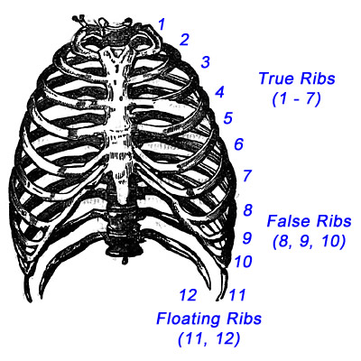
Functions of the rib cage
It protects vital organs
Plays a role in breathing by either increasing or decreasing the thoracic cavity.

Slide 34
Homework ☺
Activity 2.2.5 No 1-6
Page 175

Slide 35
The appendicular skeleton
The pectoral and pelvic girdle attach to the axial skeleton at the upper and lower ends.
The girdles join the upper and lower limbs to the axial skeleton.
The axial skeleton is made up of 80 bones.
The appendicular skeleton is make up of 126

Slide 36
The pectoral girdle
Consists of 2 scapulae (shoulder blades) at the back, and 2 clavicles (collarbones) at the front.
The scapula is a large, flat and triangular bone, with a place of attachment for muscles.
Not attached to the axial skeleton, but slides over the back of the ribs.
It has a shallow socket known as the glenoid cavity into which the arm (humerus) fits into.
The clavicle is an S-shaped bone that articulates with the scapula on one end, and with the sternum on the other end.

Slide 37
The Pectoral Girdle

Slide 38
The upper limbs
The upper limbs are made up of 6 different types of bones:
Humerus – long bone attached to the pectoral girdle to the elbow.
Ulna – longest bone in the forearm. Situated on the little finger side.
Radius – thinner of the two in the forearm. Situated on the thumb side.
Carpals – 8 small, short bones arranged in rows of four.
Metacarpals – 5 bones in the palm of your hand.
Phalanges – made up of 14 bones which form the fingers. Three in each finger but two in the thumb.

Slide 39
The Upper Limbs

Slide 40
The pelvic girdle
Consists of two hip bones, joined n the middle by an immovable joint known as the pubic symphysis.
Attached to the sacrum at the back.
The hip bones are made up of three fused bones known as the ilium, ischium, and pubis.
A deep socket, the acetabulum, occurs where the three bones are fused. This connects to the femur.
Females pelvic girdles are wider than males due to the females having to give birth.

Slide 41
The Pelvic Girdle

Slide 42
The Lower Limbs
Made up of 7 different types of bones:
Femur – longest and largest bone in the body.
Patella (kneecap) – flat, triangular bone that is found in front of the end of the femur and forms the knee joint.
Tibia – thicker of the two in lower leg.
Fibula – thinner of the two in the lower leg.
Tarsals – seven bones that form the ankle. The heel bone which occurs at the back is the largest.
Metatarsals – five bones that form the arch of the foot.
Phalanges – 14 bones that form the toes. Three in each toe except the big toe which only has two.

Slide 45
Homework ☺
Add short notes (annotations) to your diagram of the skeleton.
Ways to remember which bones are where
Amounts of bones in phalanges
Where is the radius and ulna situated?
Where is the tibia and fibula situated?
Bones making up the pelvic girdle?
Sockets formed in pectoral and pelvic girdle?
Any other relevant information.

Slide 46
Functions of the skeleton
Movement – bones + muscles
Protection – for major organs
Support – holds entire body and gives it shape
Storage of minerals – calcium
Hearing – in middle ear for transmission and amplification of sound
Antagonistic

Slide 47
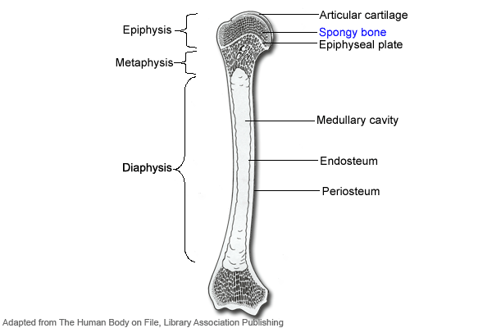
Structure of long bone
The humerus and femur and known as long bones
Characterised by a rounded structure at each end – head – comprised of spongy bone and layered with articular cartilage to prevent friction.
A long shaft between two heads – made up of compact bone – covered with endosteum on the inside and periosteum on the outside
In the centre of the shaft, a hollow cavity exists – the marrow cavity – bone marrow.
Marrow cavity

Slide 48
Relation between structure and function – bone tissue
Bone tissue consists of microscopic openings on the surface to allow for blood vessels (living tissue)
Adapted in the following ways:
Laid down in a lattice-like structure
Shaft consists of compact bone (strength) with hollow cavity in the centre (reduced weight)
Articular cartilage on heads to cushion against friction
Select bones consist of stem cells – produce red blood corpuscles – haemopoiesis

Slide 49
Relation between structure and function – cartilage
Three types of cartilage:
Hyaline cartilage
White fibro-cartilage
Yellow elastic cartilage
All have similar structure – matrix made up of the protein chondrin. Cartilage cells – chondrocytes are found within fluid filled spaces – lacunae - scattered within matrix.
Functions of cartilage:
Reduces friction
Larynx, c-shaped rings in trachea, ear, and epiglottis consist of cartilage
Shock absorbers between vertebrae
Adaptations:
Soft and strong to allow for shock absorbance and cushioning
Flexible to allow stretching in trachea

Slide 50
Relation between structure and function – tendons and ligaments
Tendons connect muscles to bone
Made up of white fibrous tissue
Non-elastic to allow for the contraction of muscles to have an effect on the bone
Ligaments join bone to bone at joints
Made up of yellow elastic fibres
Ligaments allow for stretching of bones in different directions

Slide 51
Homework ☺
Activity 2.2.10
Page 182

Slide 52
Joints
Places at which two bones meet.
At joints:
Ligaments join bone to bone
Tendons join bone to muscle
Three types of joints:
Fixed/immovable – sutures on cranium
Slightly movable – axis at base of skull
- gliding joints of the ankle/wrist
Freely movable/synovial joints – ball and socket joint of shoulder and hip
- hinge joint of the elbow &knee

Slide 53
Typical synovial joint

Slide 54
Role of bones, joints, etc
Bones in the skeleton are not continuous – joints exist – articulation
Ligaments – bone to bone – can stretch
Tendons - muscle to bone – cannot stretch
Skeletal muscles are arranged in pars – oppose each other – antagonistic
Antagonism allows for movement and return of bones.

Slide 55
Muscles
Three types of muscles:
Striated (striped) – voluntary
Smooth (unstriped) – involuntary
Cardiac – only in heart (striated, involuntary, branched)

Slide 56
Structure of voluntary skeletal muscles
Striated/skeletal muscles are responsible for all voluntary movements.
Each muscle enclosed by a connective tissue covering – epimysium – inside, bundles of muscle fibres occur covered by a perimysium

Slide 57
Each muscle fibre:
Enclosed by membrane – sarcolemma
Within the membrane – sarcoplasm – contain a number of oval nuclei.
Contain alternate light and dark bands – stripped appearance.
Made up of myofibrils:
Thick myosin filaments
Thin actin filaments
When the muscle is contracted the myosin and actin slide between each other to shorten the muscle.

Slide 58
Myosin and actin filaments

Slide 59
Diseases of the skeletal system
Self study
192 – 193
☺ Homework ☺
Activity 2.2.13
Page 192

