Slide 1
Support and transport systems in plants

Slide 2
The need for support and transport
Water is needed in plants for the process of photosynthesis.
Once photosynthesis occurs, the starch produced needs to be transported to the rest of the plant for growth and development.
Land plants tend to grow extremely tall due to competition for sunlight.
Tall plants need to be supported in order to stand up to great heights and to prevent them from collapsing.
The main supporting tissues in plants are xylem, sclerenchyma and collenchyma.

Slide 3
The need for support and transport
The taller that the plants grow, the greater distance over which water, mineral salts and food need to be transported.
The main tissues responsible for transport of water, mineral salts and food?

Slide 4
Anatomy of dicot plants
The leaf was studied in the previous section. Roots and stems will be studied now and flowers will be studied in grade 11
ROOTS
Two types of roots exist:
Tap root system
Adventitious root systems
Main differences outlined on page 132

Slide 5
Roots
Roots have two main functions:
They anchor the plant to the ground
They absorb water from the surrounding land for the plant.
External structure of the root tip
When looking at a root, we see 5 main sections:
The root cap
Growing point
Region of elongation
Region of root hairs
Mature region

Slide 6
External structure of roots
Root cap – made of paranchyma cells. Some get damaged when pushing through soil due to growth. The root cap protects inner layer of the root.
Growing point - made up of meristematic cells. Some differentiate to replace paranchyma cells of the root cap which were damaged. Other differentiated tissue is pushed into the region of elongation as more cells are produced.
Region of elongation – cells coming from growing point now begin to elongate.

Slide 7
External structure of roots
Root hair region – characterized by the presence of root hairs. These increase surface area for water and mineral salt absorption. Internally, cells begin to differentiate and mature into tissues such as:
Epidermis
Paranchyma
Sclerenchyma
Xylem
Phloem
Due to differentiating nature of this region, it is also referred to as the region of differentiation.
Mature region – identified by the presence of side roots and various types of permanent tissues

Slide 8
External structure of roots

Slide 9
Homework ☺
Draw table 1.1.1
Page 132
Draw figure 2.1.2 (the root tip)
Page 133

Slide 10
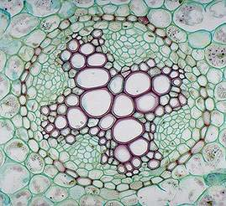
Internal structure of roots
Looking at a cross section of the root, we can distinguish three main sections:
The epidermis
Single layer of cells
Root hairs
The cortex
Thin walled paranchyma cells
Endodermis
Some of the endodermal cells
are thickened by the casparian
strip
Passage cells occur between these
thickened cells
The stele/ vascular cylinder
Xylem; phloem
Cambium ; pericycle
Cambium occurs between the x and p
Pericycle surrounds entire stele

Slide 11
Internal structure of roots

Slide 13
Functions of the various root tissues
Root hairs increase surface area for absorbance of water and minerals and also anchor the plant to the ground.
The parenchyma of the cortex contains intercellular spaces – starch storage and water passage
Passage cells in endodermis direct water to xylem
Pericycle give rise to side roots
Xylem and phloem transports water and manufactured food.
Cambium gives rise to additional xylem and phloem as the root grows in thickness.
Distinguishing factors between root and stem – pg 135

Slide 14
Homework ☺
Activity 2.1.1
Page 135
Drawing of figure 2.1.4 to be done on the separate page that will be given to you.
Add also, the vascular tissues from the leaf*

Slide 16
The stem
Most stems are the portions of the plant that are above ground.
The functions of the stem include:
The hold leaves in position for photosynthesis
The hold flowers in position for pollination.
Some are able to photosynthesise
Storage of food and water
Transport of water and food to and from the leaves.

Slide 17
External structure of the stem
The stem is usually above ground, erect and cylindrical.
Leaves and buds arise from the stem. A node is a portion on the stem from which leaves arise. the portion of stem between two nodes is an internode.
Two types of buds exist:
Apical bud – top of stem
Auxiliary bud – in the axil formed between a leaf and stem.

Slide 19
Internal structure of a stem
Examining the internal structure of a leaf, we find four regions:
The epidermis
The cortex
Vascular bundles
The pith

Slide 23
Functions of the various tissues
Cuticle – reduces transpirations and allows light to pass through
Epidermis – protection of inner cells & guard cells for gaseous exchange
Hypodermis of sclerenchyma and paranchyma – provides strength
Paranchyma – stores food, water and air in intercellular spaces
Endodermal cells store starch
Sclerenchymal fibres – provides strength
Xylem and phloem – transports water, mineral salts and food

Slide 25
Homework ☺
Activity 2.1.4
Page 140

Slide 26
Tissues responsible for transport and support
Page 140 – 146
Homework ☺
Activity 2.1.6
Page 145 ONLY no 1

Slide 27
Secondary growth (secondary thickening)
Increase in length of the stem is known as primary growth.
Secondary growth/ secondary thickening is the thickening of the circumference of the plant.
Happens in three stages:
Formation of secondary xylem and secondary phloem
Formation of cork
Formation of lenticels

Slide 29
Formation of secondary xylem and phloem
Paranchyma cells between the vascular bundles, in line with vascular cambium, become meristematic.
This forms a complete ring of cambium
The entire ring of cambium (old and new) now begins to produce secondary xylem towards the inside of the ring, and secondary phloem toward the outside of the ring.
Each year, new secondary xylem and phloem are formed.
Due to the formation of new xylem and phloem rings forming each year, we can tell the age of trees by counting the number of annual rings.
The xylem making up the older rings eventually become clogged and are no longer able to transport water. They become known as heartwood

Slide 33
Reading annual rings
Scientists who study annual rings are known as dendrochonologists.
They interpret the rings to give large amounts of information based on the thickness, colour, and other visibilities, micro and macroscopic.
They are able to tell about the environmental conditions:
Floods
Droughts
Lightening strikes
Earthquakes
Insect infestations
Climate change
based on the visible information apparent in the rings.

Slide 34
Formation of cork
Certain paranchyma cells in the cortex become meristematic and from cork cambium.
The cork cambium divides to form cork cells on the outside.
Cork cells have suberin laid down on the cell walls. They become suberised.

Slide 35
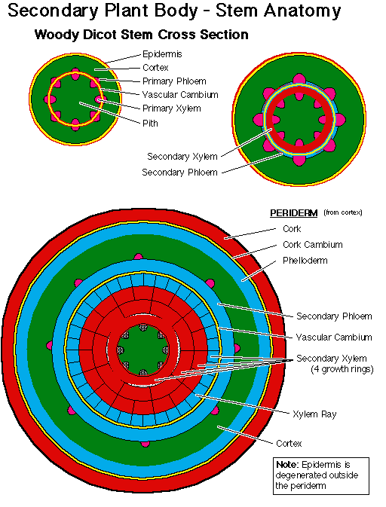

Slide 36
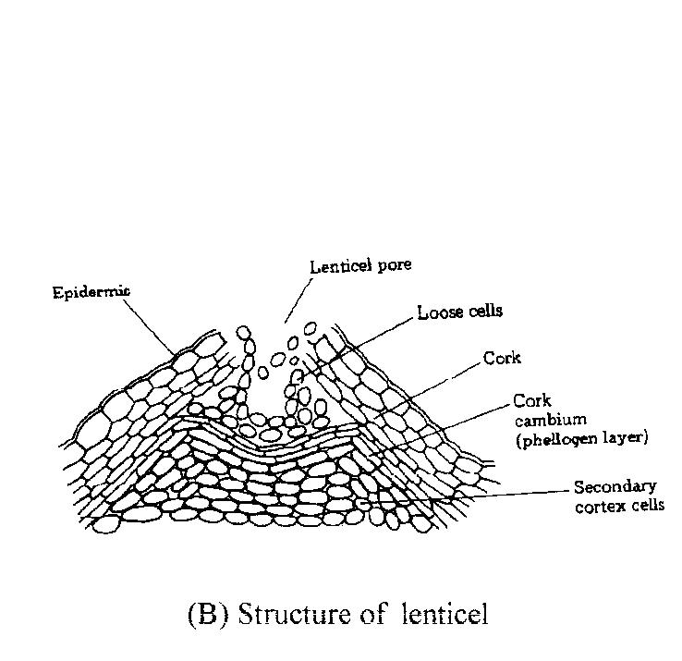
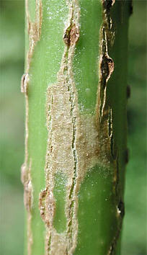
Formation of lenticles
Young herbaceous stems have stomata on the epidermis which allow for gaseous exchange.
Stems which undergo secondary thickening have blocked stomata due to the formation of cork cells.
The epidermis of woody stems breaks to form pores called lenticels which allow for gaseous exchange.

Slide 37
Homework ☺
Draw figures:
2.1.15 – page 146
2.1.17 – page 148
Complete notes on secondary thickening & formation of cork and lenticels
Self study
Tissues responsible for transport and support
Page 140 – 146
Homework
Activity 2.1.6
Page 145

Slide 38
Transpiration
Water is transported to leaves for photosynthesis.
When the stomata in the leaves open for gaseous exchange, a lot of water escapes in the formation of water vapour.
This is known as transpiration.
This creates the problem of water loss.
If more water is lost through transpiration than is absorbed by the roots, the plant begins to wilt.
It has many important benefits;
it creates transpirational pull which draws water up-wards
The evaporation of water cools the plant. (sweating)

Slide 39
Internal and external structure differ between plant species. They may differ in many aspects
Page 150
All the variations affect the rate at which water is lost through transpiration.
The shapes and size affect the portion exposed to sun.
Leaves may be situated close to each other and shade one another.
Some leaves have hairs on them to reflect light and wind flow on the leaves.
The presence of a cuticle.
The number of stomata may be reduced or sunken.

Slide 40
Effect on environmental factors on transpiration rate
Transpiration can be affected by the leaf structure (as seen previously) –these are known as internal factors.
It can also be affected by external factors:
Wind – blows away humid air – creates concentration gradient.
Temperature – high temp increases the kinetic energy of water molecules.
Humidity – decreases the concentration gradient
Light intensity - high light intensity causes stomata to open therefore increasing water loss.

Slide 41
Wilting
The factors mentioned previously might sometimes lead to an extreme loss of water and thus the rate of water loss exceeds the rate at which water is absorbed.
Less water could be absorbed due to:
Insufficient water supply.
Little coverage/surface area of roots to absorb sufficient water.
The vacoules within the cells shrink in size and volume of cytoplasm may decrease.
The cells lose turgidity or turgor pressure and plants begin to droop over and become limp. We say they are wilting.

Slide 42
Guttation
When the air is very humid, transpiration slows down or totally stops.
Due to water concentration in the air being equal to or greater than the concentration within the leaf. ie. No concentration gradient or it is reversed.
Due to this, if there is a surplus of water being absorbed – the plant is getting much more water than required.
The plant needs to get rid of the excess water through guttation.
This is the release of water droplets (not water vapour) from tiny pores called hydathodes found on the margins of leaves.

Slide 43
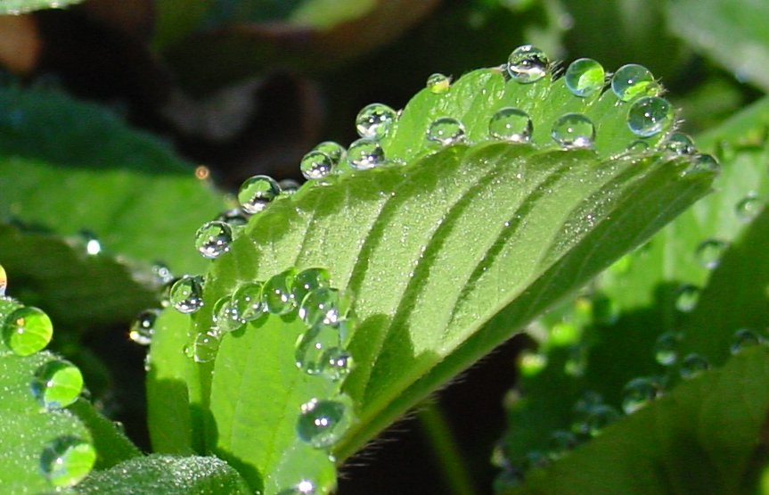
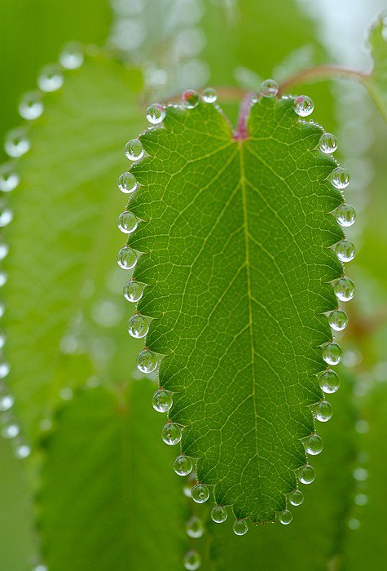

Slide 44
Absorption and transport of water and mineral salts
Water enters the roots of plants through osmosis – remember osmosis?
The three regions in consideration are:
The soil (contains lots of water and some solutes)
The cell membrane and tonoplast (semi-permeable membrane)
The inside of the root (little water with high solutes)
Therefore, water flows from the soil through the semi-permeable membrane, into the plant. Until an equilibrium is reached.
But an equilibrium is never reached due to the continual usage of water by the plant.
Water is absorbed by osmosis, which doesn’t require energy, but the solutes (minerals) need energy to be transported. (against concentration gradient.)

Slide 45
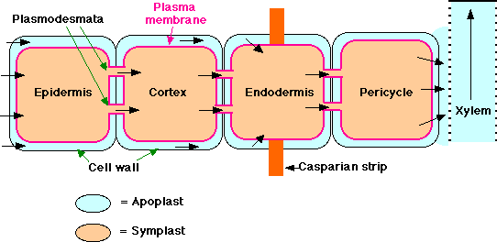
Lateral transport of water
Water can move from the root hair to the xylem tissue in 1 of 3 ways:
Along the cell walls – majority of water (casparian strip)
From cell to cell through cytoplasm – plasmodesmata
From cell to cell through vacuoles – minority of water

Slide 47
Upward movement of water and mineral salts from root to leaves through the stem
Three forces exist which contribute to the upward flow of water from the root to the leaves through the stem:
Root pressure – the continual entry of water from the roots – water only travels a short distance – active process
Capillarity – natural tendency of liquids to move up tubes with small openings – water only travels a short distance – adhesion
Transpirational pull:
during transpiration, water evaporates and leaves a pocket of dry air in the sub-stomatal chamber
The dry air absorbs water from mesophyll tissue which in-turn draws water from the xylem tissue
Due to the xylem forming a continous tube, water is pulled upwards due to the strong cohesive forces between water molecules.

Slide 48
Translocation
The movement of manufactured food from the leaves to the rest of the plant.
Not clearly understood by botanical scientists
Theories:
Food is transported through the sieve tubes of phloem tissues.
Food transported in the form of cytoplasmic strands
Cytoplasmic strands pass through the sieve plates from one tube to the next

Slide 49
Homework ☺
Activity 2.1.10
Page 157

Slide 50
End of support and transport system in plants ☺

